Slide 1
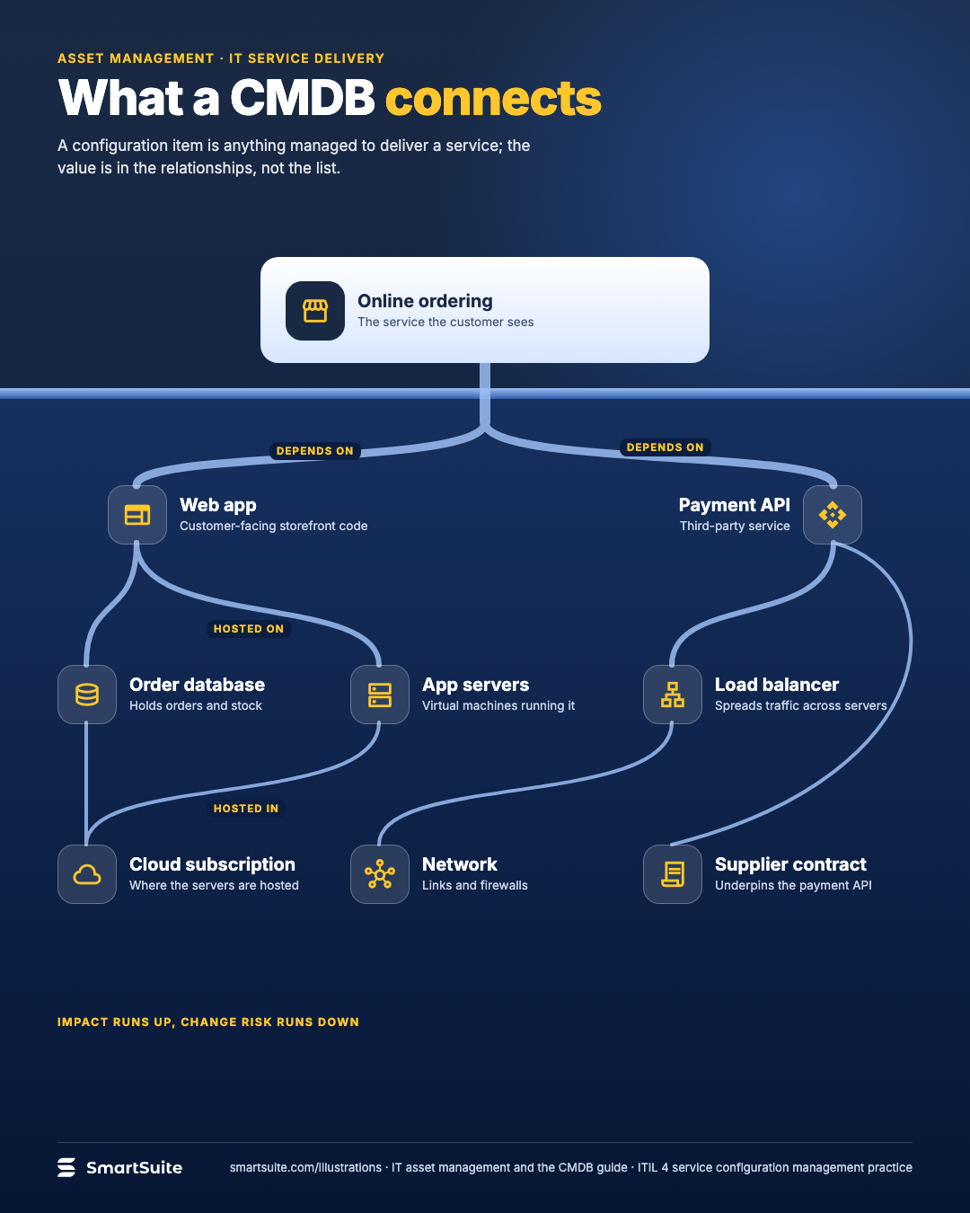
What a CMDB connects
What a CMDB connects: a service at the top and the configuration items and suppliers it depends on below.
Source: ITIL 4 service configuration management practice (CI definition, relationships); example service illustrative
Notes:
What a CMDB connects
What a CMDB connects: a service at the top and the configuration items and suppliers it depends on below.
Source: ITIL 4 service configuration management practice (CI definition, relationships); example service illustrative · From: IT asset management and the CMDB
Credit: Source: SmartSuite, smartsuite.com/illustrations

Slide 2
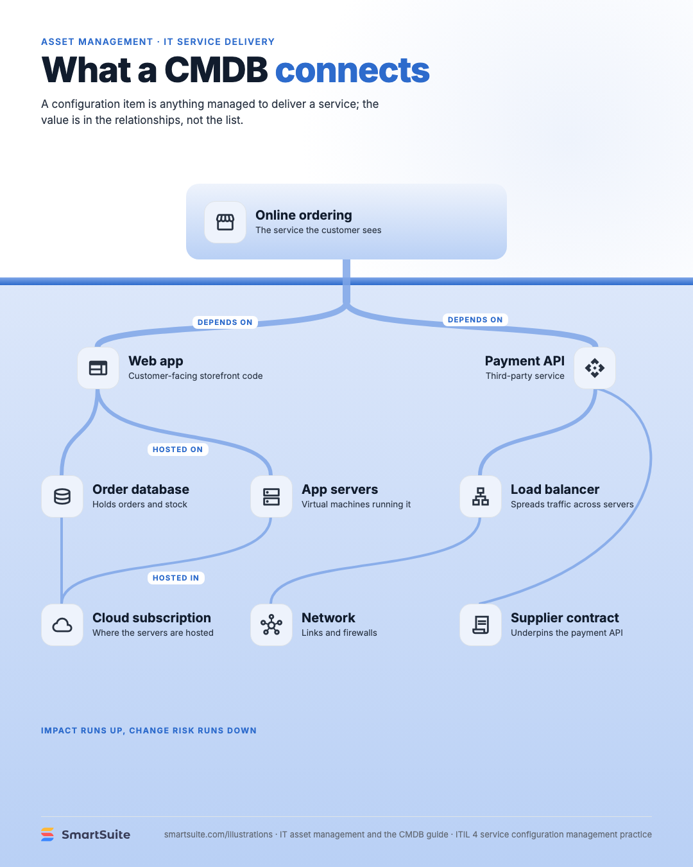
What a CMDB connects
What a CMDB connects: a service at the top and the configuration items and suppliers it depends on below.
Source: ITIL 4 service configuration management practice (CI definition, relationships); example service illustrative
Notes:
What a CMDB connects
What a CMDB connects: a service at the top and the configuration items and suppliers it depends on below.
Source: ITIL 4 service configuration management practice (CI definition, relationships); example service illustrative · From: IT asset management and the CMDB
Credit: Source: SmartSuite, smartsuite.com/illustrations

