Slide 1
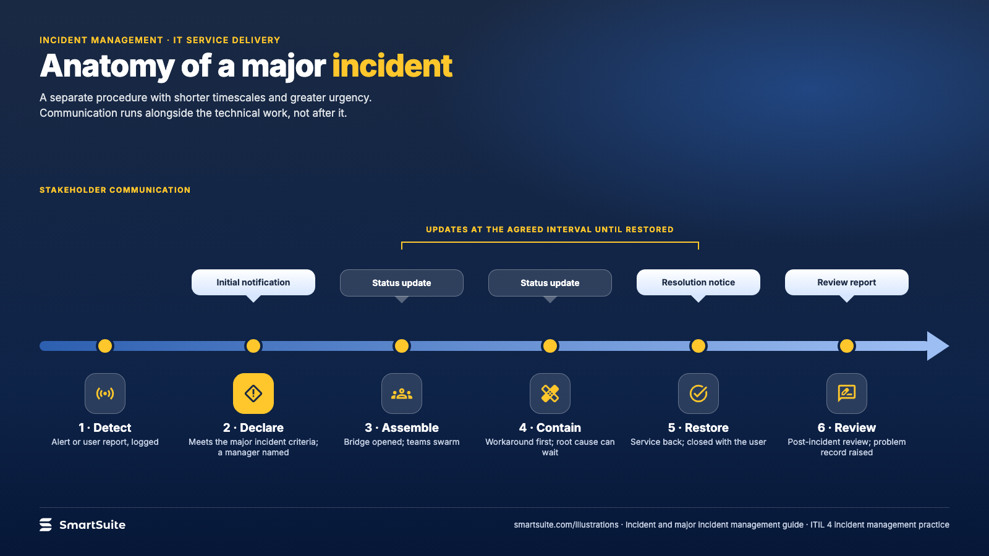
Notes:
Anatomy of a major incident
The anatomy of a major incident from detection to the post-incident review, with the communication cadence above it.
Source: ITIL 4 incident management practice (major incident procedure, swarming, stakeholder updates) · From: Incident and major incident management
Credit: Source: SmartSuite, smartsuite.com/illustrations

Slide 2
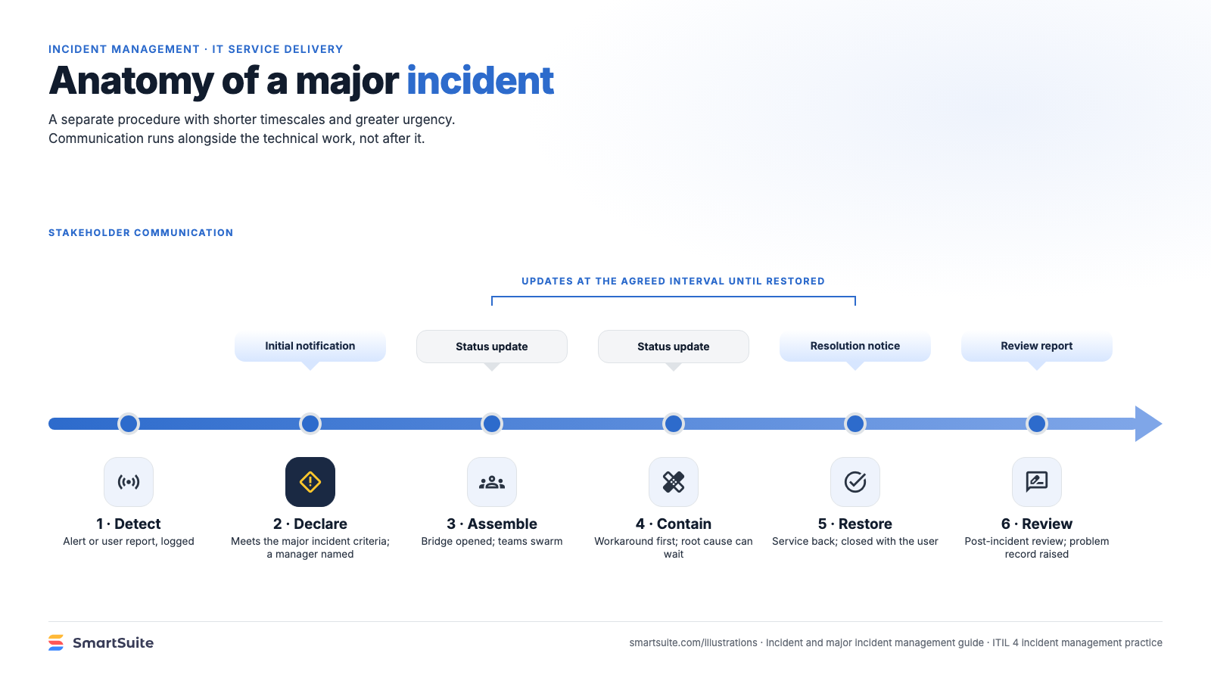
Notes:
Anatomy of a major incident
The anatomy of a major incident from detection to the post-incident review, with the communication cadence above it.
Source: ITIL 4 incident management practice (major incident procedure, swarming, stakeholder updates) · From: Incident and major incident management
Credit: Source: SmartSuite, smartsuite.com/illustrations

