Slide 1
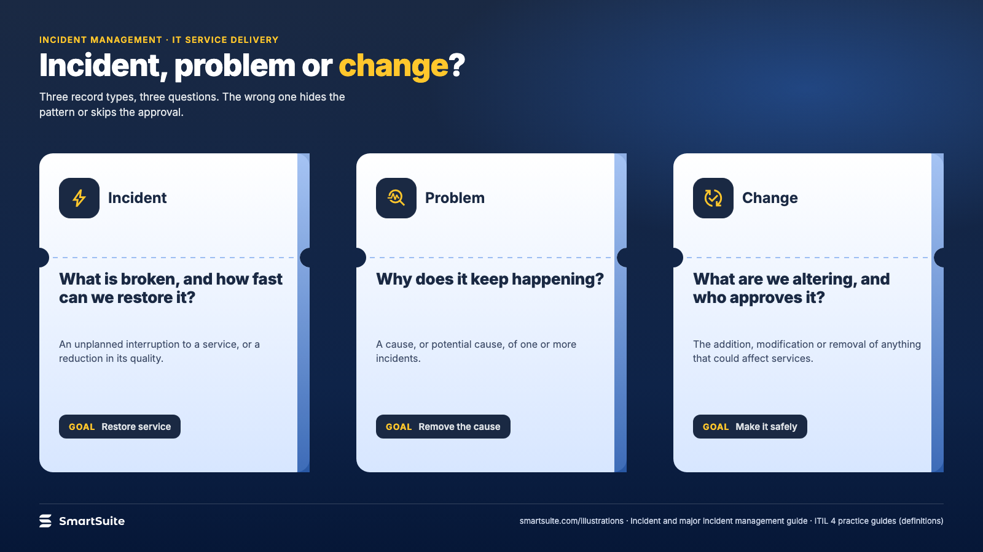
Notes:
Incident, problem or change?
Incident, problem and change as three tickets, each answering a different question.
Source: ITIL 4 practice guides: incident, problem and change definitions · From: Incident and major incident management
Credit: Source: SmartSuite, smartsuite.com/illustrations

Slide 2
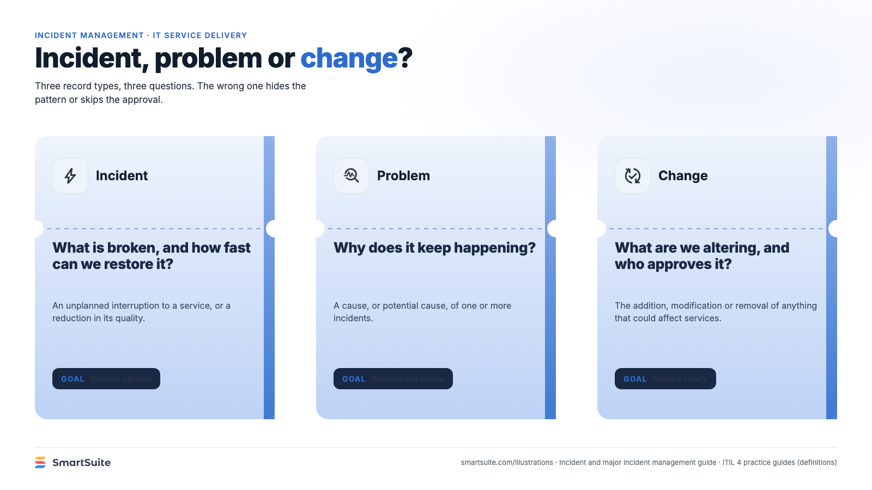
Notes:
Incident, problem or change?
Incident, problem and change as three tickets, each answering a different question.
Source: ITIL 4 practice guides: incident, problem and change definitions · From: Incident and major incident management
Credit: Source: SmartSuite, smartsuite.com/illustrations

