Slide 1
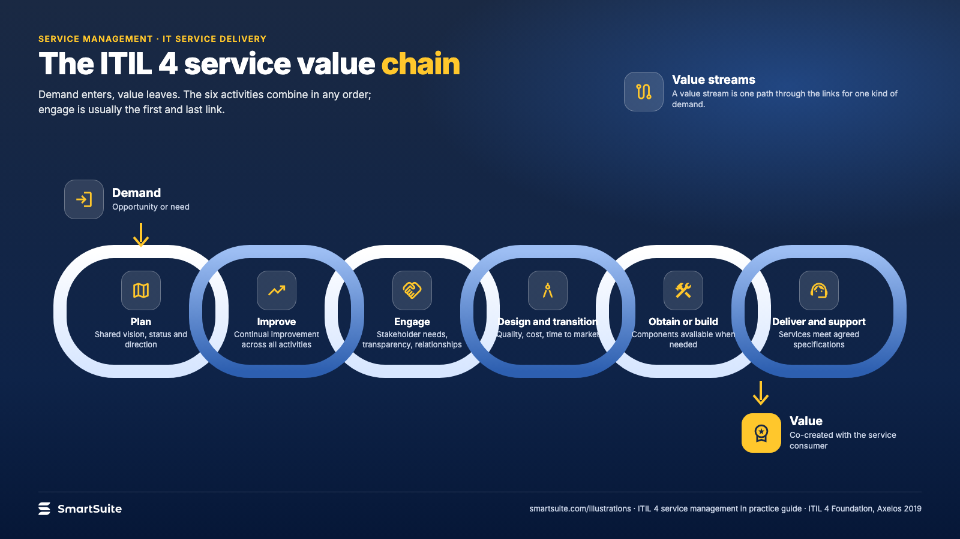
Notes:
The ITIL 4 service value chain
The six activities of the ITIL 4 service value chain, from demand to value.
Source: ITIL 4 Foundation, Axelos 2019 (activity purposes paraphrased) · From: ITIL 4 service management in practice
Credit: Source: SmartSuite, smartsuite.com/illustrations

Slide 2
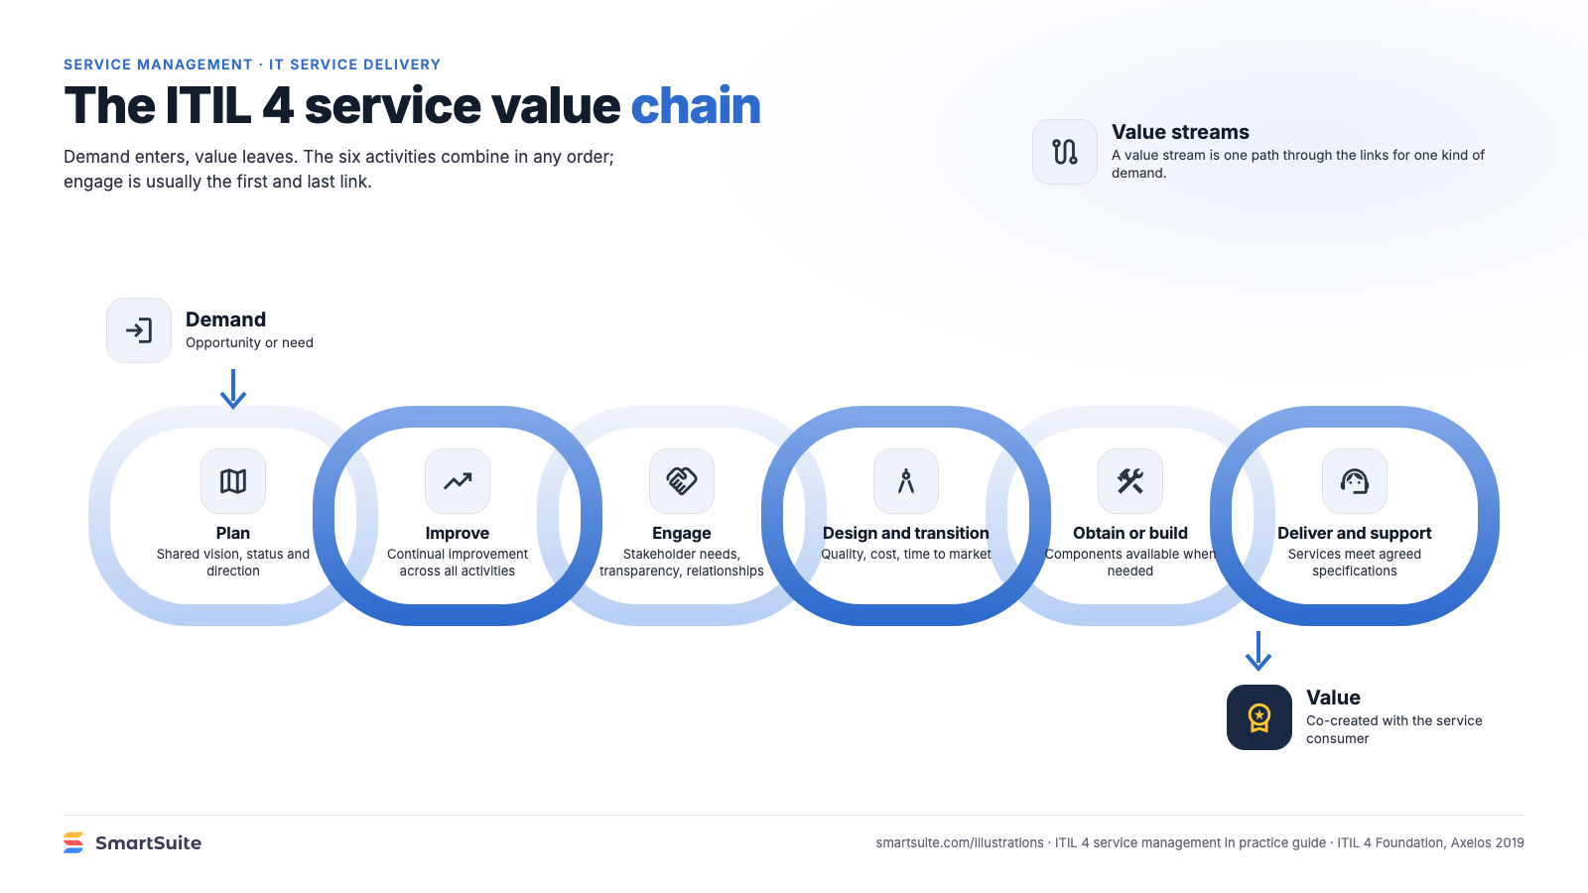
Notes:
The ITIL 4 service value chain
The six activities of the ITIL 4 service value chain, from demand to value.
Source: ITIL 4 Foundation, Axelos 2019 (activity purposes paraphrased) · From: ITIL 4 service management in practice
Credit: Source: SmartSuite, smartsuite.com/illustrations

