Slide 1
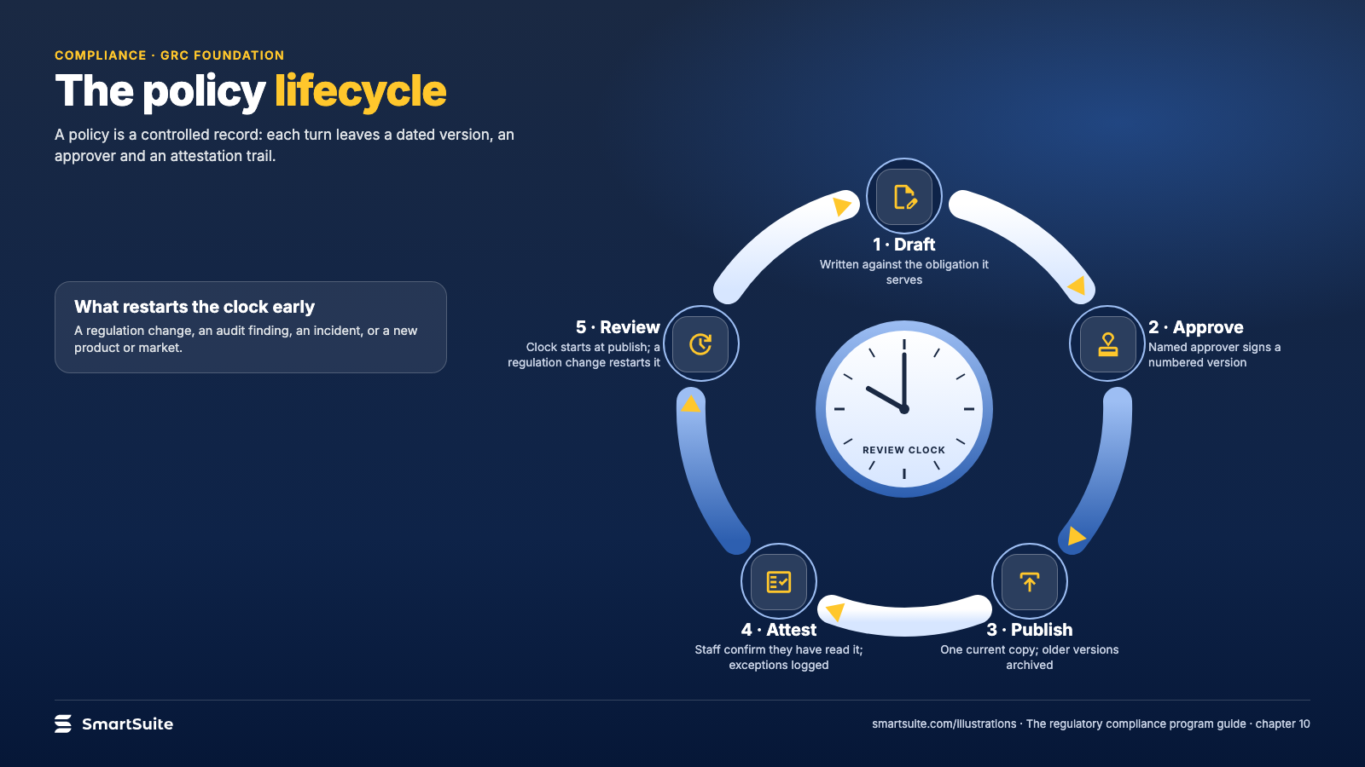
Notes:
The policy lifecycle
The policy lifecycle: draft, approve, publish, attest and review, and what restarts the review clock.
Source: guide chapter 10 · From: The regulatory compliance program
Credit: Source: SmartSuite, smartsuite.com/illustrations

Slide 2
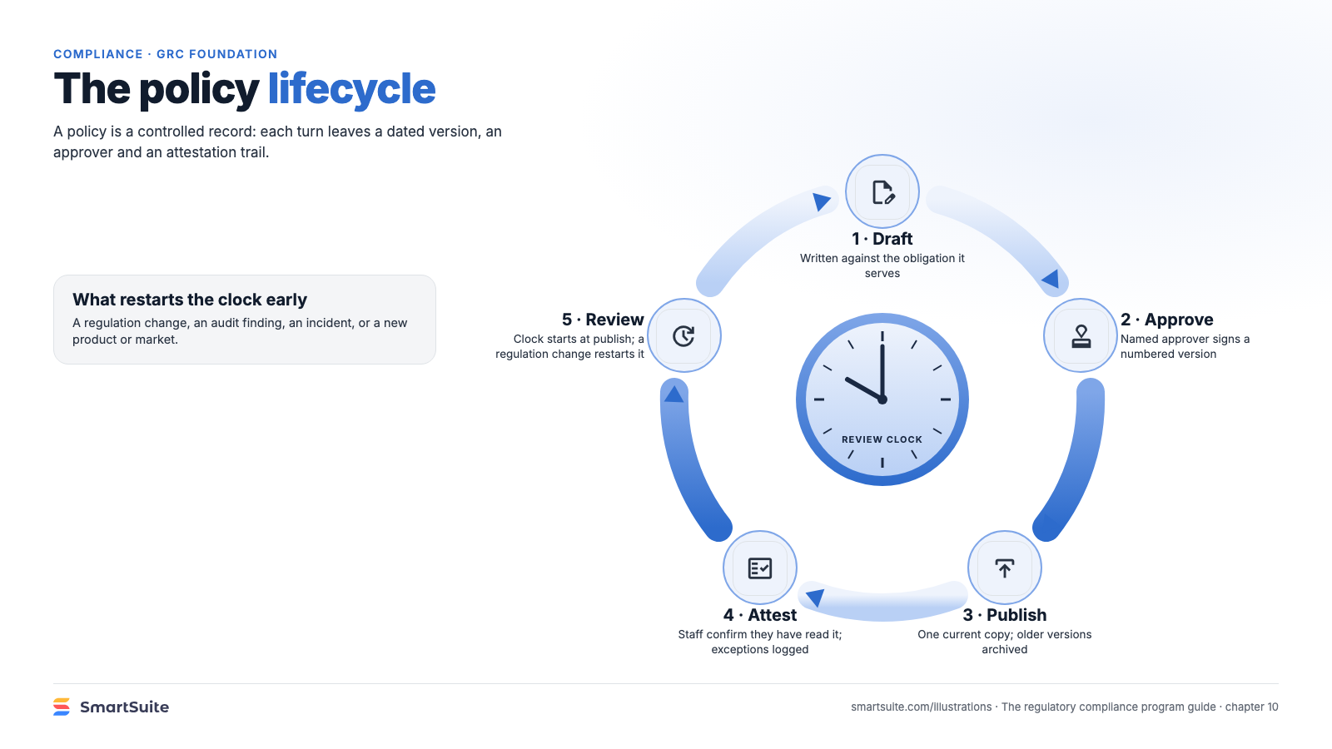
Notes:
The policy lifecycle
The policy lifecycle: draft, approve, publish, attest and review, and what restarts the review clock.
Source: guide chapter 10 · From: The regulatory compliance program
Credit: Source: SmartSuite, smartsuite.com/illustrations

