Slide 1
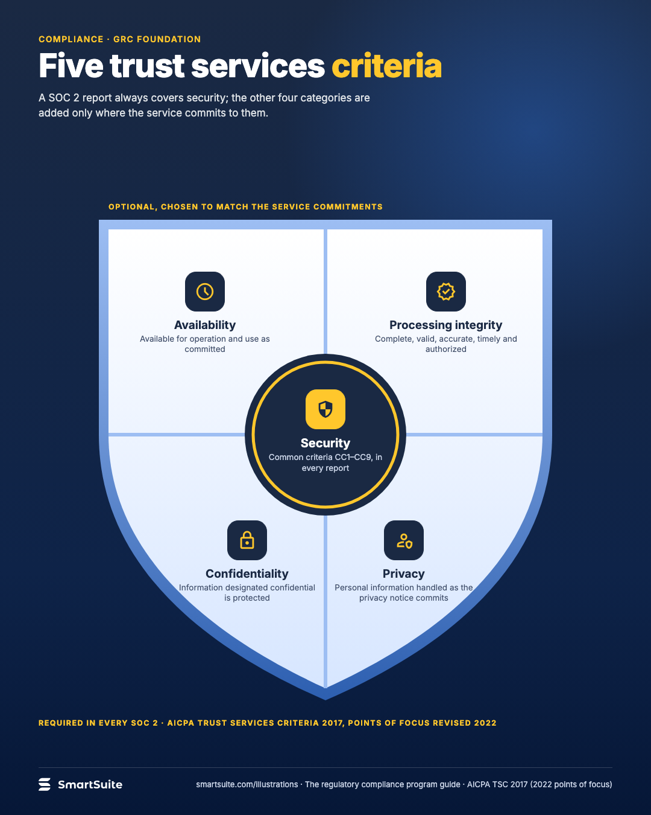
Five trust services criteria
The five AICPA trust services criteria, with security as the mandatory common criteria and four optional categories.
Source: AICPA TSC 2017 with 2022 points of focus; security = common criteria CC1–CC9
Notes:
Five trust services criteria
The five AICPA trust services criteria, with security as the mandatory common criteria and four optional categories.
Source: AICPA TSC 2017 with 2022 points of focus; security = common criteria CC1–CC9 · From: The regulatory compliance program
Credit: Source: SmartSuite, smartsuite.com/illustrations

Slide 2
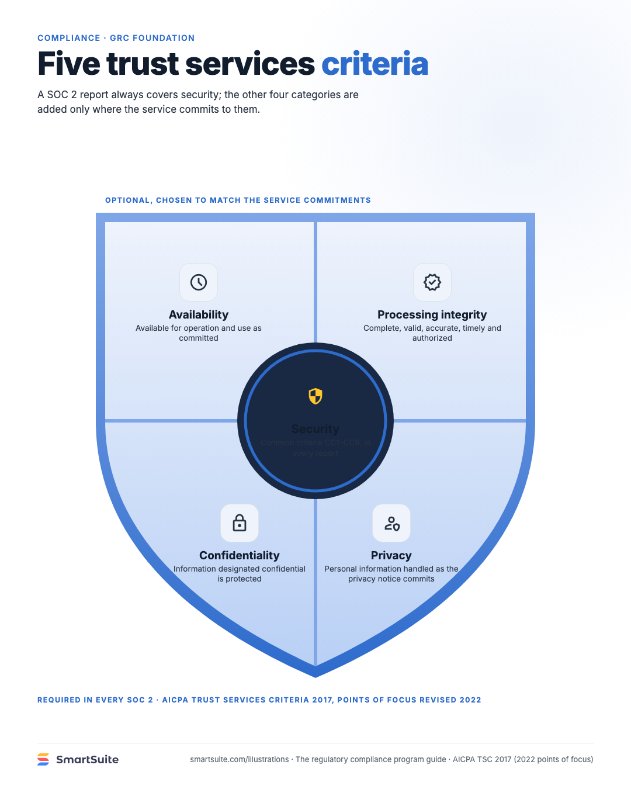
Five trust services criteria
The five AICPA trust services criteria, with security as the mandatory common criteria and four optional categories.
Source: AICPA TSC 2017 with 2022 points of focus; security = common criteria CC1–CC9
Notes:
Five trust services criteria
The five AICPA trust services criteria, with security as the mandatory common criteria and four optional categories.
Source: AICPA TSC 2017 with 2022 points of focus; security = common criteria CC1–CC9 · From: The regulatory compliance program
Credit: Source: SmartSuite, smartsuite.com/illustrations

