Slide 1
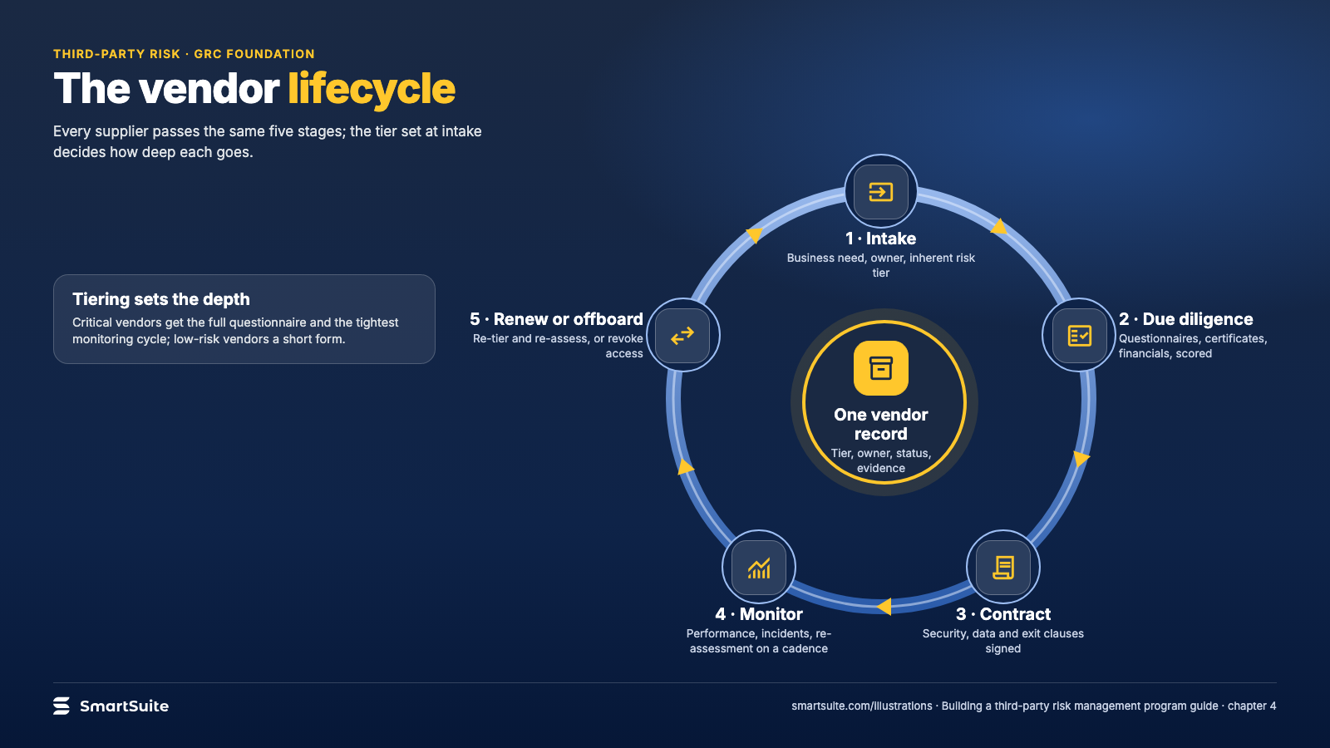
Notes:
The vendor lifecycle
The vendor lifecycle from intake and due diligence to contract, monitoring and offboarding, around one vendor record.
Source: guide chapter 4 · From: Building a third-party risk management program
Credit: Source: SmartSuite, smartsuite.com/illustrations

Slide 2
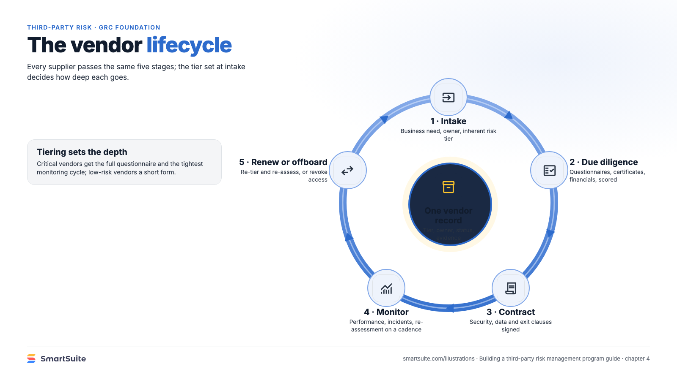
Notes:
The vendor lifecycle
The vendor lifecycle from intake and due diligence to contract, monitoring and offboarding, around one vendor record.
Source: guide chapter 4 · From: Building a third-party risk management program
Credit: Source: SmartSuite, smartsuite.com/illustrations

