Slide 1
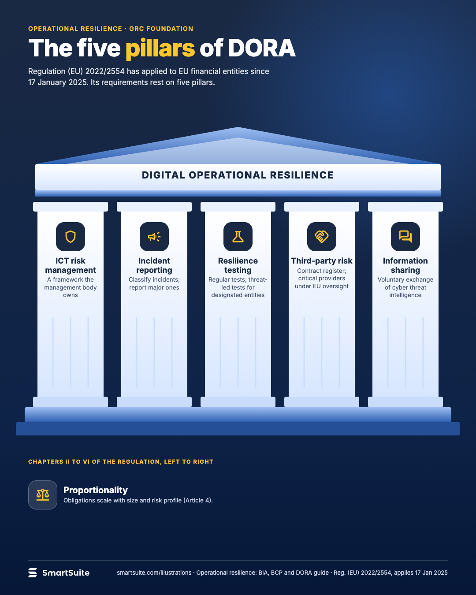
The five pillars of DORA
The five pillars of the EU Digital Operational Resilience Act and what each requires of a financial entity.
Source: Regulation (EU) 2022/2554, applies from 17 Jan 2025
Notes:
The five pillars of DORA
The five pillars of the EU Digital Operational Resilience Act and what each requires of a financial entity.
Source: Regulation (EU) 2022/2554, applies from 17 Jan 2025 · From: Operational resilience: BIA, BCP and DORA
Credit: Source: SmartSuite, smartsuite.com/illustrations

Slide 2
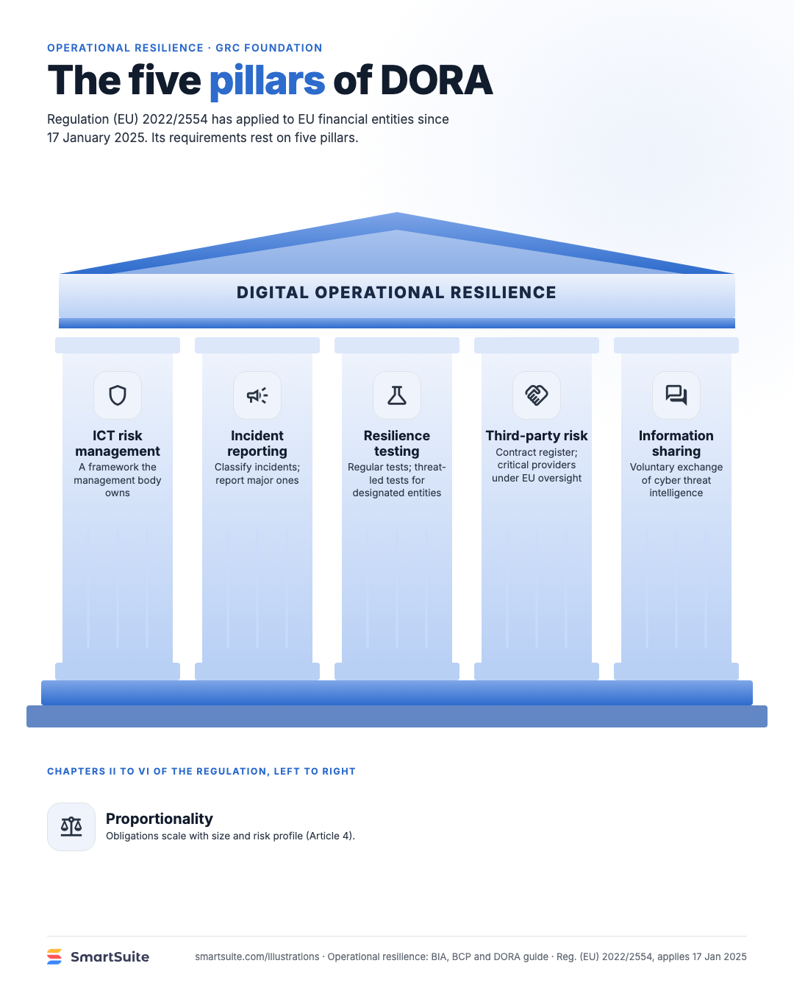
The five pillars of DORA
The five pillars of the EU Digital Operational Resilience Act and what each requires of a financial entity.
Source: Regulation (EU) 2022/2554, applies from 17 Jan 2025
Notes:
The five pillars of DORA
The five pillars of the EU Digital Operational Resilience Act and what each requires of a financial entity.
Source: Regulation (EU) 2022/2554, applies from 17 Jan 2025 · From: Operational resilience: BIA, BCP and DORA
Credit: Source: SmartSuite, smartsuite.com/illustrations

