Slide 1
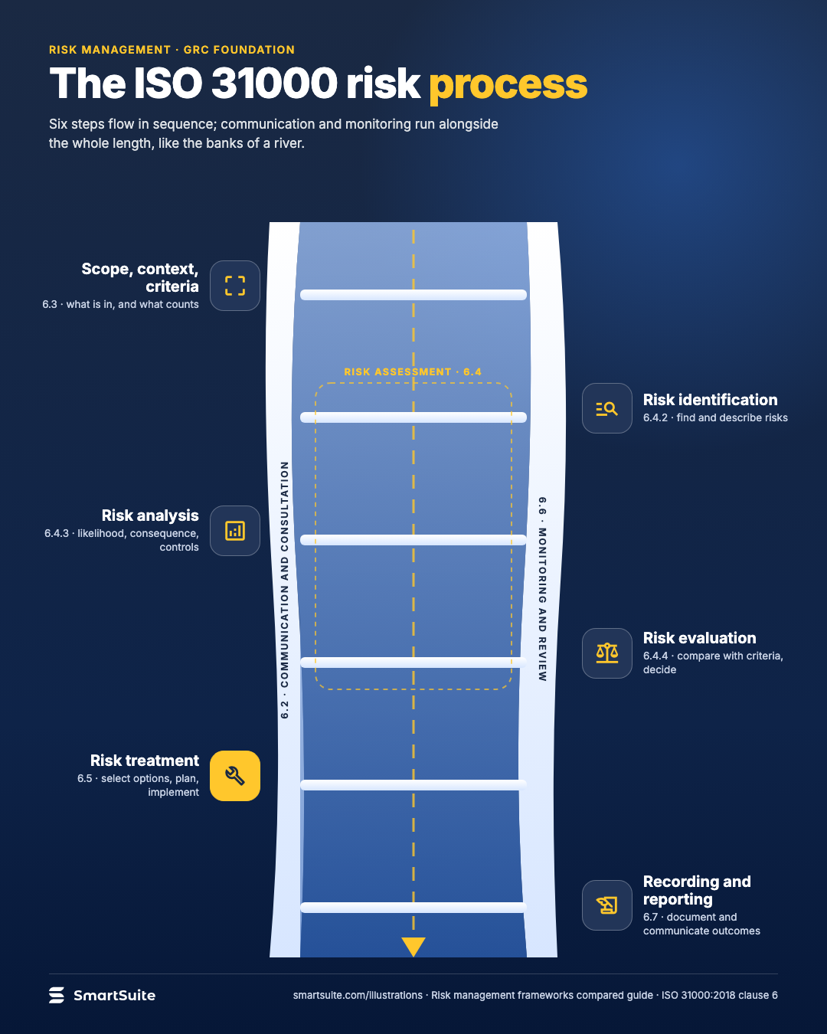
The ISO 31000 risk process
The ISO 31000:2018 risk process, clauses 6.2 to 6.7, with communication and monitoring running alongside.
Source: ISO 31000:2018 clause 6
Notes:
The ISO 31000 risk process
The ISO 31000:2018 risk process, clauses 6.2 to 6.7, with communication and monitoring running alongside.
Source: ISO 31000:2018 clause 6 · From: Risk management frameworks compared
Credit: Source: SmartSuite, smartsuite.com/illustrations

Slide 2
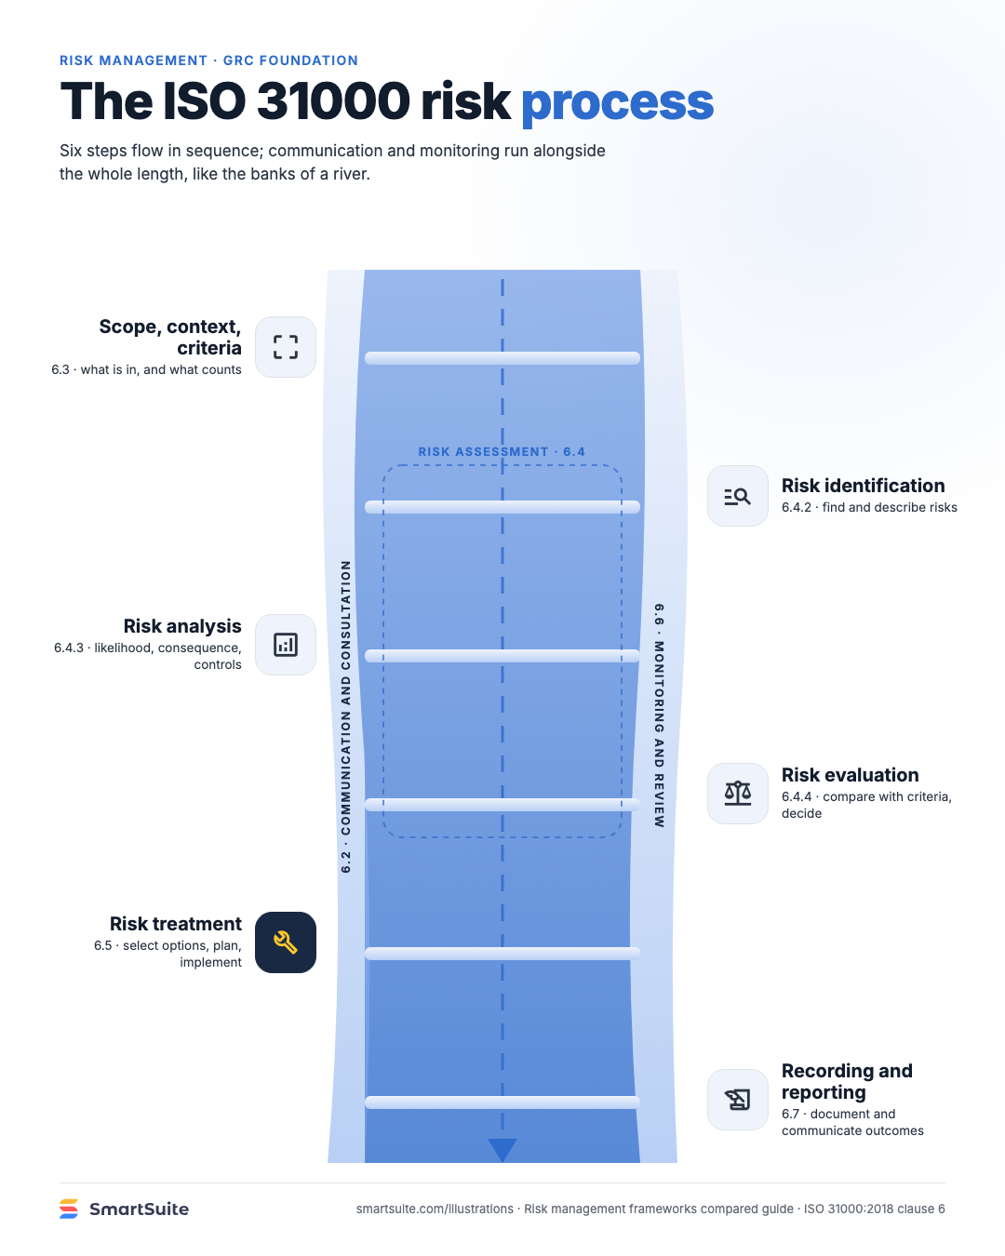
The ISO 31000 risk process
The ISO 31000:2018 risk process, clauses 6.2 to 6.7, with communication and monitoring running alongside.
Source: ISO 31000:2018 clause 6
Notes:
The ISO 31000 risk process
The ISO 31000:2018 risk process, clauses 6.2 to 6.7, with communication and monitoring running alongside.
Source: ISO 31000:2018 clause 6 · From: Risk management frameworks compared
Credit: Source: SmartSuite, smartsuite.com/illustrations

