Slide 1
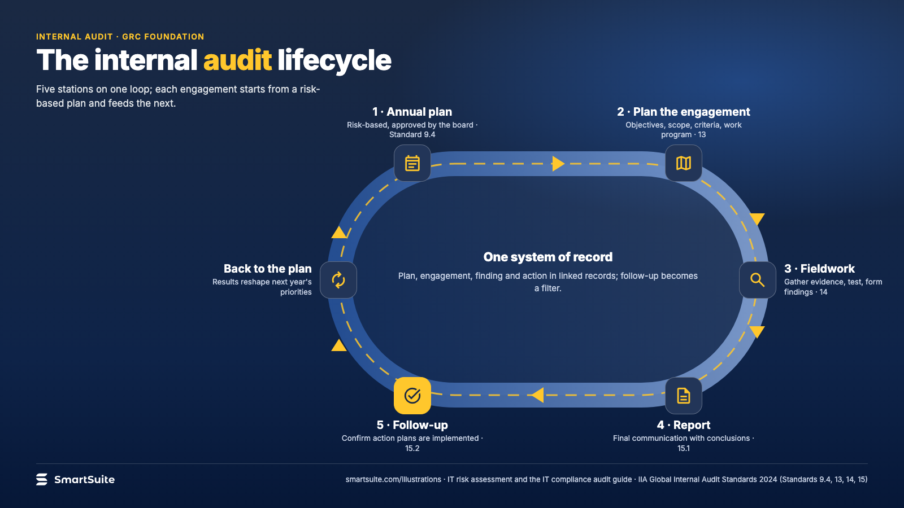
Notes:
The internal audit lifecycle
The internal audit lifecycle from the annual plan through fieldwork, reporting and follow-up, on one system of record.
Source: IIA Global Internal Audit Standards 2024 (Standards 9.4, 13, 14, 15) · From: IT risk assessment and the IT compliance audit
Credit: Source: SmartSuite, smartsuite.com/illustrations

Slide 2
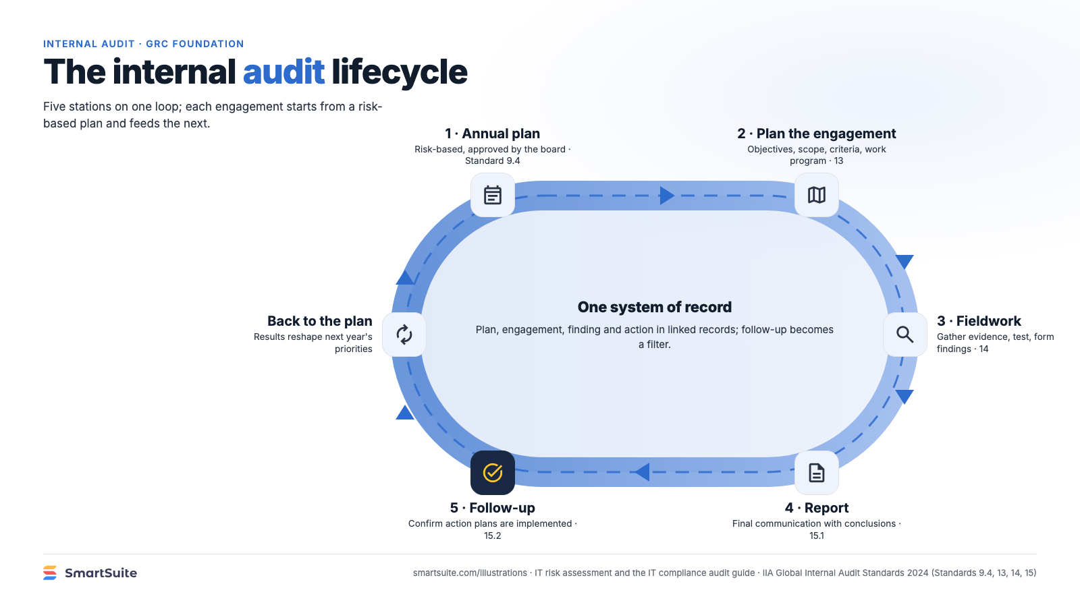
Notes:
The internal audit lifecycle
The internal audit lifecycle from the annual plan through fieldwork, reporting and follow-up, on one system of record.
Source: IIA Global Internal Audit Standards 2024 (Standards 9.4, 13, 14, 15) · From: IT risk assessment and the IT compliance audit
Credit: Source: SmartSuite, smartsuite.com/illustrations

