Slide 1
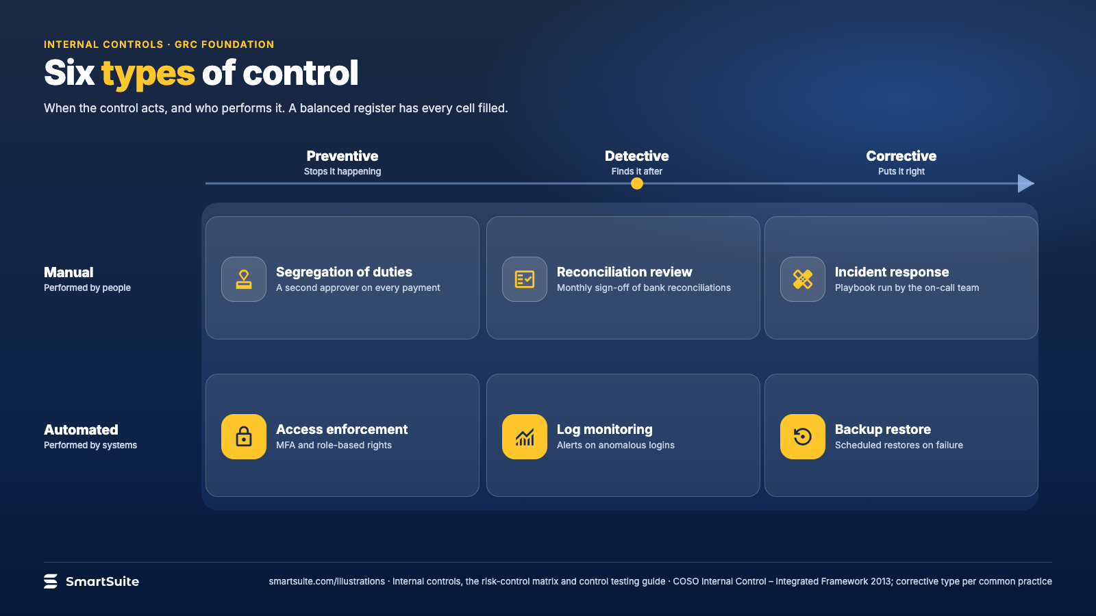
Notes:
Six types of control
Preventive, detective and corrective controls, manual and automated, with one example in every cell.
Source: COSO Internal Control – Integrated Framework 2013; corrective type per common practice · From: Internal controls, the risk-control matrix and control testing
Credit: Source: SmartSuite, smartsuite.com/illustrations

Slide 2
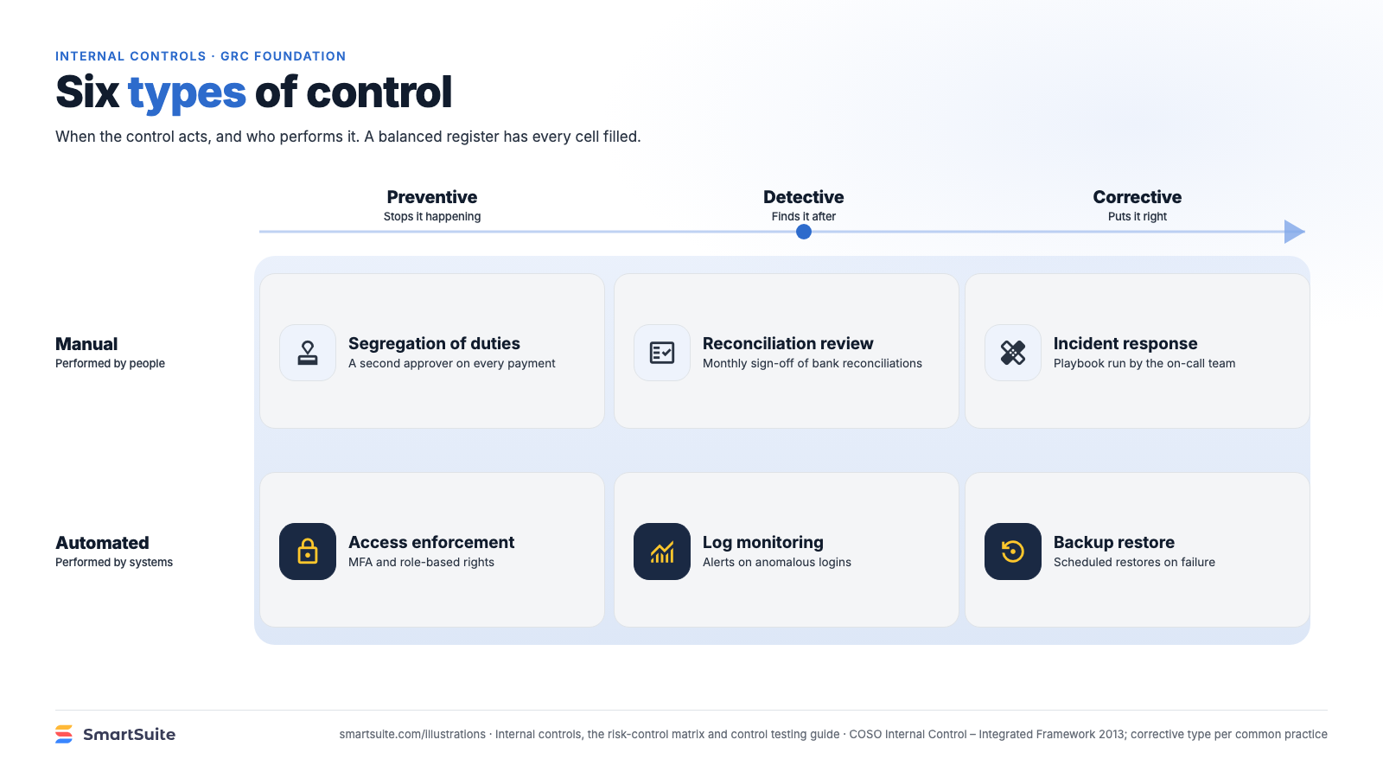
Notes:
Six types of control
Preventive, detective and corrective controls, manual and automated, with one example in every cell.
Source: COSO Internal Control – Integrated Framework 2013; corrective type per common practice · From: Internal controls, the risk-control matrix and control testing
Credit: Source: SmartSuite, smartsuite.com/illustrations

