Slide 1
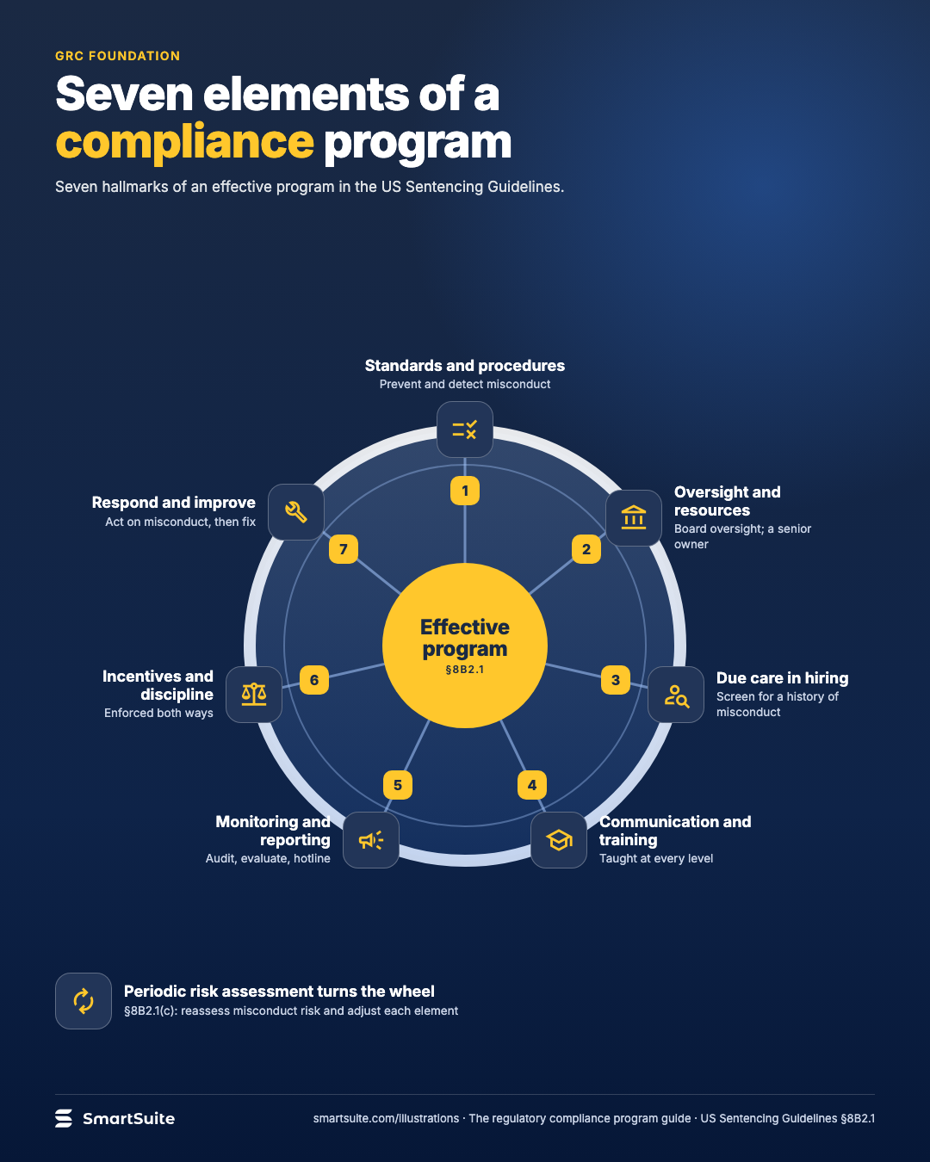
Seven elements of a compliance program
The seven elements of an effective compliance program from the US Sentencing Guidelines, drawn as one wheel.
Source: US Sentencing Guidelines §8B2.1
Notes:
Seven elements of a compliance program
The seven elements of an effective compliance program from the US Sentencing Guidelines, drawn as one wheel.
Source: US Sentencing Guidelines §8B2.1 · From: The regulatory compliance program
Credit: Source: SmartSuite, smartsuite.com/illustrations

Slide 2
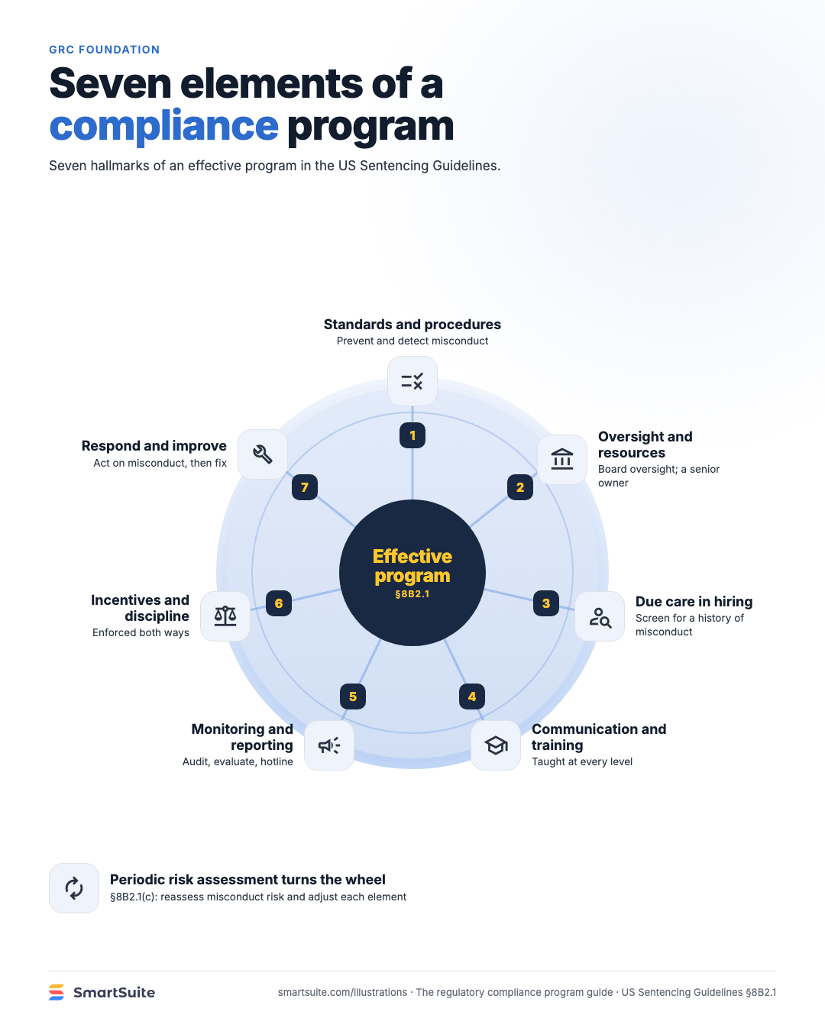
Seven elements of a compliance program
The seven elements of an effective compliance program from the US Sentencing Guidelines, drawn as one wheel.
Source: US Sentencing Guidelines §8B2.1
Notes:
Seven elements of a compliance program
The seven elements of an effective compliance program from the US Sentencing Guidelines, drawn as one wheel.
Source: US Sentencing Guidelines §8B2.1 · From: The regulatory compliance program
Credit: Source: SmartSuite, smartsuite.com/illustrations

