Slide 1
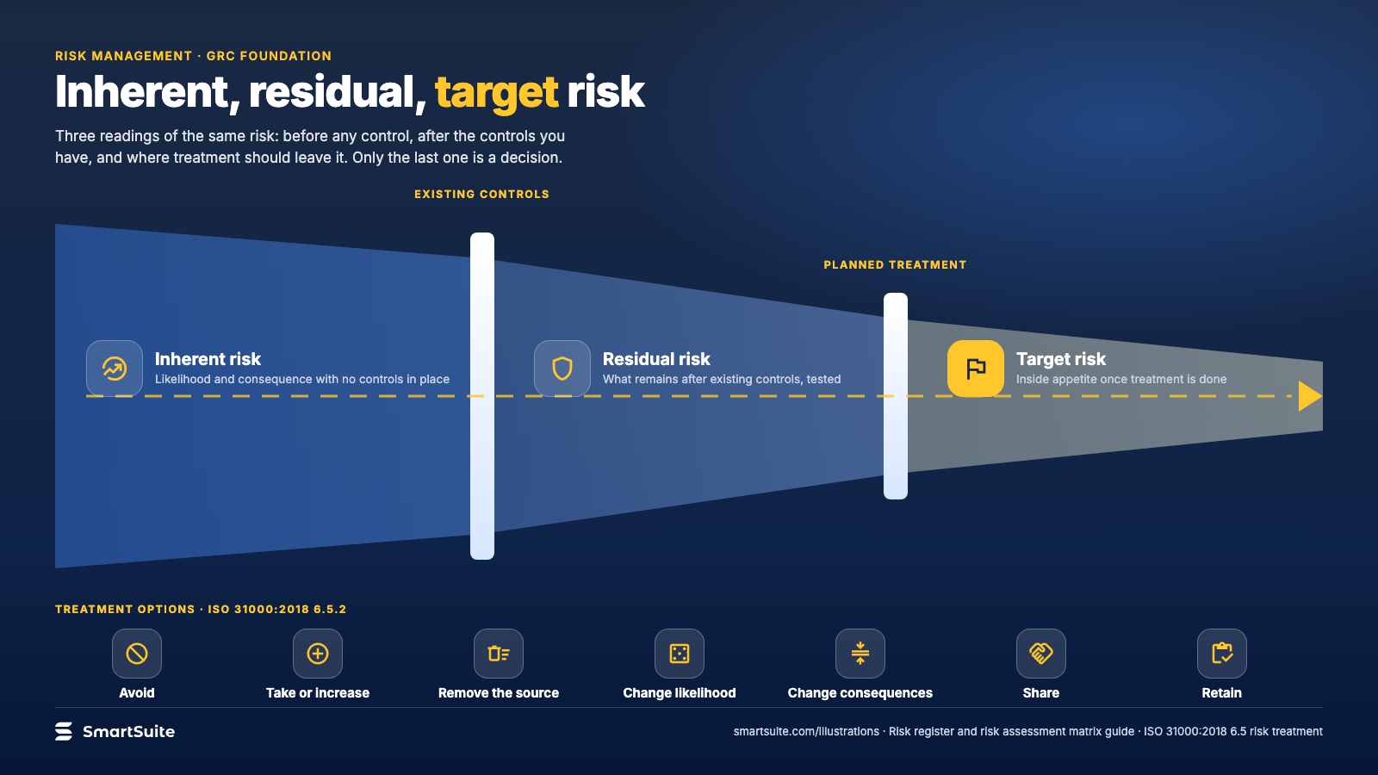
Notes:
Inherent, residual, target risk
Inherent, residual and target risk as a funnel narrowed by controls, with the ISO 31000 treatment options.
Source: ISO 31000:2018 6.5 risk treatment · From: Risk register and risk assessment matrix
Credit: Source: SmartSuite, smartsuite.com/illustrations

Slide 2
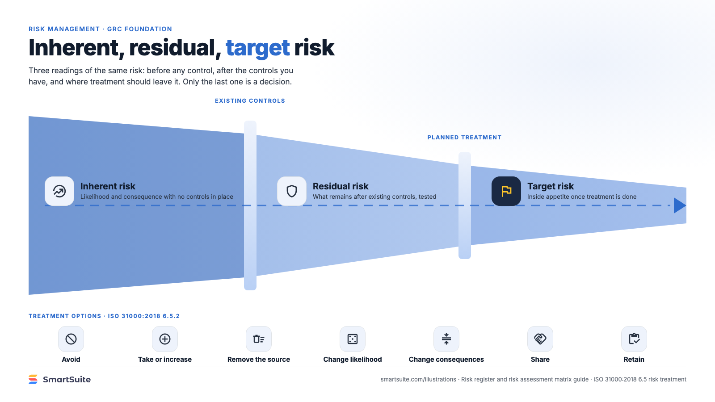
Notes:
Inherent, residual, target risk
Inherent, residual and target risk as a funnel narrowed by controls, with the ISO 31000 treatment options.
Source: ISO 31000:2018 6.5 risk treatment · From: Risk register and risk assessment matrix
Credit: Source: SmartSuite, smartsuite.com/illustrations

