Slide 1
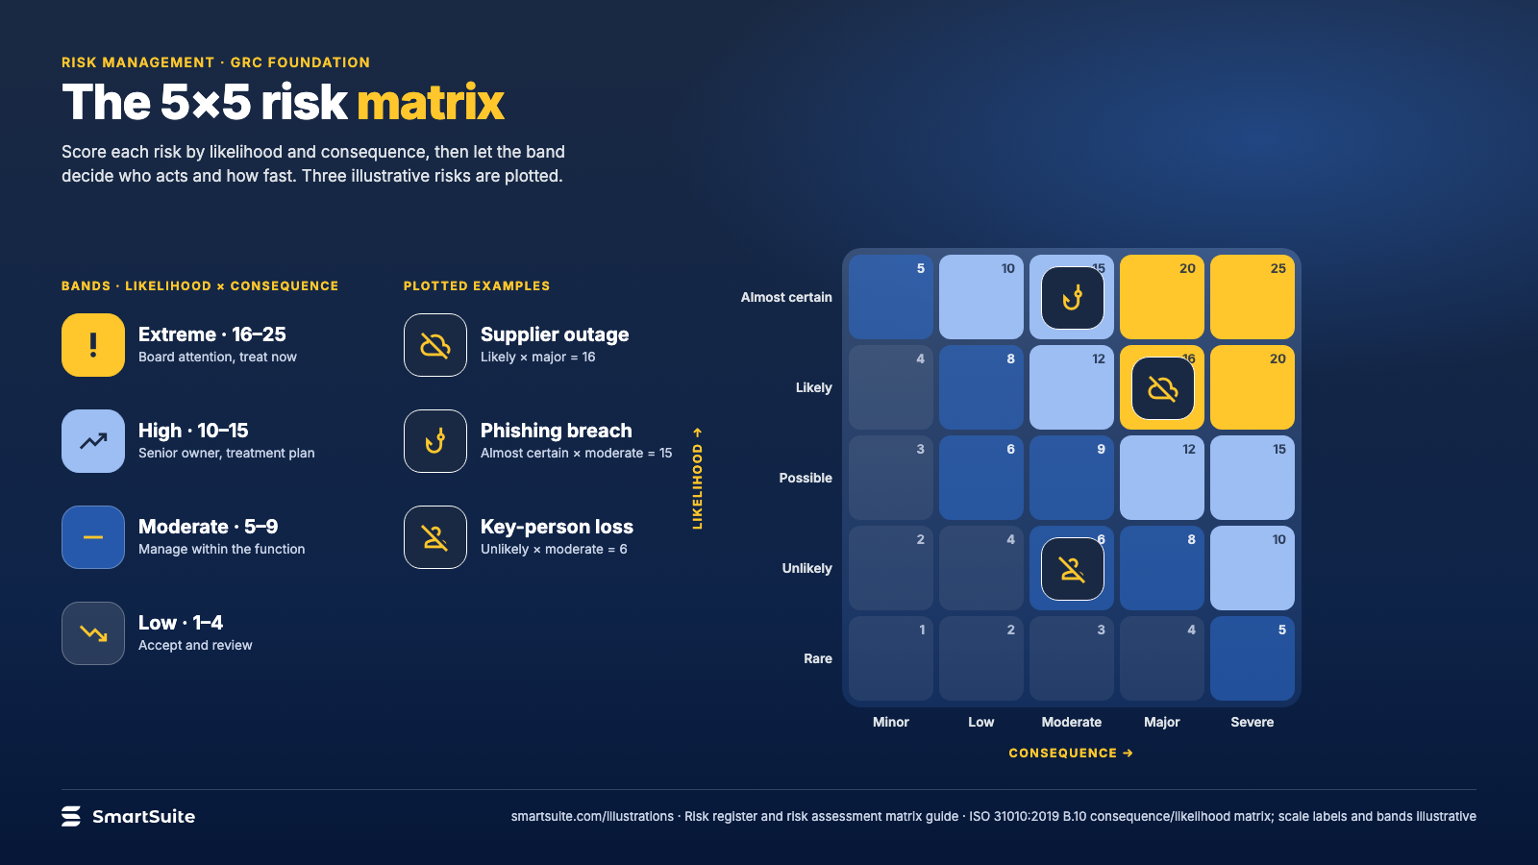
Notes:
The 5×5 risk matrix
A 5×5 likelihood-and-consequence matrix with example risks plotted and the bands that decide who acts.
Source: ISO 31010:2019 B.10 consequence/likelihood matrix; scale labels and bands illustrative · From: Risk register and risk assessment matrix
Credit: Source: SmartSuite, smartsuite.com/illustrations

Slide 2
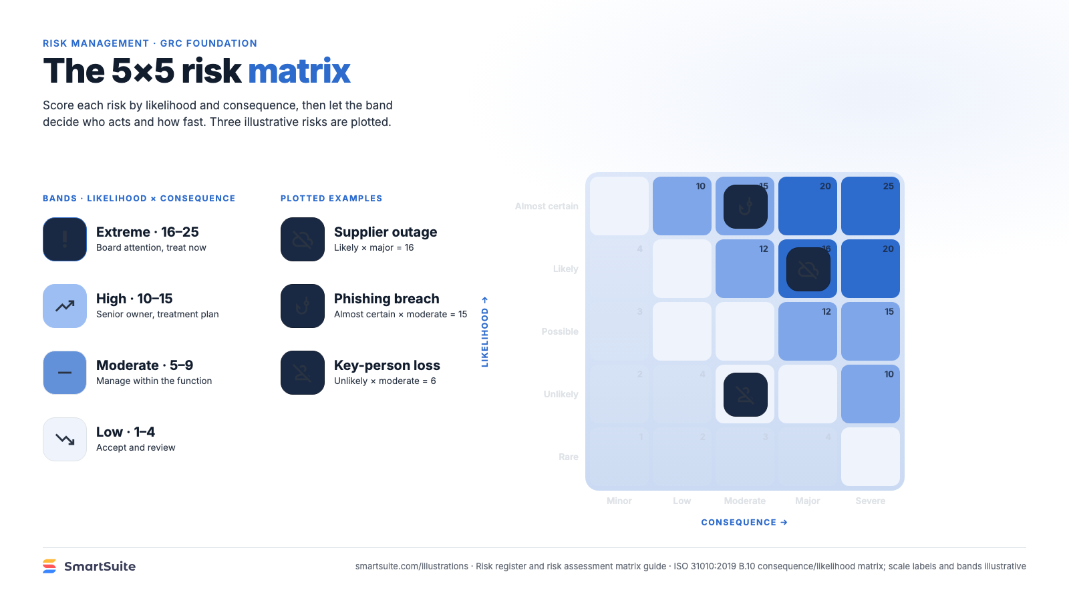
Notes:
The 5×5 risk matrix
A 5×5 likelihood-and-consequence matrix with example risks plotted and the bands that decide who acts.
Source: ISO 31010:2019 B.10 consequence/likelihood matrix; scale labels and bands illustrative · From: Risk register and risk assessment matrix
Credit: Source: SmartSuite, smartsuite.com/illustrations

