Slide 1
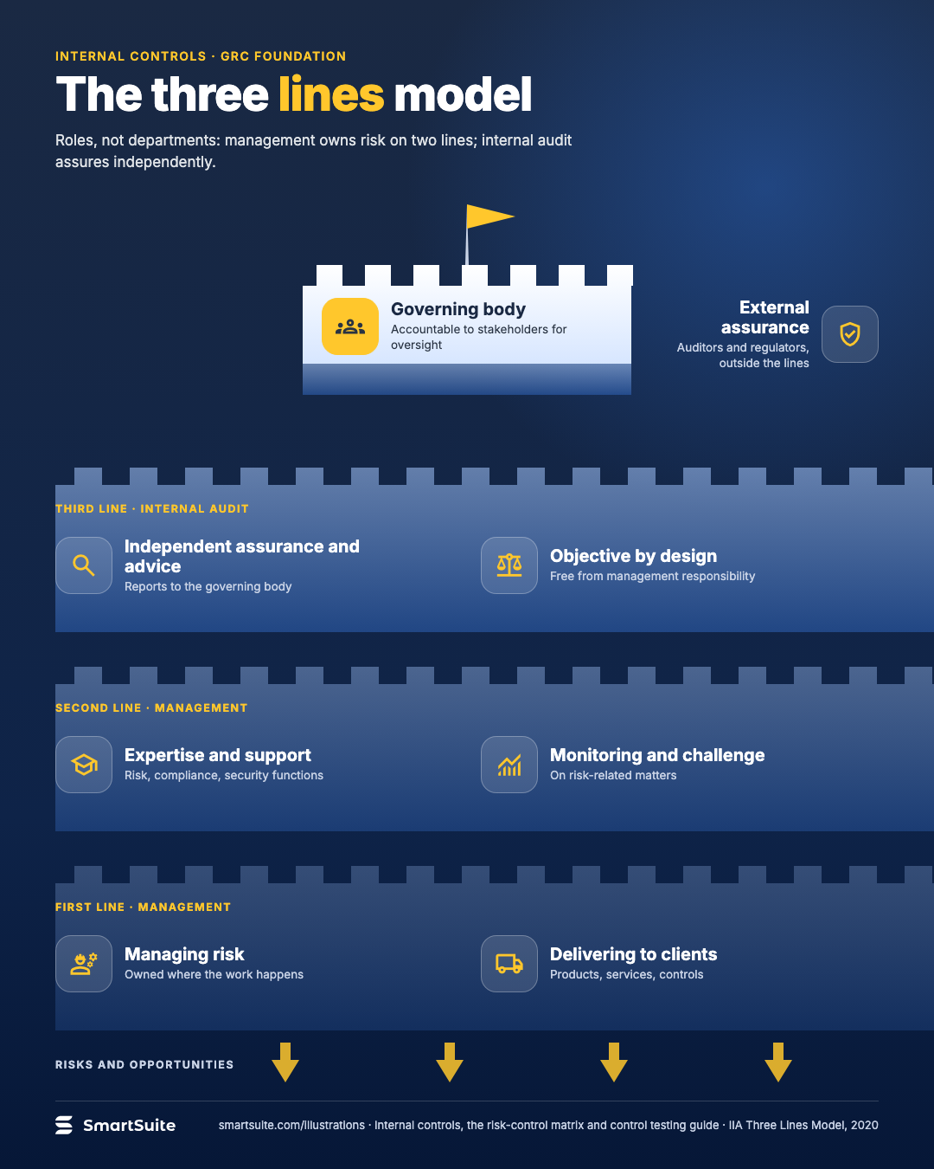
The three lines model
The IIA three lines model: governing body, management's two lines, internal audit and external assurance.
Source: IIA Three Lines Model, 2020
Notes:
The three lines model
The IIA three lines model: governing body, management's two lines, internal audit and external assurance.
Source: IIA Three Lines Model, 2020 · From: Internal controls, the risk-control matrix and control testing
Credit: Source: SmartSuite, smartsuite.com/illustrations

Slide 2
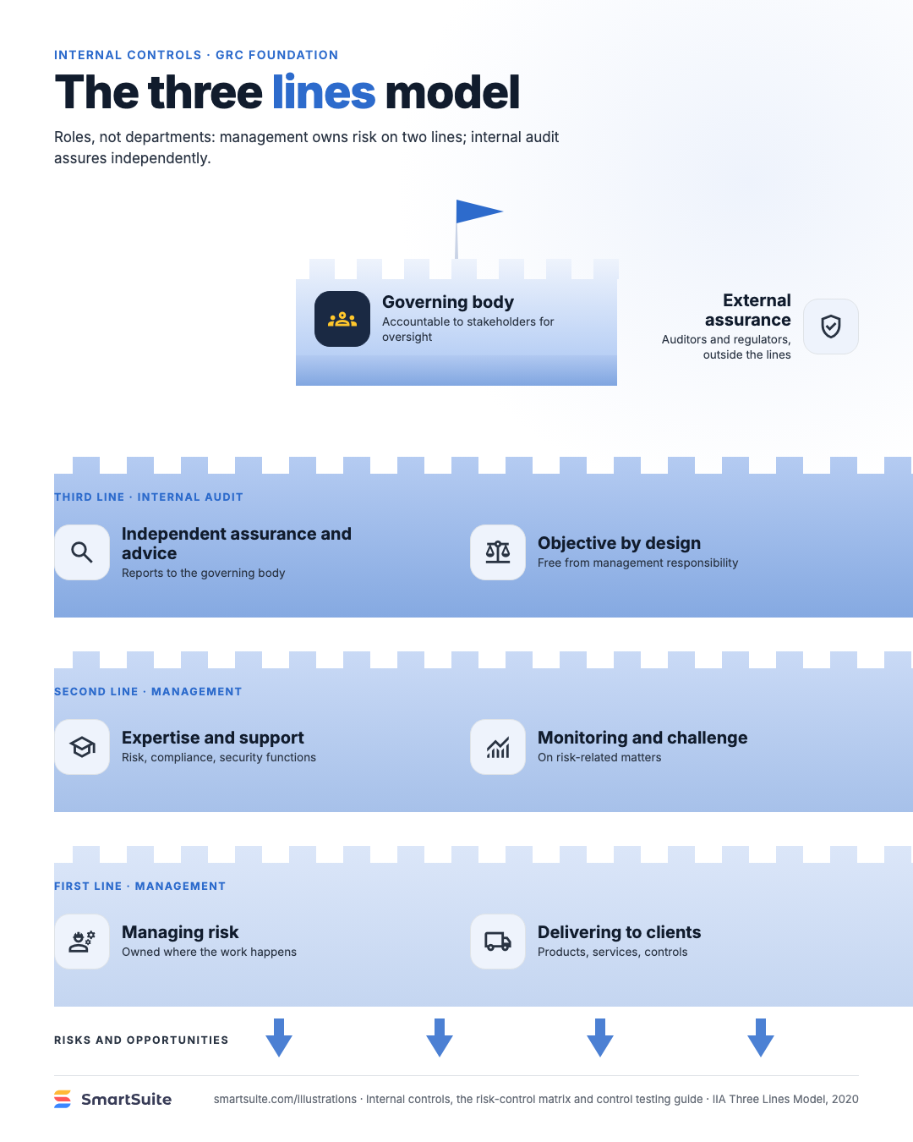
The three lines model
The IIA three lines model: governing body, management's two lines, internal audit and external assurance.
Source: IIA Three Lines Model, 2020
Notes:
The three lines model
The IIA three lines model: governing body, management's two lines, internal audit and external assurance.
Source: IIA Three Lines Model, 2020 · From: Internal controls, the risk-control matrix and control testing
Credit: Source: SmartSuite, smartsuite.com/illustrations

