Slide 1
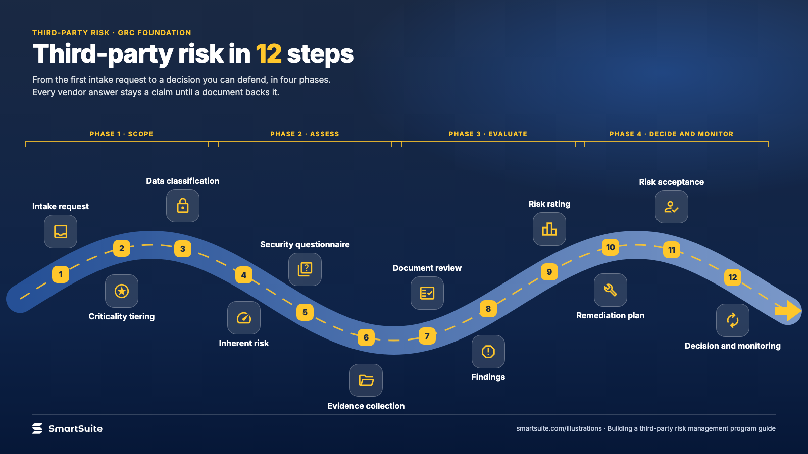
Notes:
Third-party risk in 12 steps
The twelve steps of a third-party risk assessment in four phases, from intake to decision and monitoring.
Source: guide chapters: 12 steps in 4 phases · From: Building a third-party risk management program
Credit: Source: SmartSuite, smartsuite.com/illustrations

Slide 2
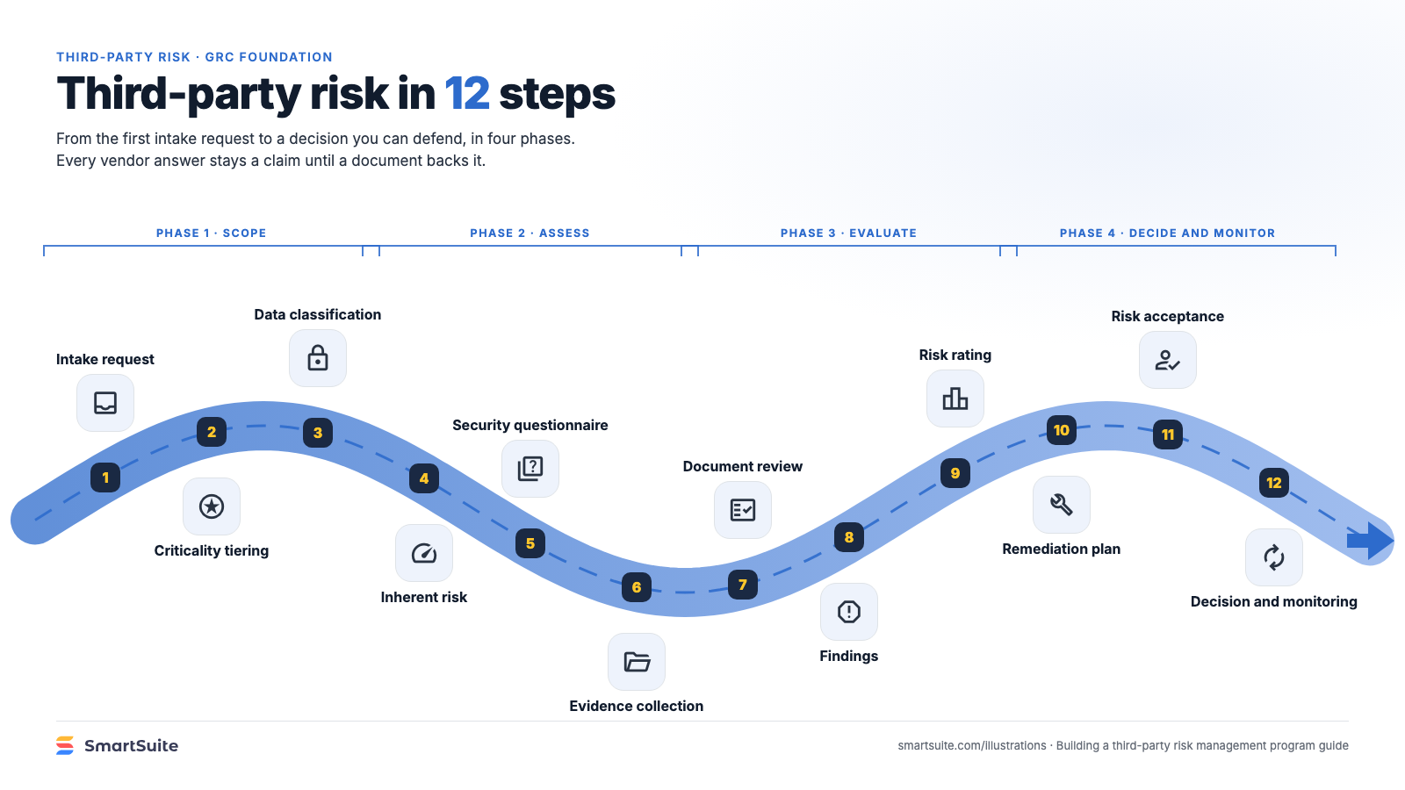
Notes:
Third-party risk in 12 steps
The twelve steps of a third-party risk assessment in four phases, from intake to decision and monitoring.
Source: guide chapters: 12 steps in 4 phases · From: Building a third-party risk management program
Credit: Source: SmartSuite, smartsuite.com/illustrations

