Slide 1
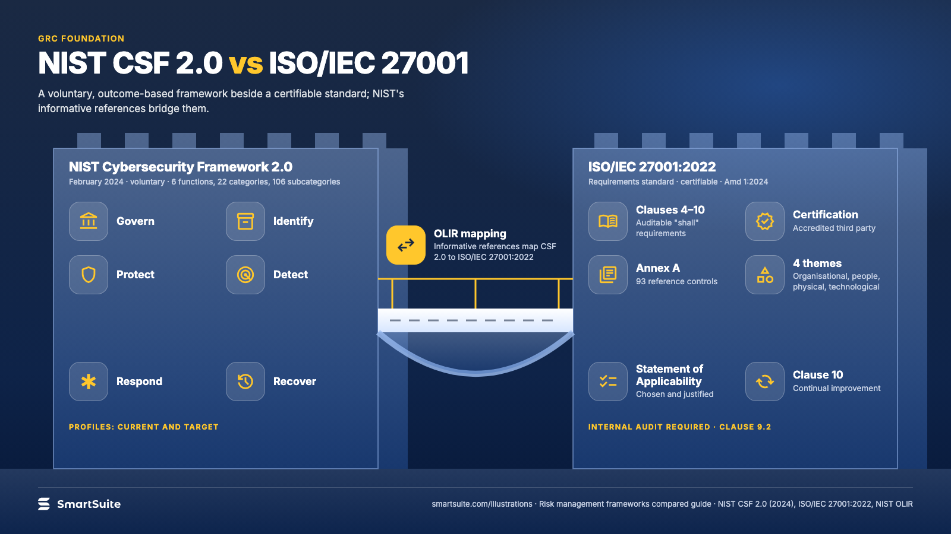
Notes:
NIST CSF 2.0 vs ISO/IEC 27001
NIST CSF 2.0 and ISO/IEC 27001:2022 side by side: structure, certification, controls and how the OLIR mapping joins them.
Source: NIST CSF 2.0 (2024), ISO/IEC 27001:2022, NIST OLIR · From: Risk management frameworks compared
Credit: Source: SmartSuite, smartsuite.com/illustrations

Slide 2
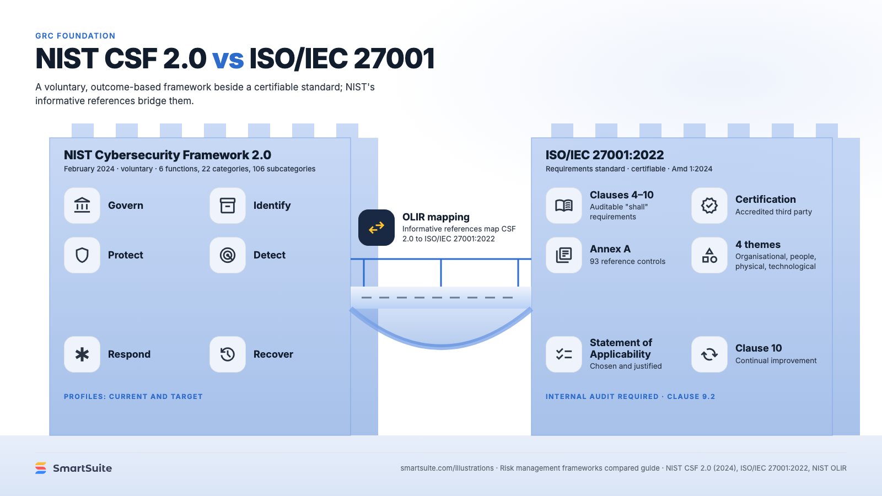
Notes:
NIST CSF 2.0 vs ISO/IEC 27001
NIST CSF 2.0 and ISO/IEC 27001:2022 side by side: structure, certification, controls and how the OLIR mapping joins them.
Source: NIST CSF 2.0 (2024), ISO/IEC 27001:2022, NIST OLIR · From: Risk management frameworks compared
Credit: Source: SmartSuite, smartsuite.com/illustrations

