Slide 1
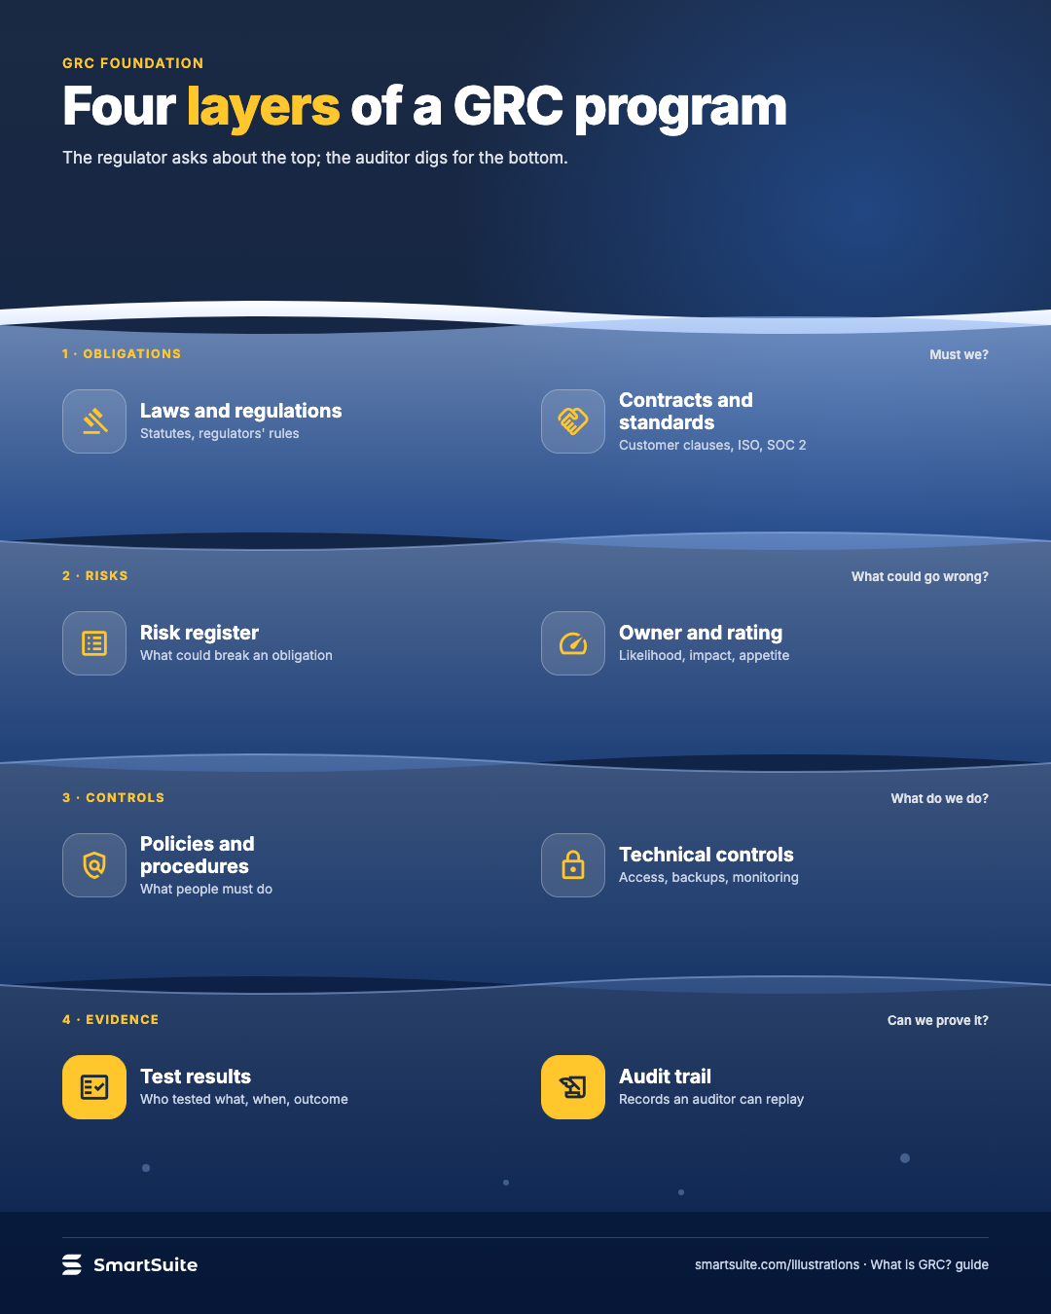
Four layers of a GRC program
Obligations, risks, controls and evidence as four linked layers, and why connecting them is what integrated GRC means.
Source: guide's own four-layer model (obligations, risks, controls, evidence)
Notes:
Four layers of a GRC program
Obligations, risks, controls and evidence as four linked layers, and why connecting them is what integrated GRC means.
Source: guide's own four-layer model (obligations, risks, controls, evidence) · From: What is GRC?
Credit: Source: SmartSuite, smartsuite.com/illustrations

Slide 2
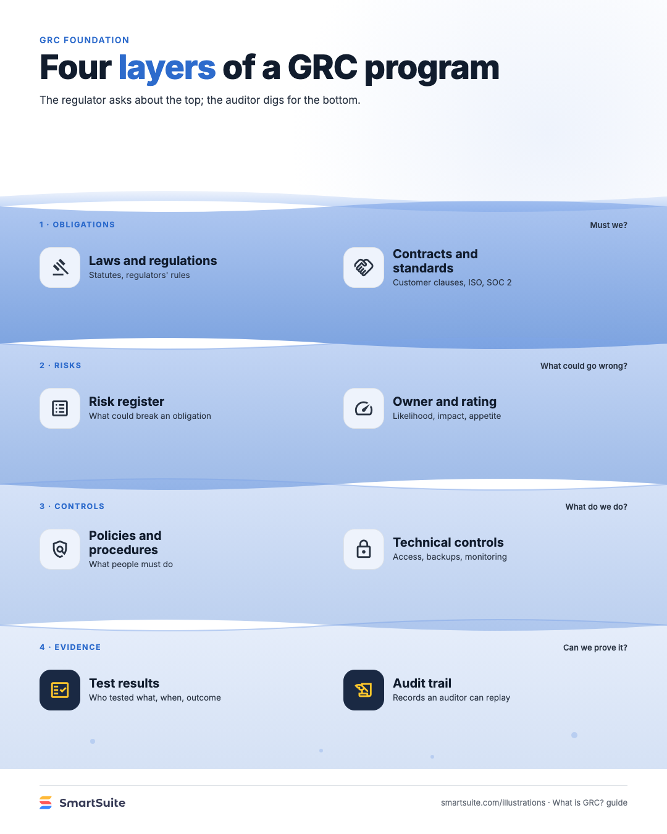
Four layers of a GRC program
Obligations, risks, controls and evidence as four linked layers, and why connecting them is what integrated GRC means.
Source: guide's own four-layer model (obligations, risks, controls, evidence)
Notes:
Four layers of a GRC program
Obligations, risks, controls and evidence as four linked layers, and why connecting them is what integrated GRC means.
Source: guide's own four-layer model (obligations, risks, controls, evidence) · From: What is GRC?
Credit: Source: SmartSuite, smartsuite.com/illustrations

