Slide 1
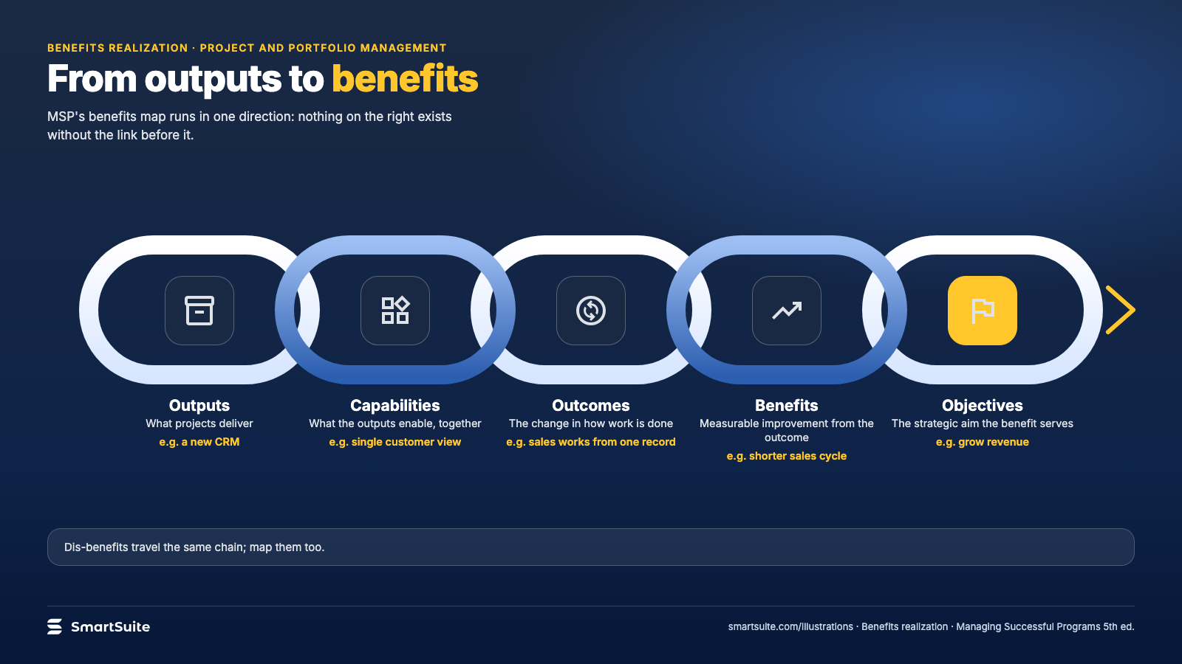
Notes:
From outputs to benefits
A benefits map from outputs through capabilities and outcomes to benefits and objectives.
Source: Managing Successful Programmes 5th ed. · From: Benefits realization
Credit: Source: SmartSuite, smartsuite.com/illustrations

Slide 2
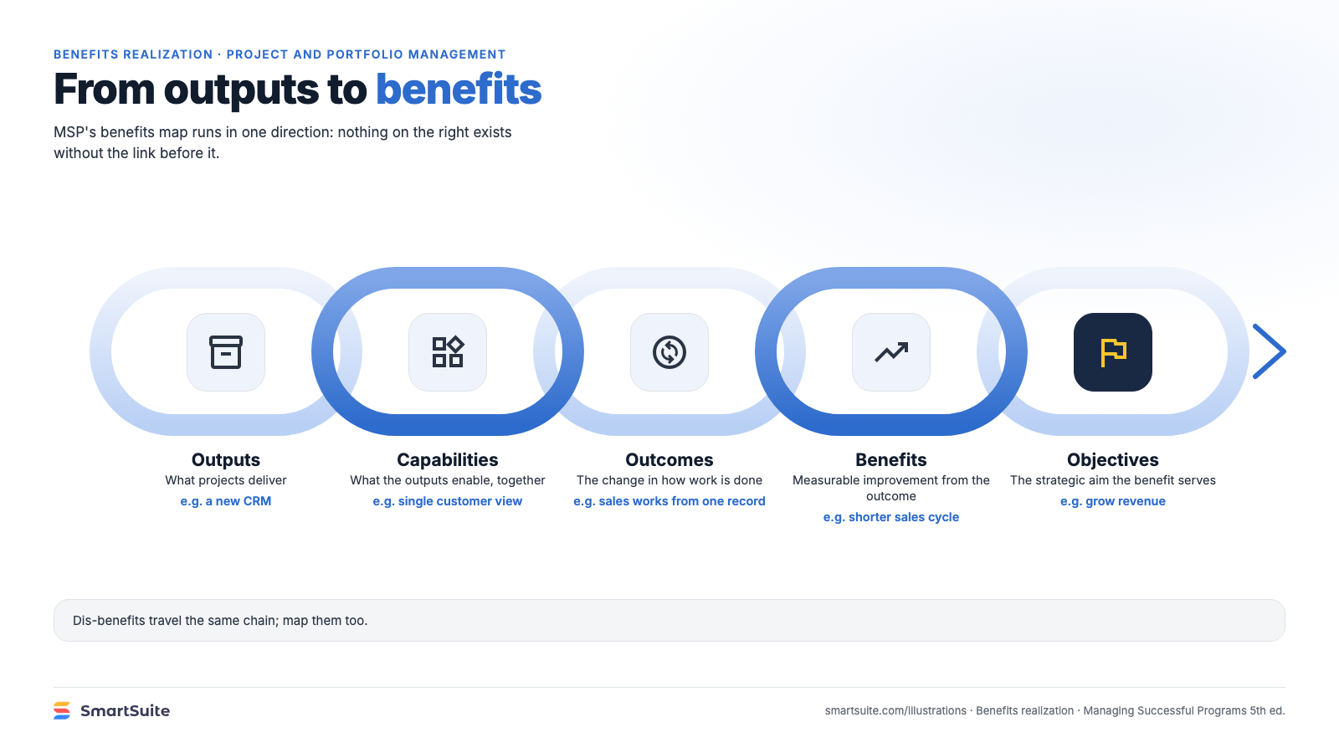
Notes:
From outputs to benefits
A benefits map from outputs through capabilities and outcomes to benefits and objectives.
Source: Managing Successful Programmes 5th ed. · From: Benefits realization
Credit: Source: SmartSuite, smartsuite.com/illustrations

