Slide 1
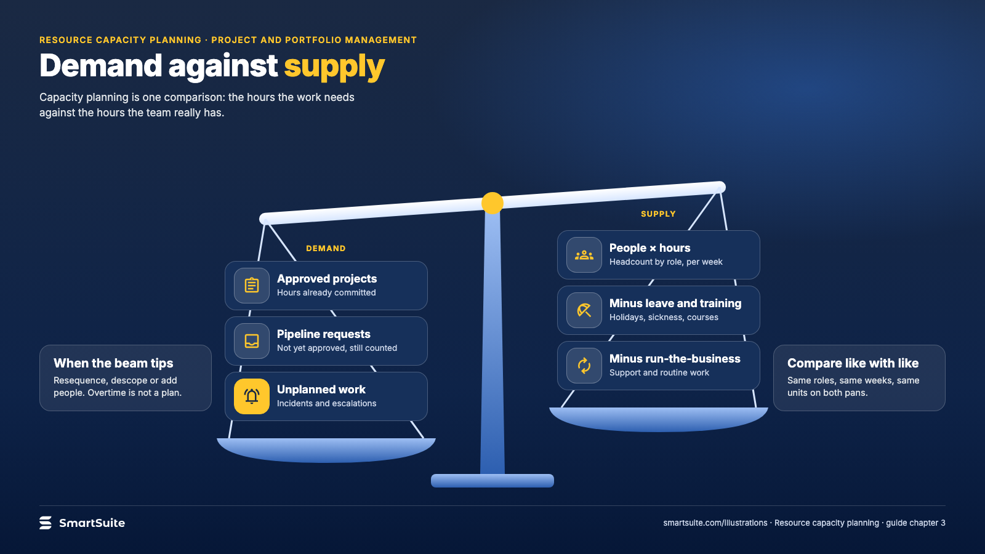
Notes:
Demand against supply
Resource capacity as a balance between project demand and the hours a team can supply.
Source: guide chapter 3 · From: Resource capacity planning
Credit: Source: SmartSuite, smartsuite.com/illustrations

Slide 2
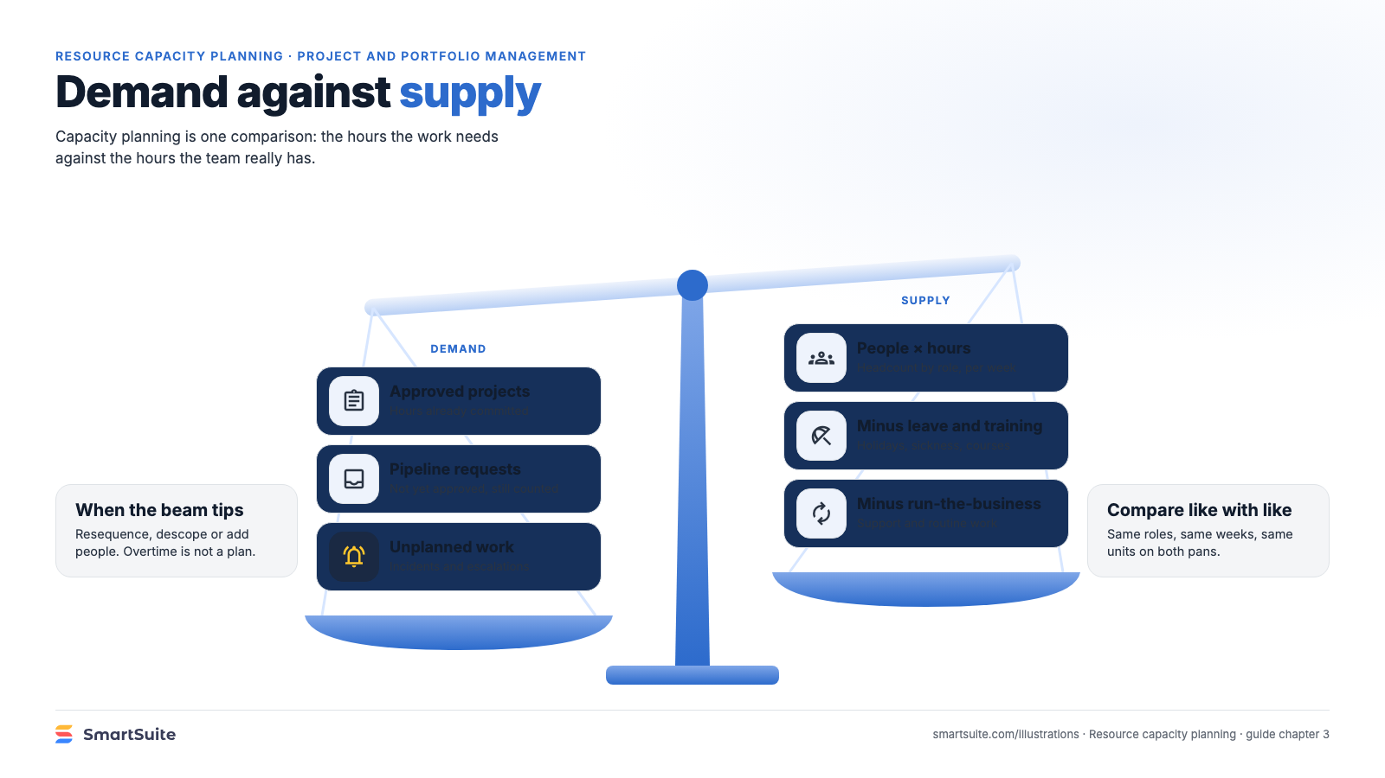
Notes:
Demand against supply
Resource capacity as a balance between project demand and the hours a team can supply.
Source: guide chapter 3 · From: Resource capacity planning
Credit: Source: SmartSuite, smartsuite.com/illustrations

