Slide 1
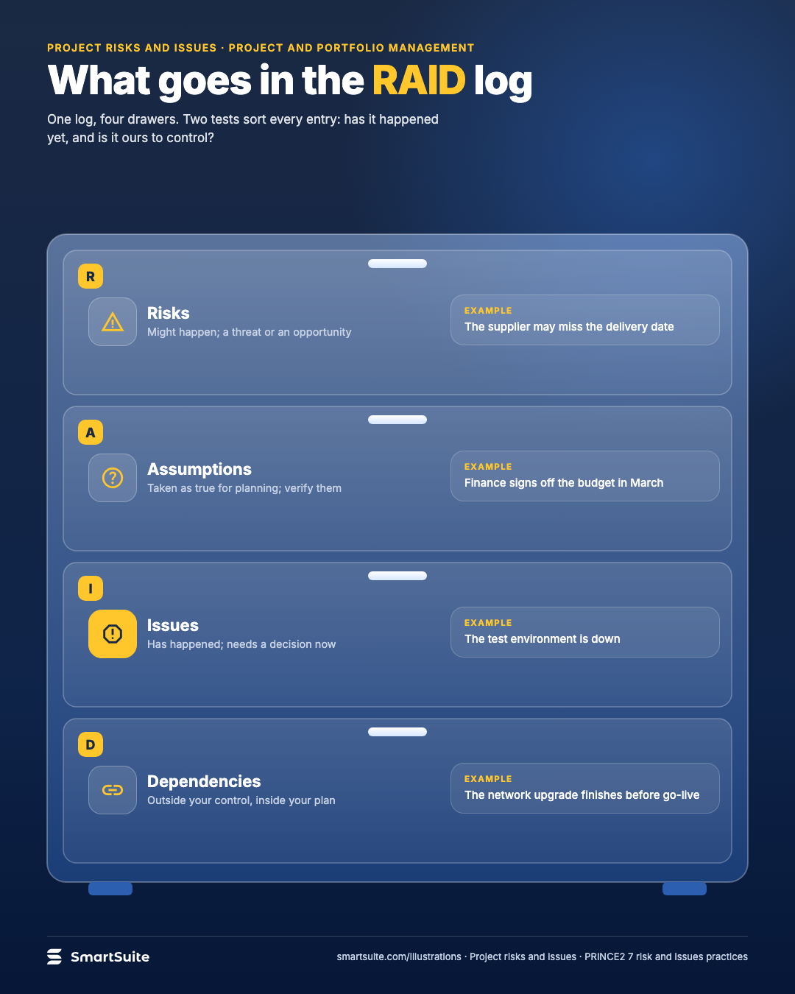
What goes in the RAID log
Risks, assumptions, issues and dependencies: what each drawer of a RAID log holds.
Source: PRINCE2 7 risk and issue themes
Notes:
What goes in the RAID log
Risks, assumptions, issues and dependencies: what each drawer of a RAID log holds.
Source: PRINCE2 7 risk and issue themes · From: Project risks and issues
Credit: Source: SmartSuite, smartsuite.com/illustrations

Slide 2
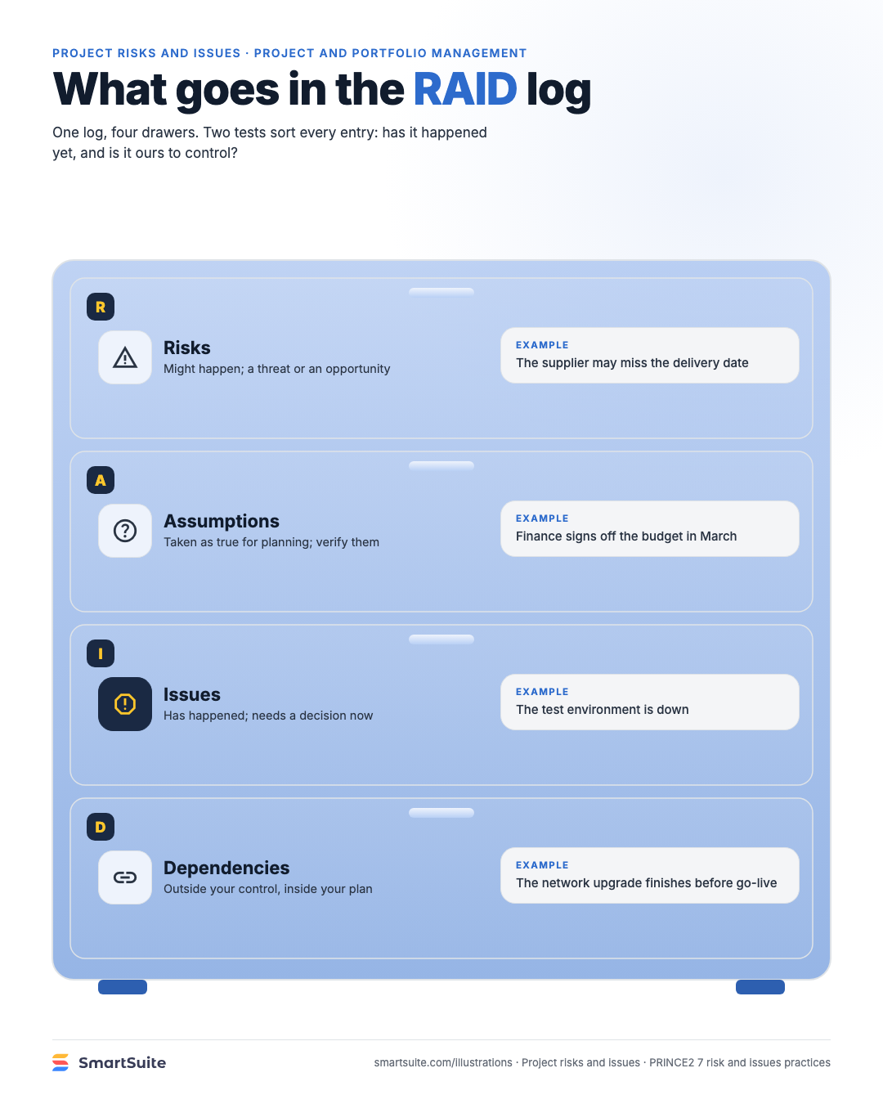
What goes in the RAID log
Risks, assumptions, issues and dependencies: what each drawer of a RAID log holds.
Source: PRINCE2 7 risk and issue themes
Notes:
What goes in the RAID log
Risks, assumptions, issues and dependencies: what each drawer of a RAID log holds.
Source: PRINCE2 7 risk and issue themes · From: Project risks and issues
Credit: Source: SmartSuite, smartsuite.com/illustrations

