Slide 1
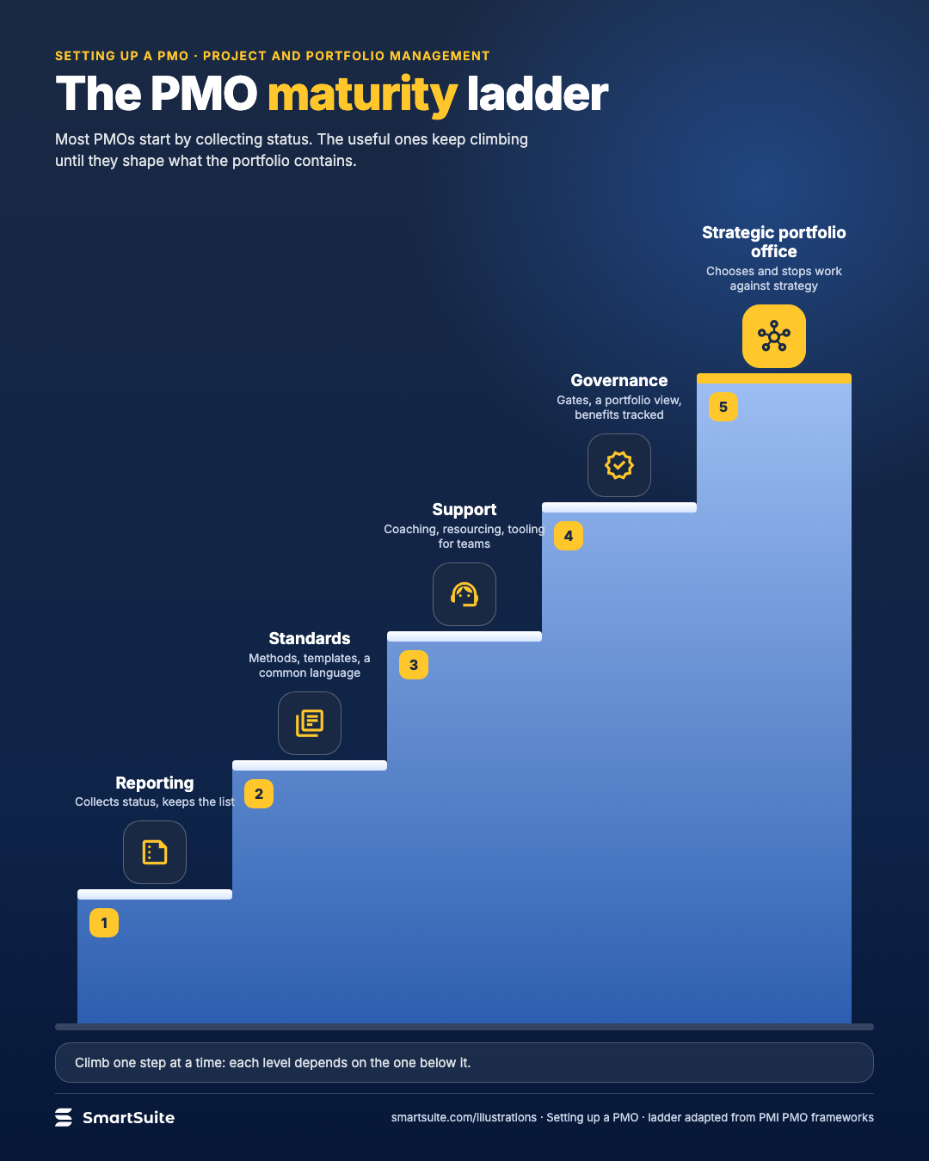
The PMO maturity ladder
Five steps of PMO maturity, from collecting status to a strategic portfolio office.
Source: PMI PMO frameworks
Notes:
The PMO maturity ladder
Five steps of PMO maturity, from collecting status to a strategic portfolio office.
Source: PMI PMO frameworks · From: Setting up a PMO
Credit: Source: SmartSuite, smartsuite.com/illustrations

Slide 2
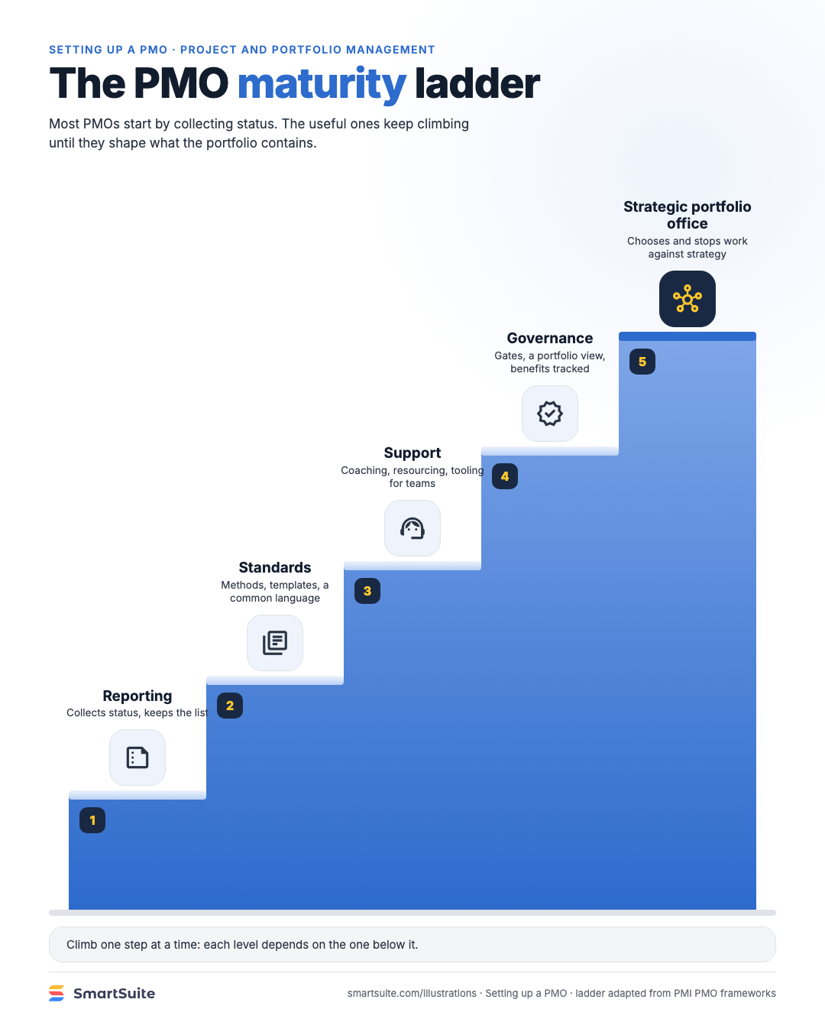
The PMO maturity ladder
Five steps of PMO maturity, from collecting status to a strategic portfolio office.
Source: PMI PMO frameworks
Notes:
The PMO maturity ladder
Five steps of PMO maturity, from collecting status to a strategic portfolio office.
Source: PMI PMO frameworks · From: Setting up a PMO
Credit: Source: SmartSuite, smartsuite.com/illustrations

