Slide 1
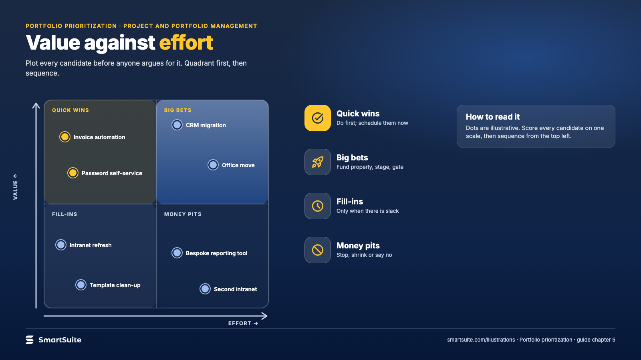
Notes:
Value against effort
Value against effort as a 2×2 for portfolio prioritization, with example projects in each quadrant.
Source: guide chapter 5 · From: Portfolio prioritization
Credit: Source: SmartSuite, smartsuite.com/illustrations

Slide 2
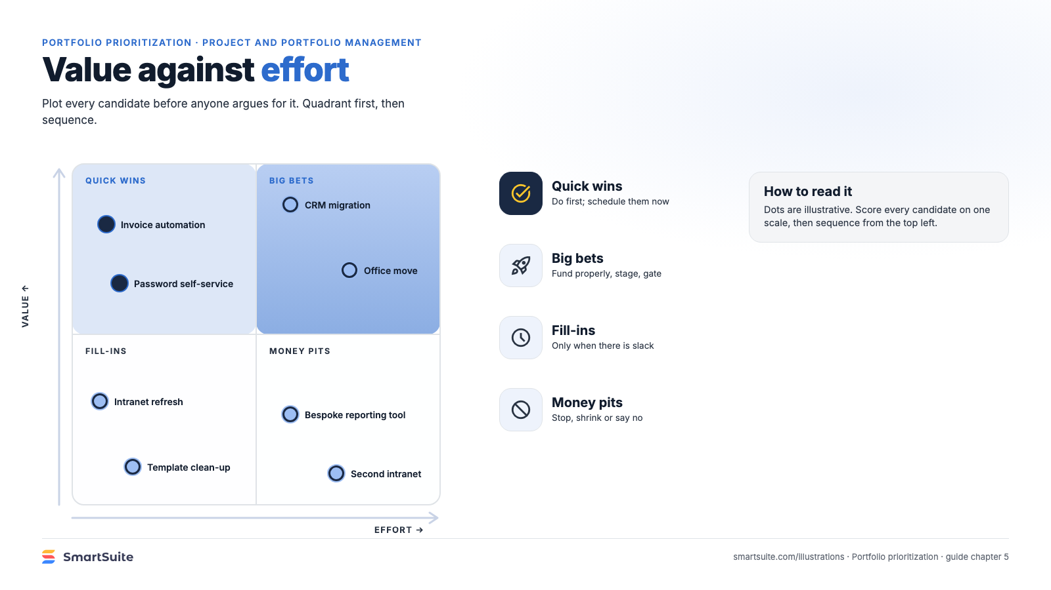
Notes:
Value against effort
Value against effort as a 2×2 for portfolio prioritization, with example projects in each quadrant.
Source: guide chapter 5 · From: Portfolio prioritization
Credit: Source: SmartSuite, smartsuite.com/illustrations

