Slide 1
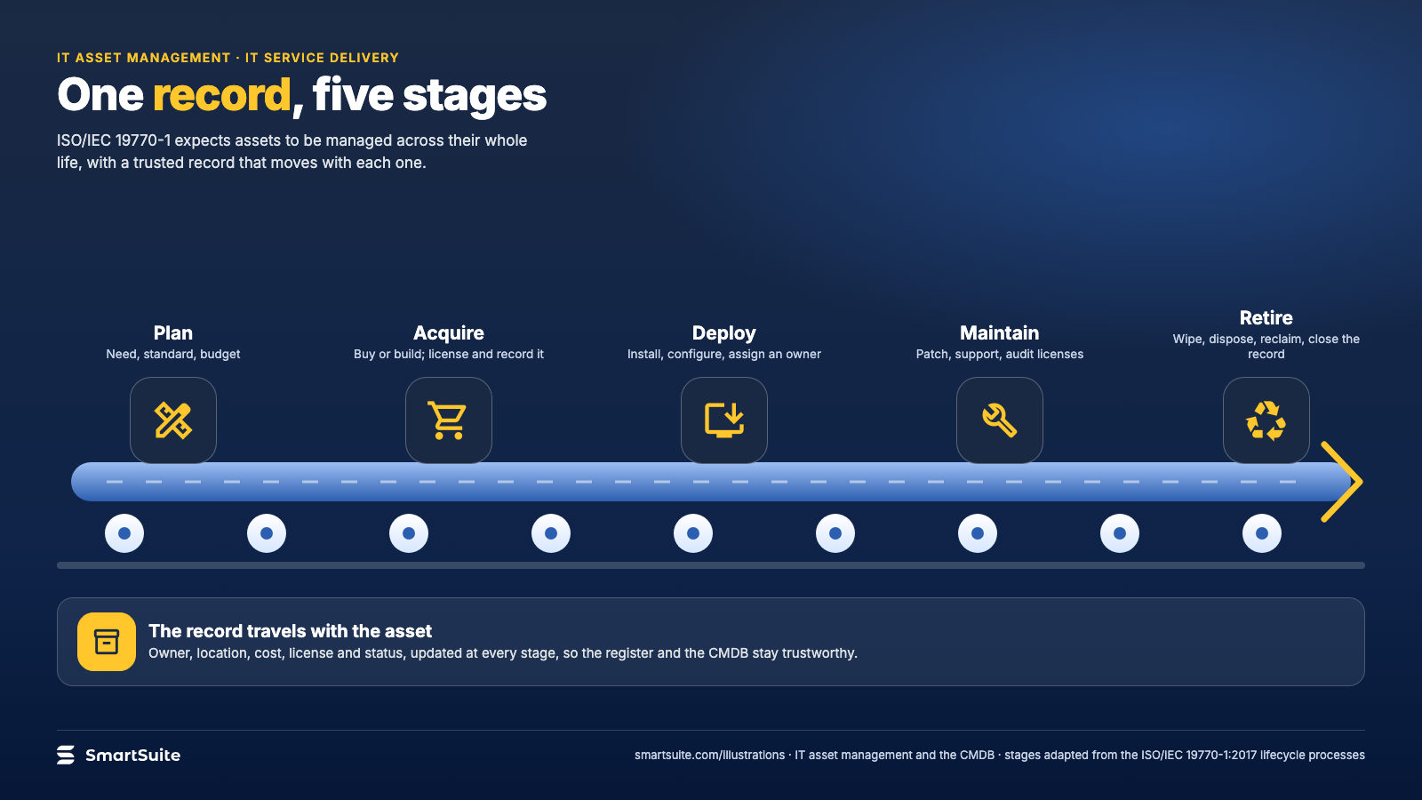
Notes:
One record, five stages
The IT asset lifecycle from plan to retire, with one record traveling with the asset.
Source: ISO/IEC 19770-1:2017 · From: IT asset management and the CMDB
Credit: Source: SmartSuite, smartsuite.com/illustrations

Slide 2
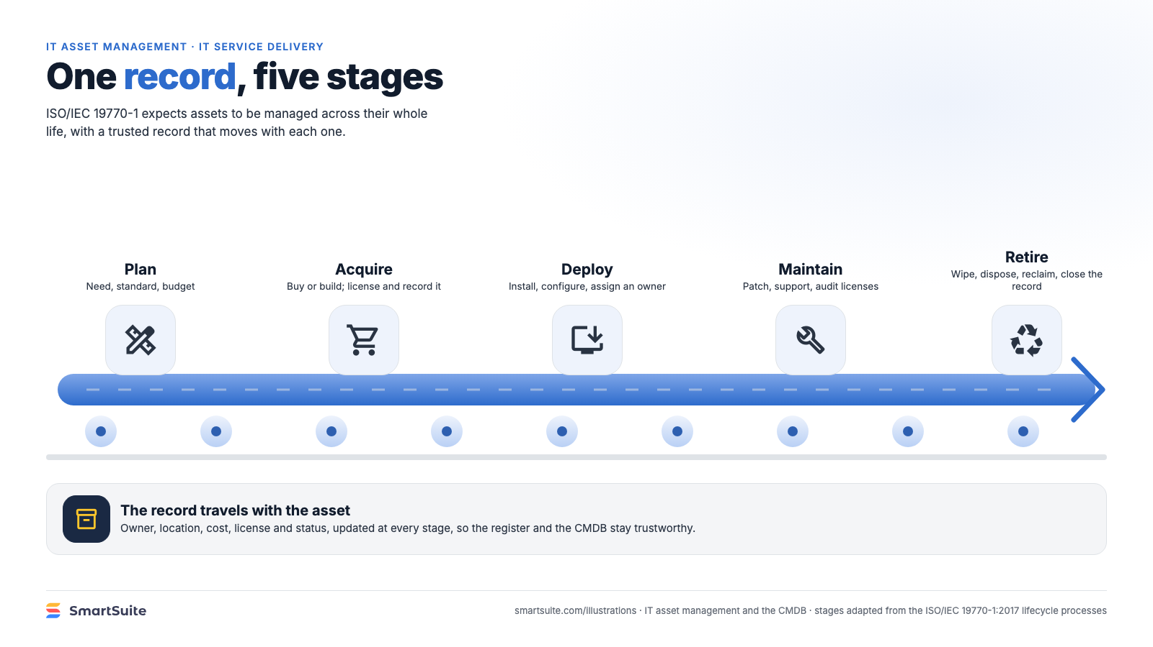
Notes:
One record, five stages
The IT asset lifecycle from plan to retire, with one record traveling with the asset.
Source: ISO/IEC 19770-1:2017 · From: IT asset management and the CMDB
Credit: Source: SmartSuite, smartsuite.com/illustrations

