Slide 1
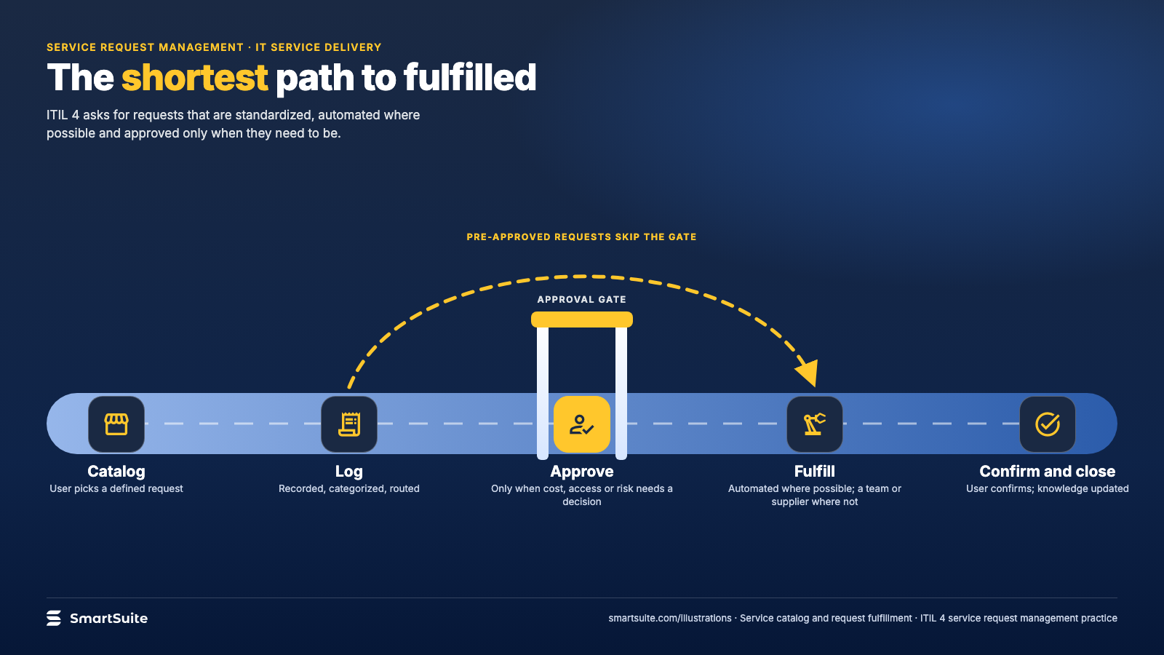
Notes:
The shortest path to fulfilled
How a service request travels from catalog to fulfillment, with approval gates and the pre-approved shortcut.
Source: ITIL 4 service request management practice · From: Service catalog and request fulfillment
Credit: Source: SmartSuite, smartsuite.com/illustrations

Slide 2
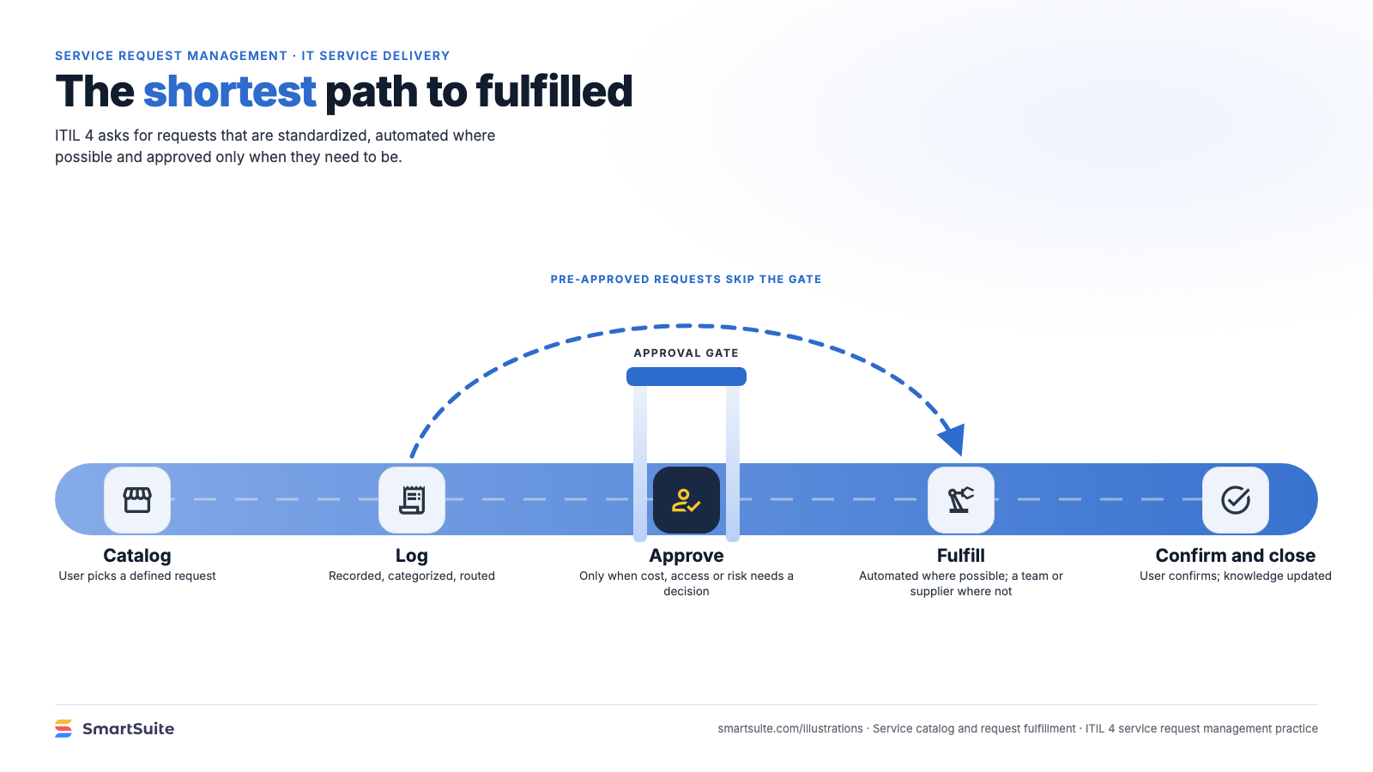
Notes:
The shortest path to fulfilled
How a service request travels from catalog to fulfillment, with approval gates and the pre-approved shortcut.
Source: ITIL 4 service request management practice · From: Service catalog and request fulfillment
Credit: Source: SmartSuite, smartsuite.com/illustrations

