Slide 1
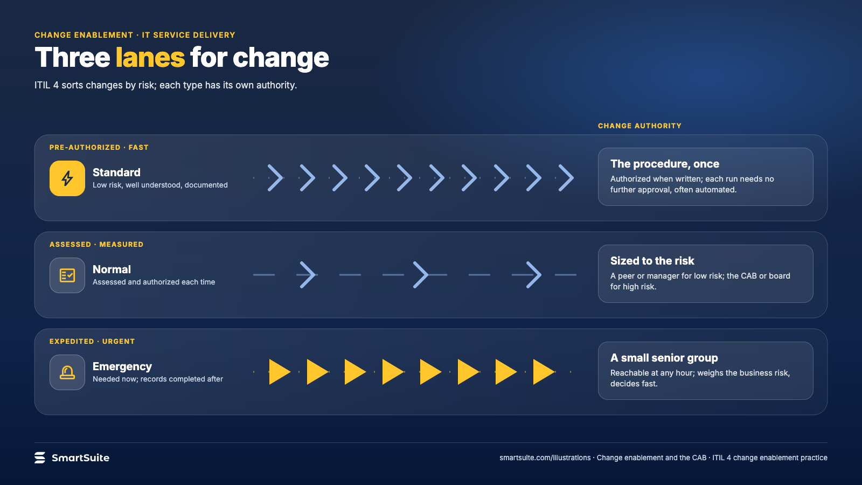
Notes:
Three lanes for change
Standard, normal and emergency change as three lanes of different speed, with the change authority for each.
Source: ITIL 4 change enablement practice · From: Change enablement and the CAB
Credit: Source: SmartSuite, smartsuite.com/illustrations

Slide 2
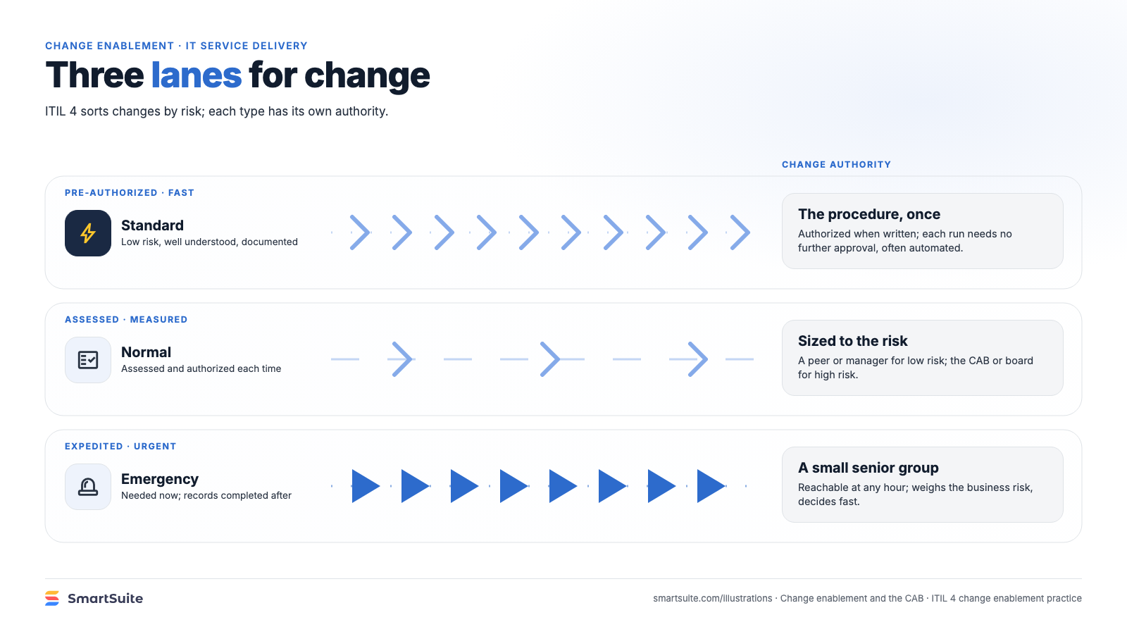
Notes:
Three lanes for change
Standard, normal and emergency change as three lanes of different speed, with the change authority for each.
Source: ITIL 4 change enablement practice · From: Change enablement and the CAB
Credit: Source: SmartSuite, smartsuite.com/illustrations

