Slide 1
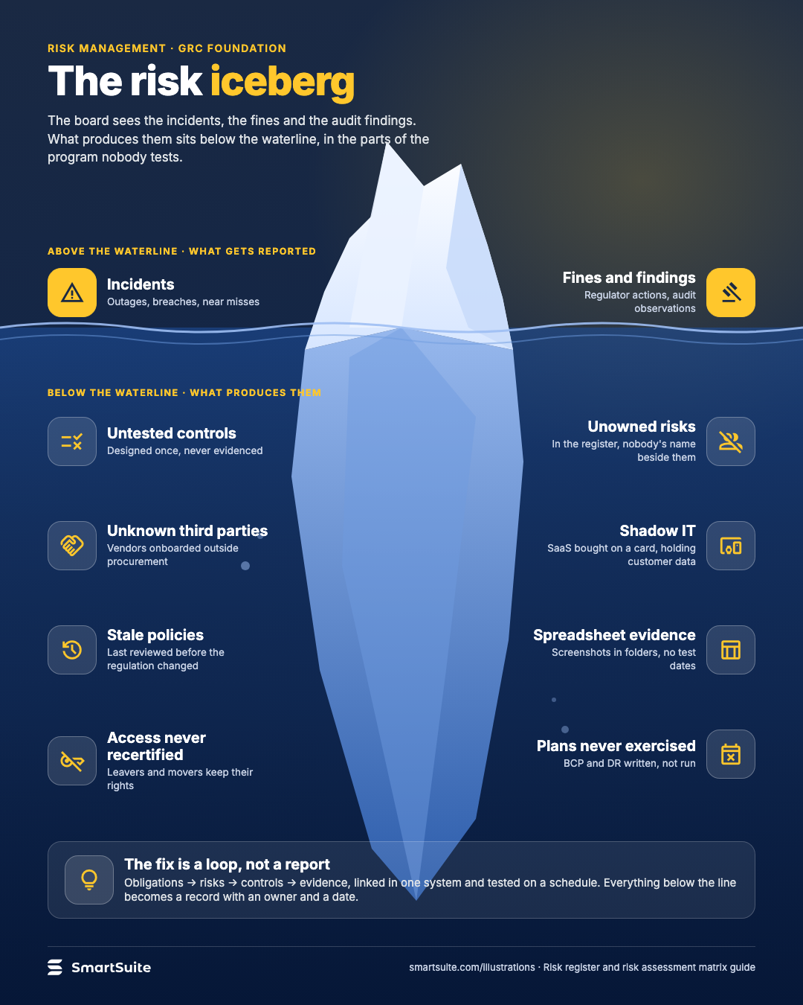
The risk iceberg
What the board sees above the waterline, and the untested controls, unowned risks and stale policies that produce it.
Source: guide
Notes:
The risk iceberg
What the board sees above the waterline, and the untested controls, unowned risks and stale policies that produce it.
Source: guide · From: Risk register and risk assessment matrix
Credit: Source: SmartSuite, smartsuite.com/illustrations

Slide 2
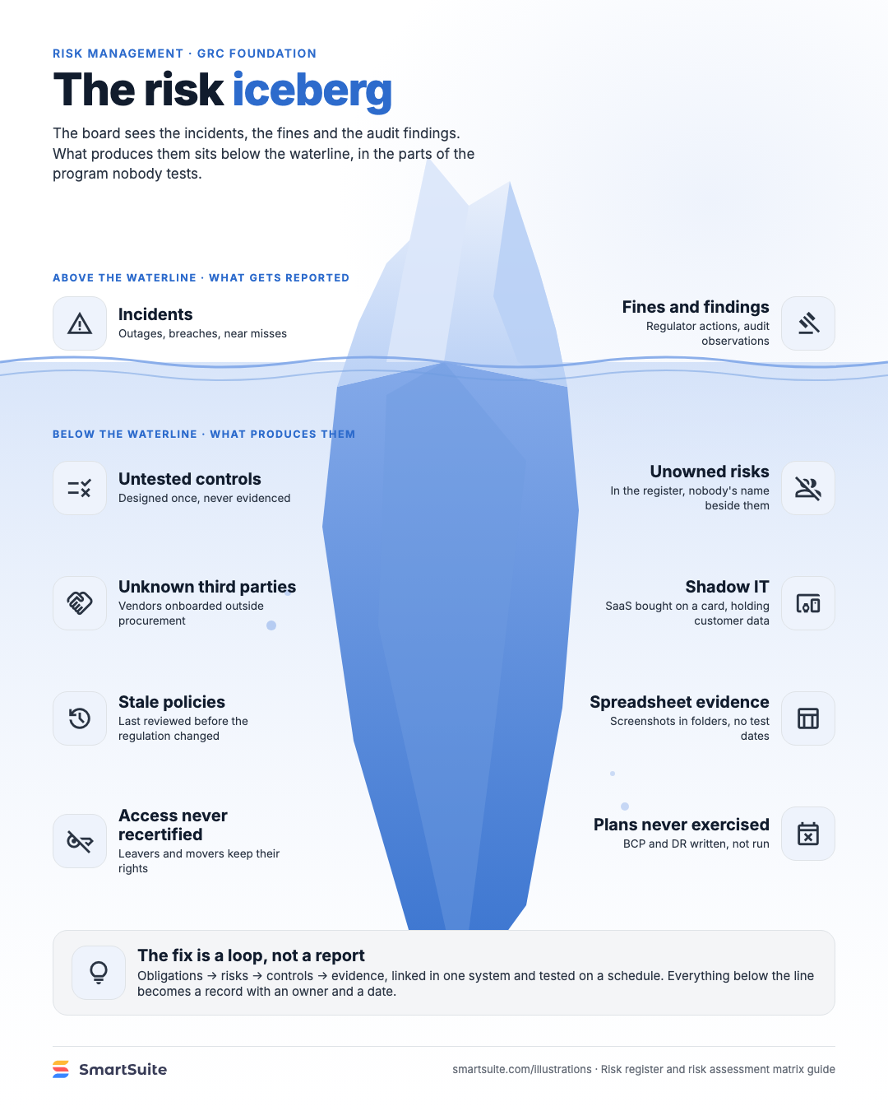
The risk iceberg
What the board sees above the waterline, and the untested controls, unowned risks and stale policies that produce it.
Source: guide
Notes:
The risk iceberg
What the board sees above the waterline, and the untested controls, unowned risks and stale policies that produce it.
Source: guide · From: Risk register and risk assessment matrix
Credit: Source: SmartSuite, smartsuite.com/illustrations

