Slide 1
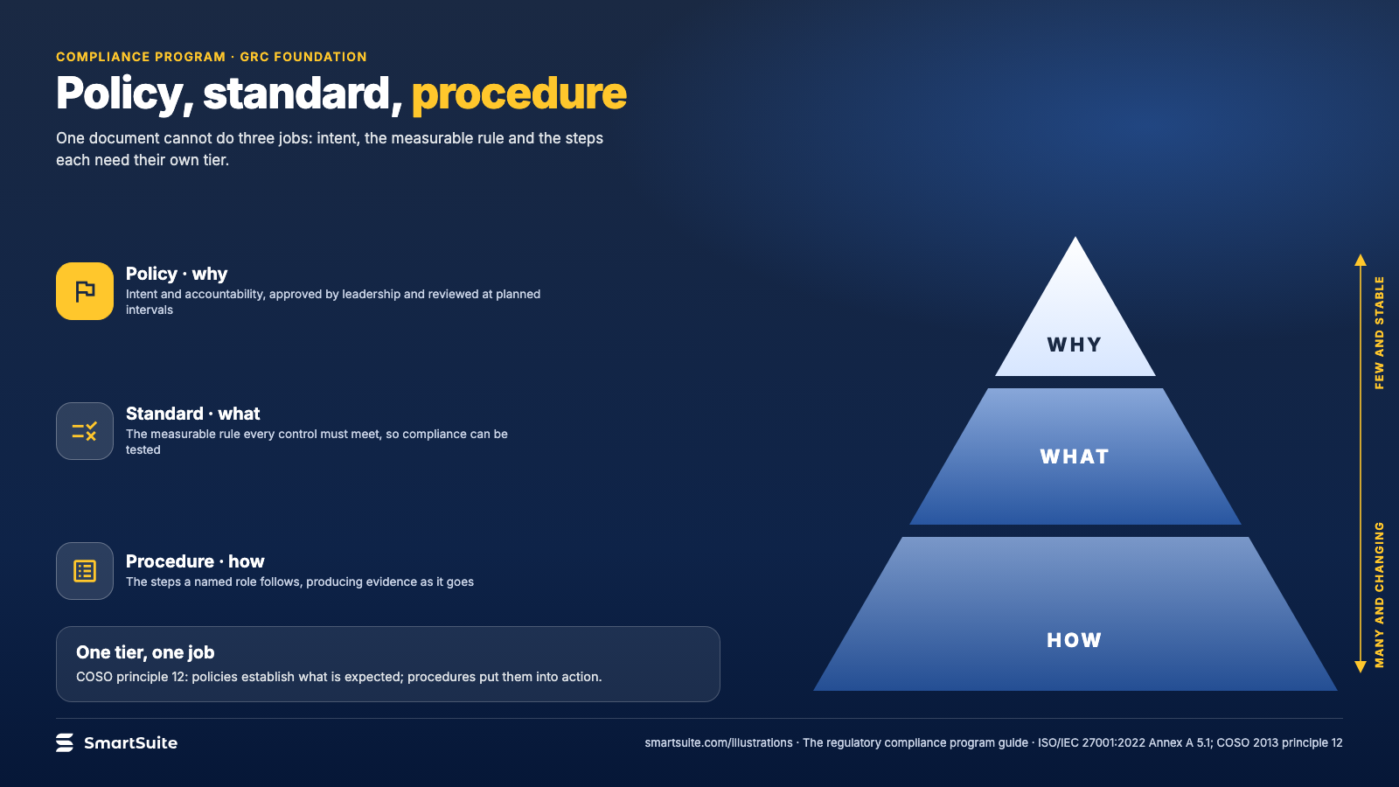
Notes:
Policy, standard, procedure
Why one document cannot do three jobs: policies set intent, standards set the measurable rule, procedures set the steps.
Source: ISO/IEC 27001:2022 Annex A 5.1; COSO 2013 principle 12 · From: The regulatory compliance program
Credit: Source: SmartSuite, smartsuite.com/illustrations

Slide 2
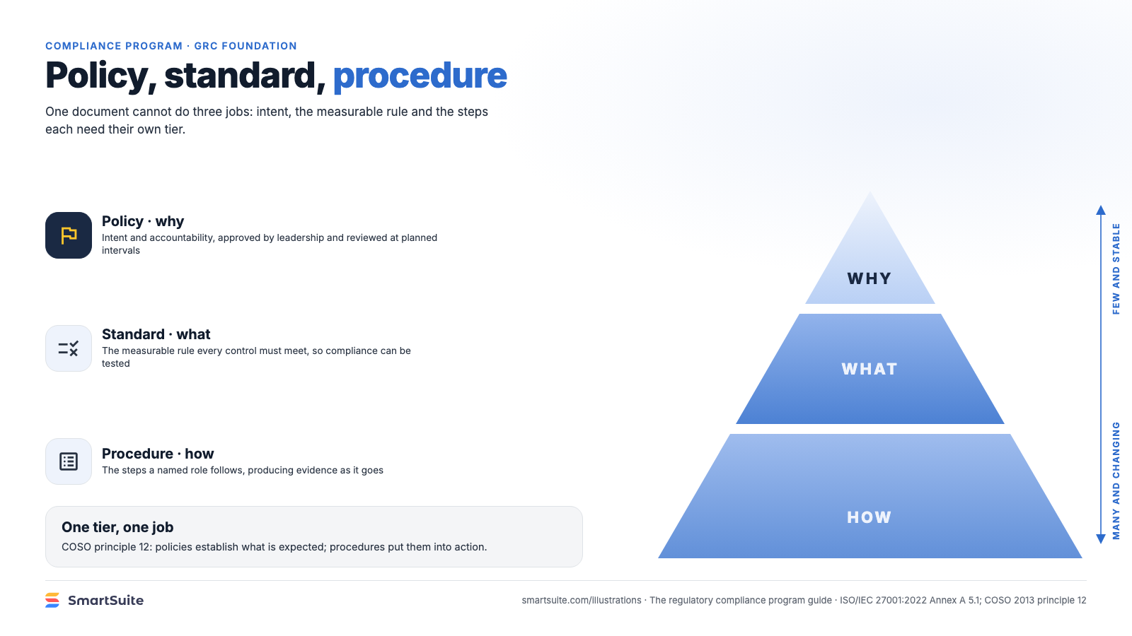
Notes:
Policy, standard, procedure
Why one document cannot do three jobs: policies set intent, standards set the measurable rule, procedures set the steps.
Source: ISO/IEC 27001:2022 Annex A 5.1; COSO 2013 principle 12 · From: The regulatory compliance program
Credit: Source: SmartSuite, smartsuite.com/illustrations

