Slide 1
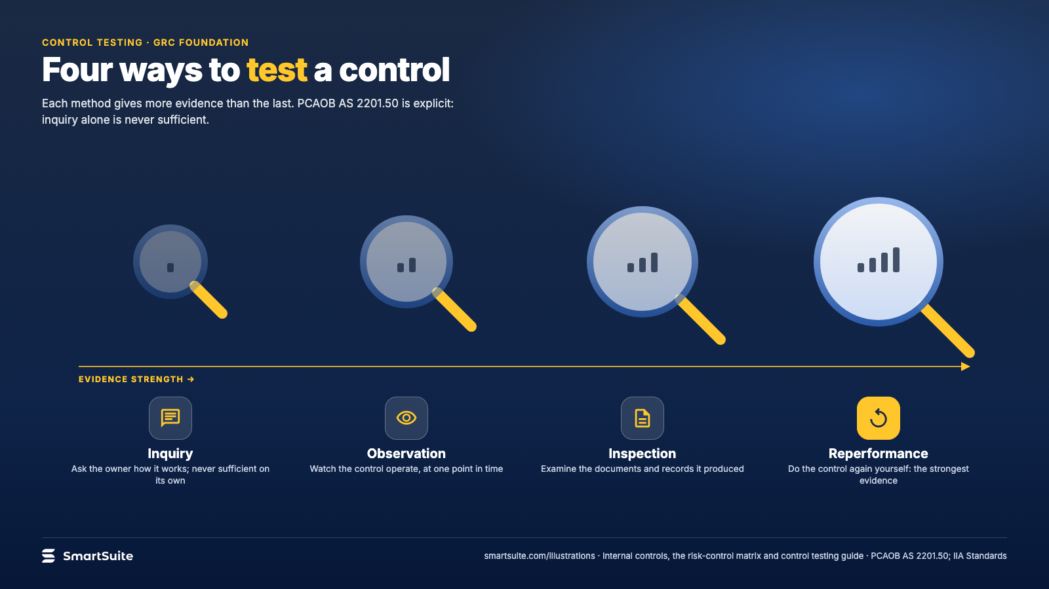
Notes:
Four ways to test a control
Inquiry, observation, inspection and reperformance, in rising order of the evidence they give.
Source: PCAOB AS 2201 .50; IIA Standards · From: Internal controls, the risk-control matrix and control testing
Credit: Source: SmartSuite, smartsuite.com/illustrations

Slide 2
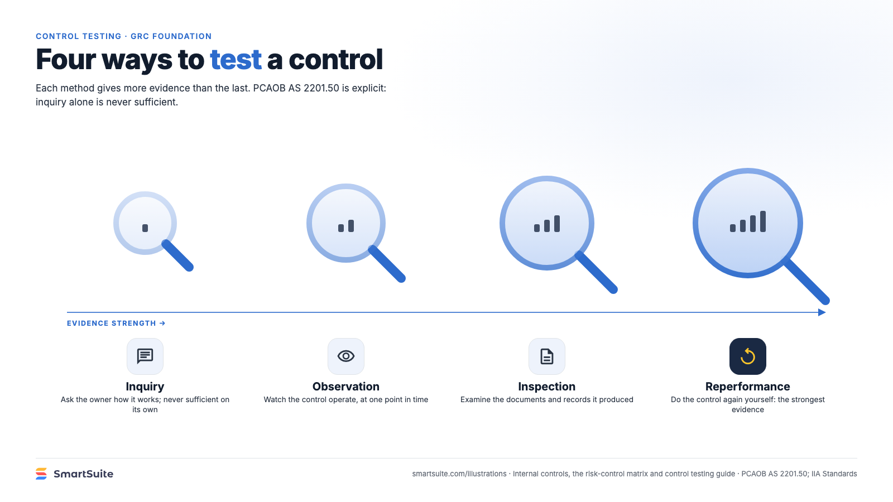
Notes:
Four ways to test a control
Inquiry, observation, inspection and reperformance, in rising order of the evidence they give.
Source: PCAOB AS 2201 .50; IIA Standards · From: Internal controls, the risk-control matrix and control testing
Credit: Source: SmartSuite, smartsuite.com/illustrations

