Slide 1
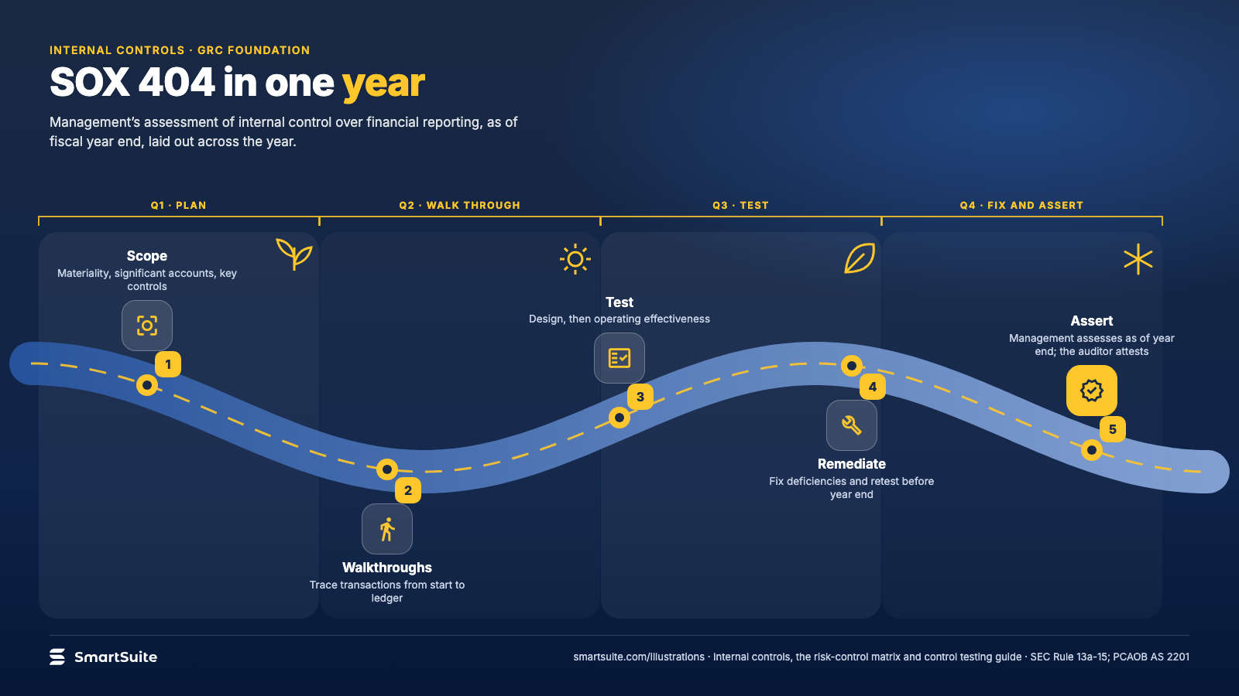
Notes:
SOX 404 in one year
Scoping, walkthroughs, testing, remediation and the management assertion, laid out on a fiscal year.
Source: SEC Rule 13a-15; PCAOB AS 2201 · From: Internal controls, the risk-control matrix and control testing
Credit: Source: SmartSuite, smartsuite.com/illustrations

Slide 2
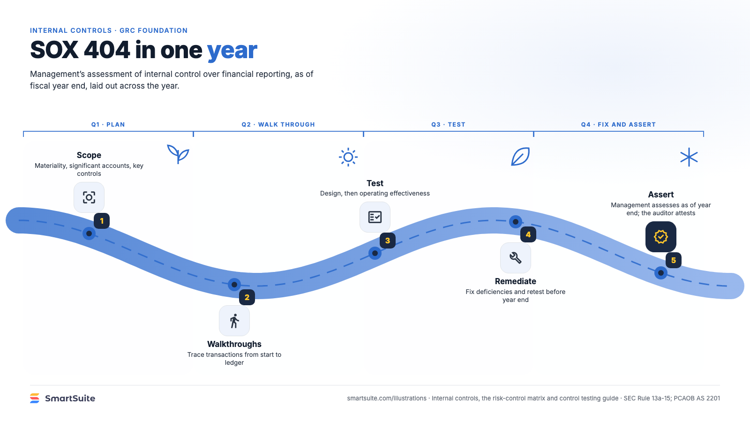
Notes:
SOX 404 in one year
Scoping, walkthroughs, testing, remediation and the management assertion, laid out on a fiscal year.
Source: SEC Rule 13a-15; PCAOB AS 2201 · From: Internal controls, the risk-control matrix and control testing
Credit: Source: SmartSuite, smartsuite.com/illustrations

