Slide 1
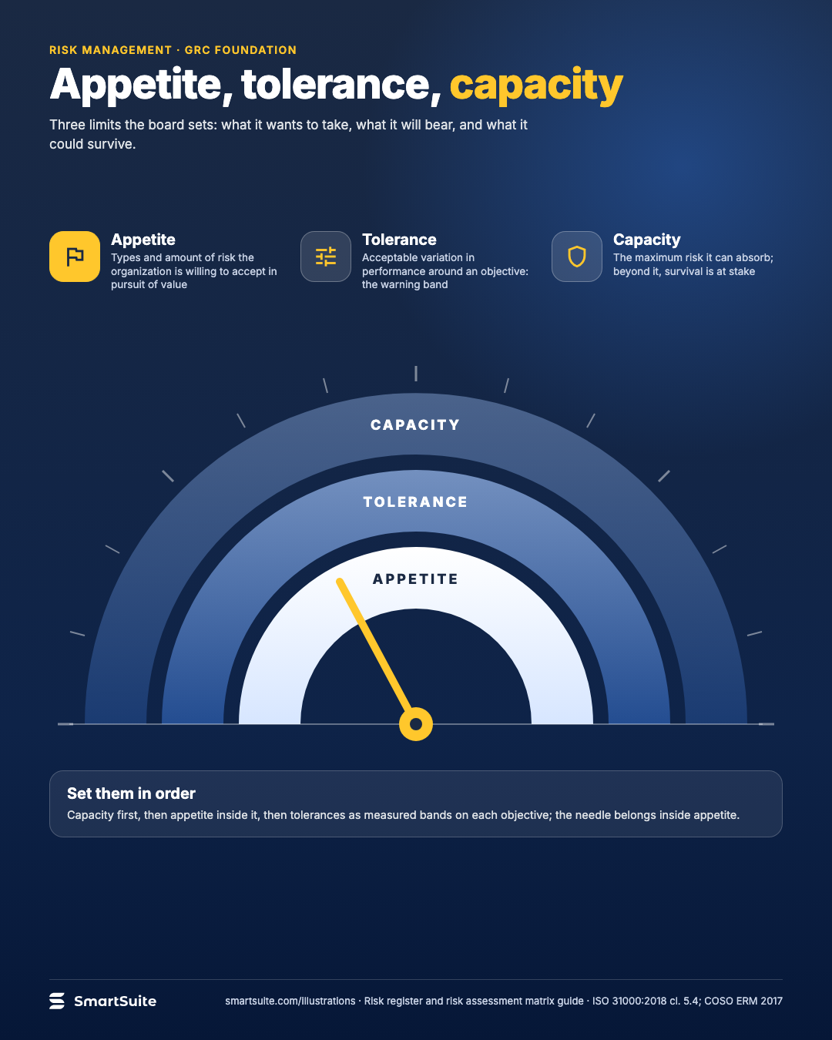
Appetite, tolerance, capacity
The three limits a board sets, from what it wants to take to what it could survive.
Source: ISO 31000:2018 cl. 5.4; COSO ERM 2017
Notes:
Appetite, tolerance, capacity
The three limits a board sets, from what it wants to take to what it could survive.
Source: ISO 31000:2018 cl. 5.4; COSO ERM 2017 · From: Risk register and risk assessment matrix
Credit: Source: SmartSuite, smartsuite.com/illustrations

Slide 2
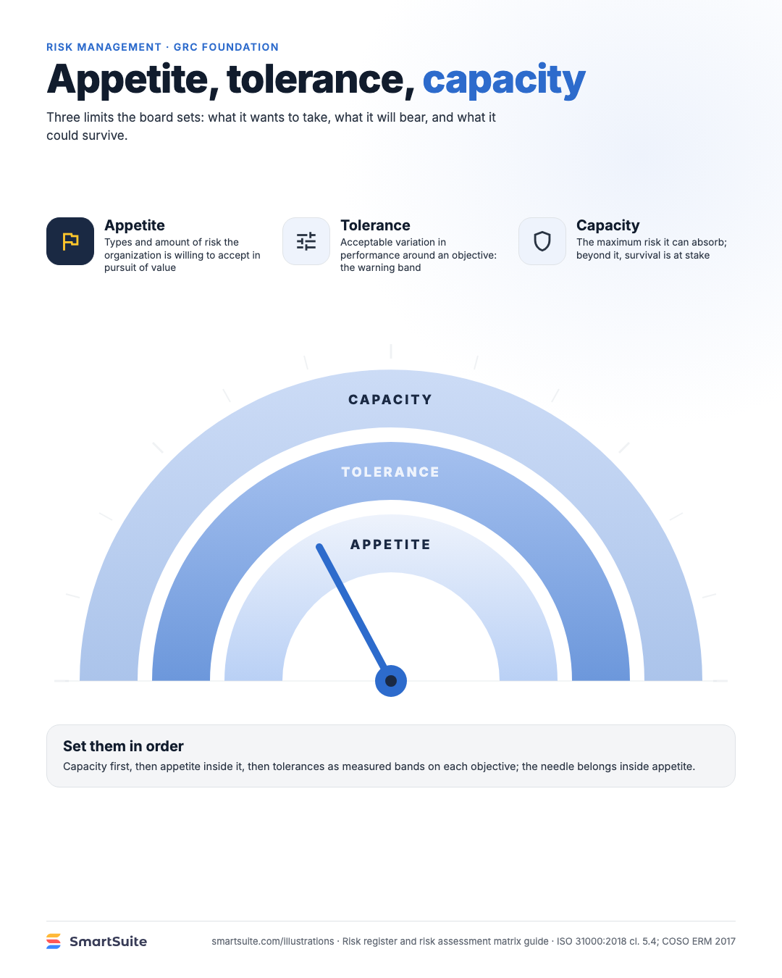
Appetite, tolerance, capacity
The three limits a board sets, from what it wants to take to what it could survive.
Source: ISO 31000:2018 cl. 5.4; COSO ERM 2017
Notes:
Appetite, tolerance, capacity
The three limits a board sets, from what it wants to take to what it could survive.
Source: ISO 31000:2018 cl. 5.4; COSO ERM 2017 · From: Risk register and risk assessment matrix
Credit: Source: SmartSuite, smartsuite.com/illustrations

