Slide 1
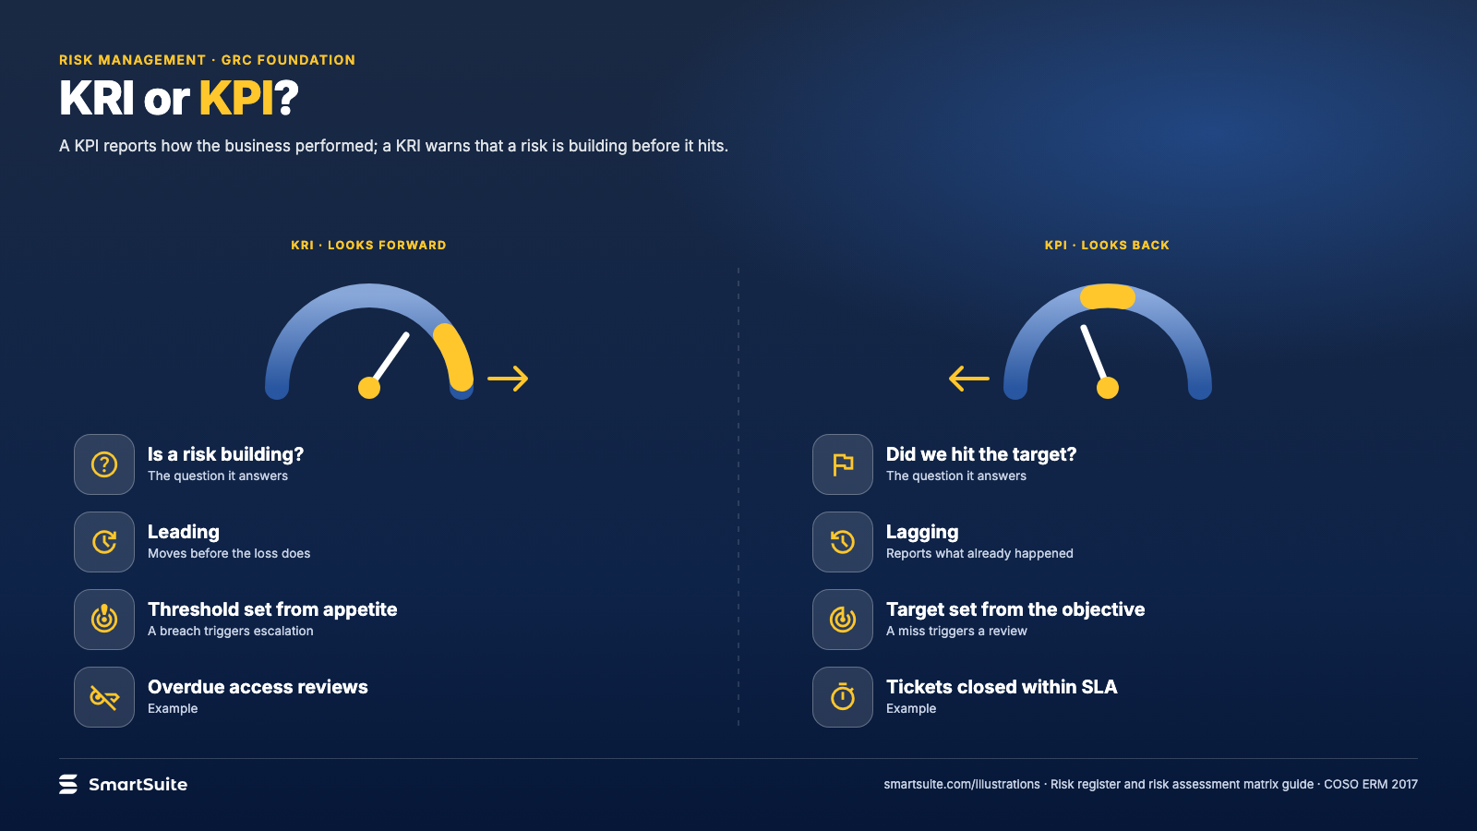
Notes:
KRI or KPI?
A KPI tells you how the business performed; a KRI warns you a risk is building. One table of differences.
Source: COSO ERM 2017 principle 14 · From: Risk register and risk assessment matrix
Credit: Source: SmartSuite, smartsuite.com/illustrations

Slide 2
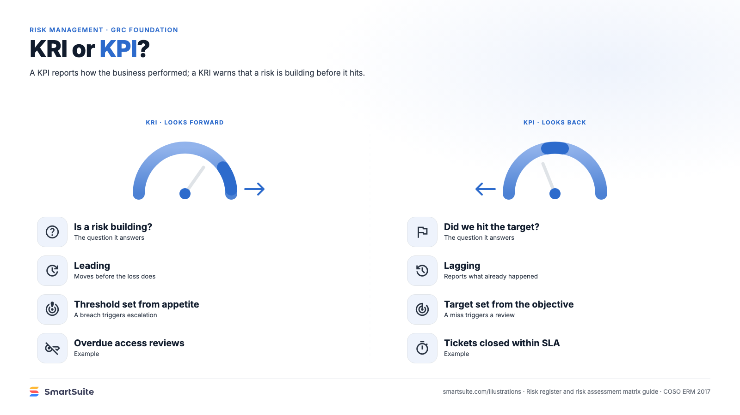
Notes:
KRI or KPI?
A KPI tells you how the business performed; a KRI warns you a risk is building. One table of differences.
Source: COSO ERM 2017 principle 14 · From: Risk register and risk assessment matrix
Credit: Source: SmartSuite, smartsuite.com/illustrations

