Slide 1
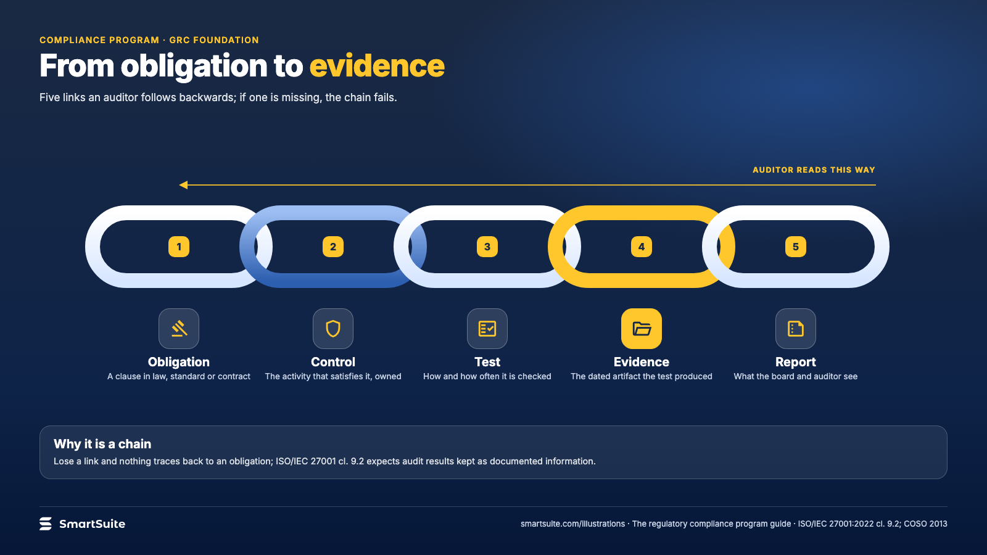
Notes:
From obligation to evidence
Obligation, control, test, evidence, report: the chain an auditor follows backwards.
Source: ISO/IEC 27001:2022 cl. 9.2; COSO 2013 · From: The regulatory compliance program
Credit: Source: SmartSuite, smartsuite.com/illustrations

Slide 2
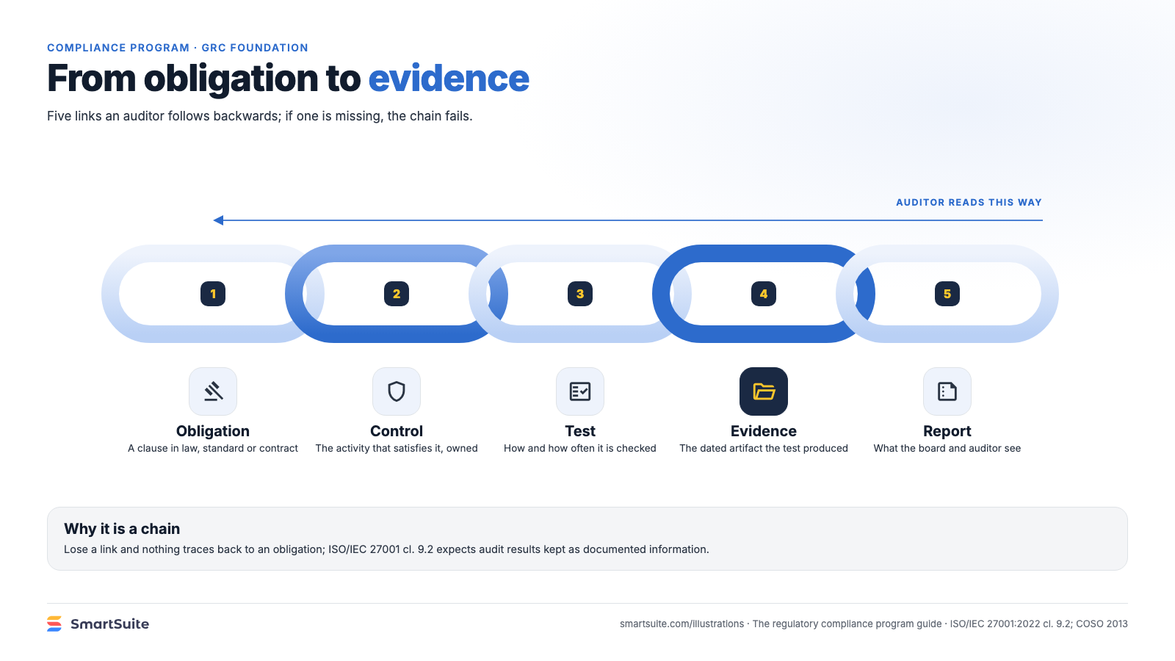
Notes:
From obligation to evidence
Obligation, control, test, evidence, report: the chain an auditor follows backwards.
Source: ISO/IEC 27001:2022 cl. 9.2; COSO 2013 · From: The regulatory compliance program
Credit: Source: SmartSuite, smartsuite.com/illustrations

