Slide 1
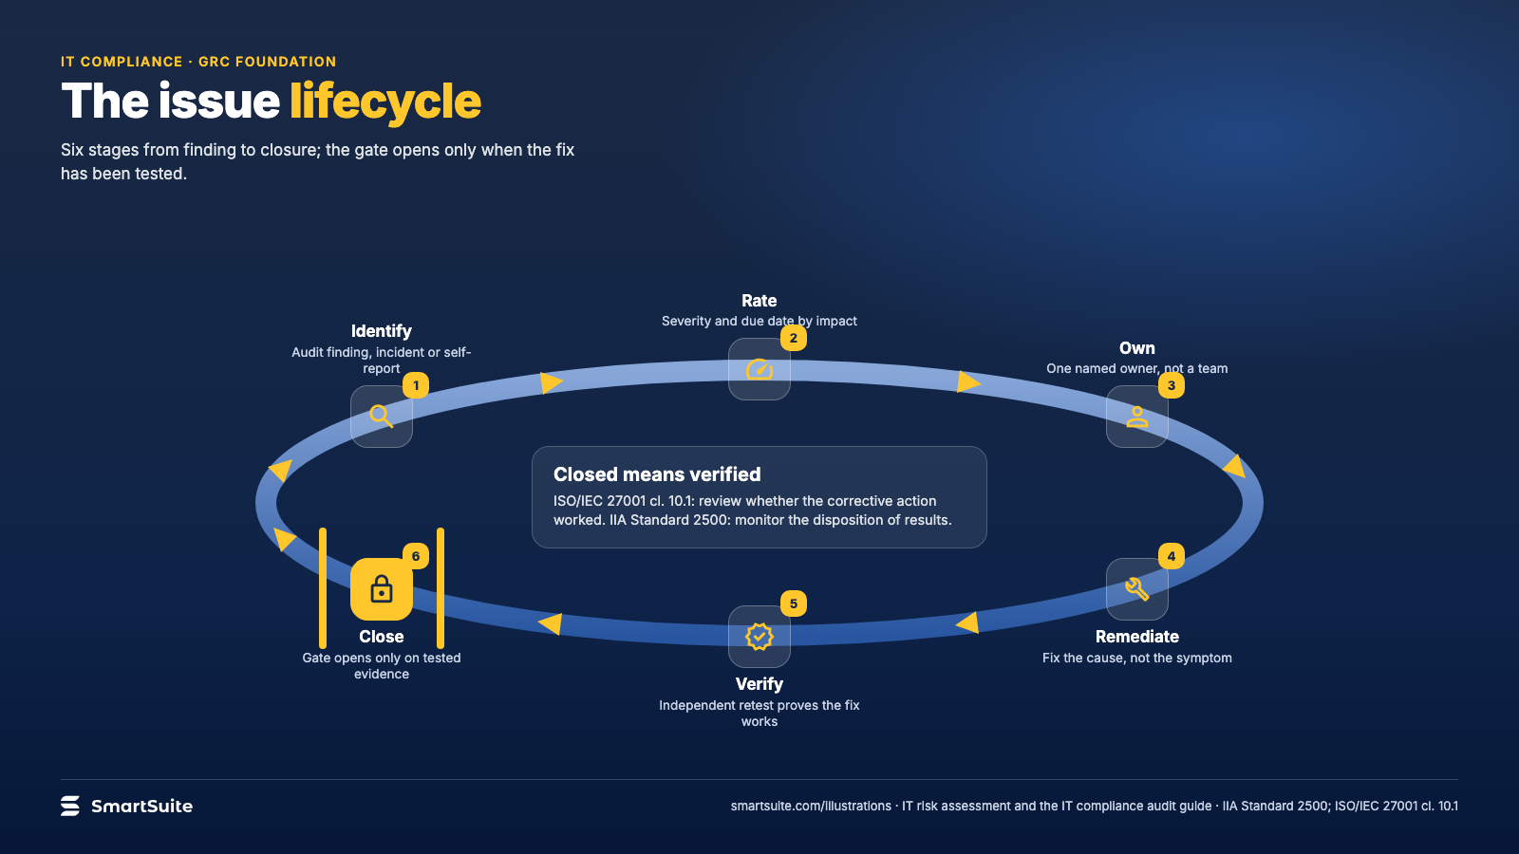
Notes:
The issue lifecycle
Identify, rate, own, remediate, verify, close: why an issue is only closed when the fix is tested.
Source: IIA Standard 2500; ISO/IEC 27001 cl. 10.1 · From: IT risk assessment and the IT compliance audit
Credit: Source: SmartSuite, smartsuite.com/illustrations

Slide 2
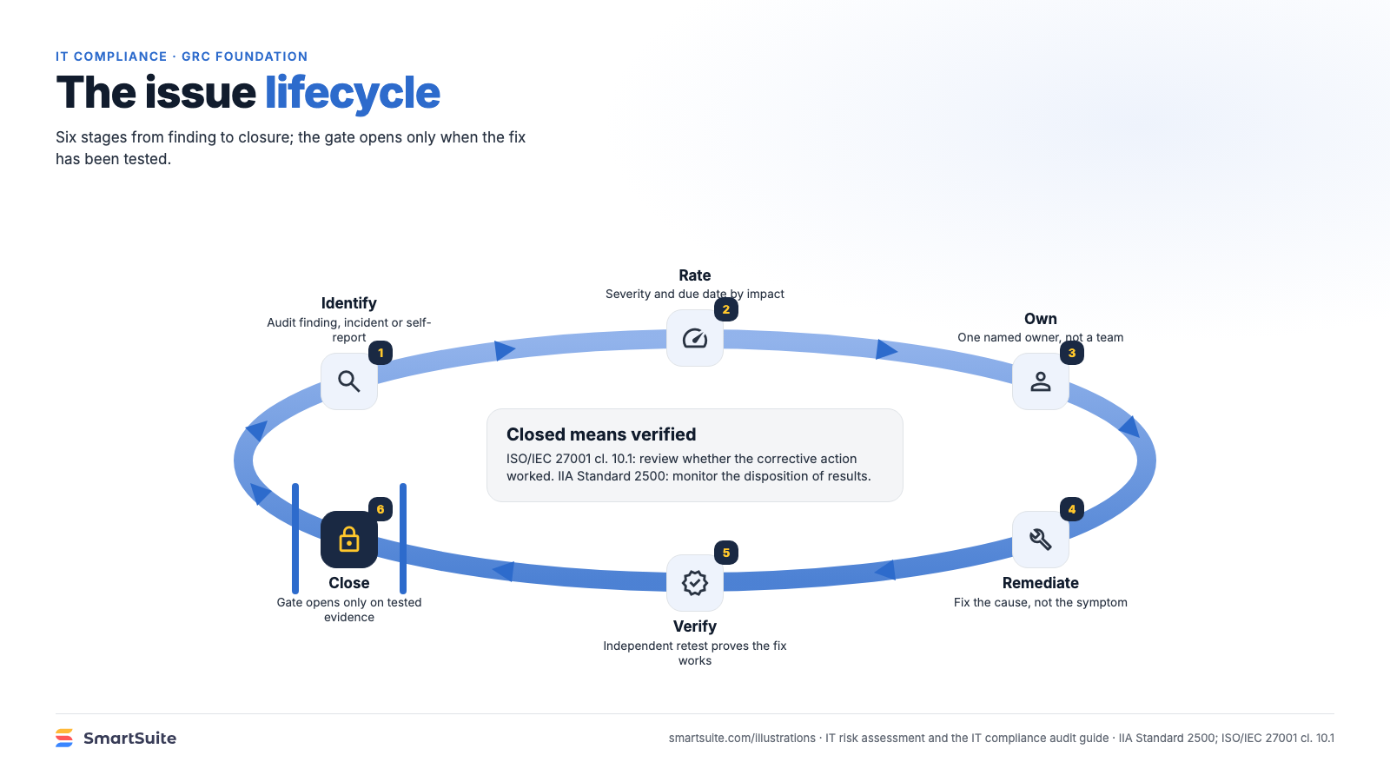
Notes:
The issue lifecycle
Identify, rate, own, remediate, verify, close: why an issue is only closed when the fix is tested.
Source: IIA Standard 2500; ISO/IEC 27001 cl. 10.1 · From: IT risk assessment and the IT compliance audit
Credit: Source: SmartSuite, smartsuite.com/illustrations

