Slide 1
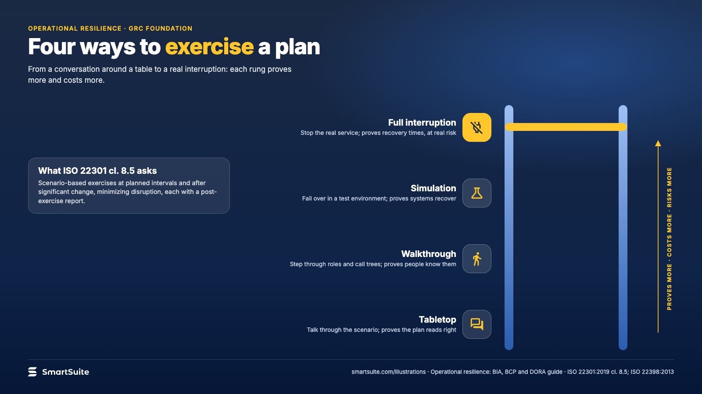
Notes:
Four ways to exercise a plan
Tabletop, walkthrough, simulation and full interruption, what each proves and what it costs.
Source: ISO 22301:2019 cl. 8.5; ISO 22398:2013 · From: Operational resilience: BIA, BCP and DORA
Credit: Source: SmartSuite, smartsuite.com/illustrations

Slide 2
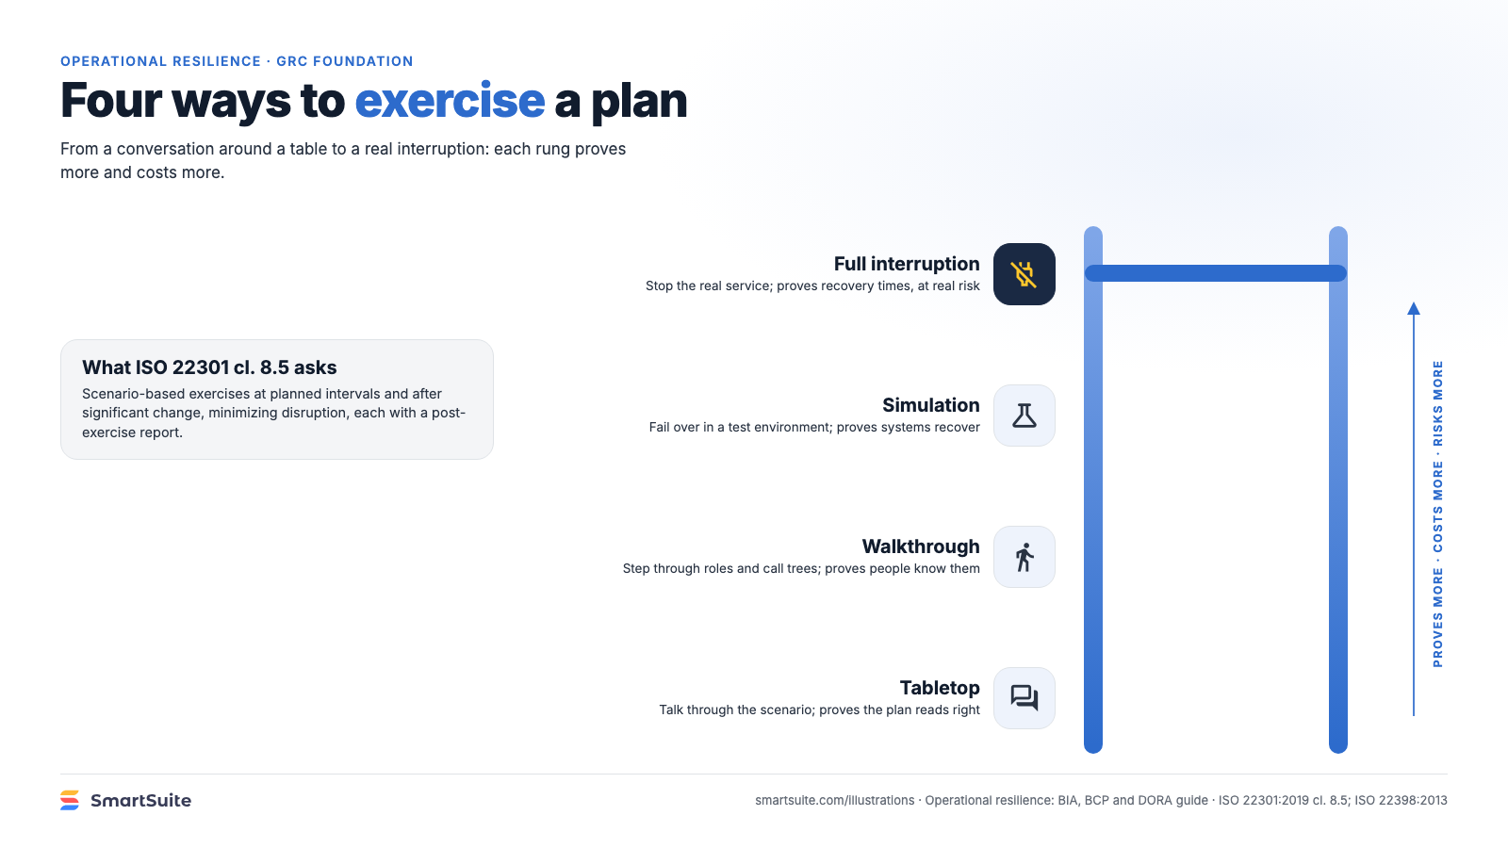
Notes:
Four ways to exercise a plan
Tabletop, walkthrough, simulation and full interruption, what each proves and what it costs.
Source: ISO 22301:2019 cl. 8.5; ISO 22398:2013 · From: Operational resilience: BIA, BCP and DORA
Credit: Source: SmartSuite, smartsuite.com/illustrations

