Slide 1
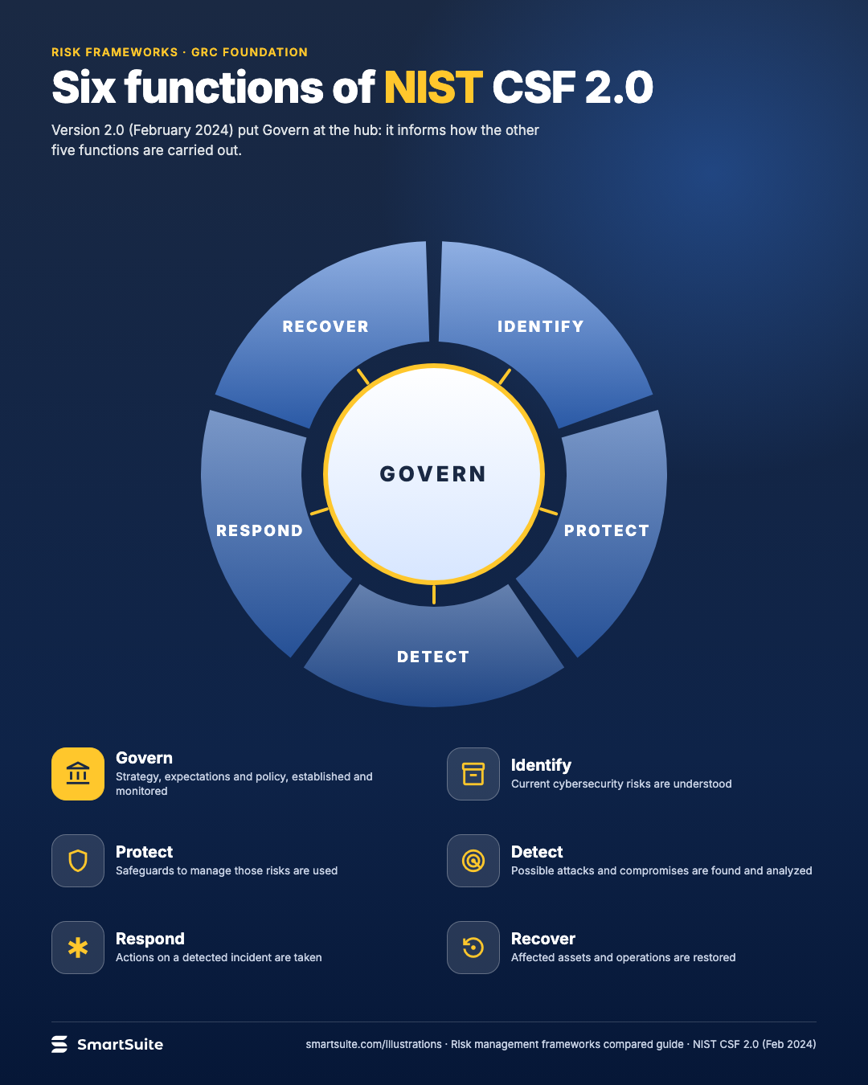
Six functions of NIST CSF 2.0
Govern, identify, protect, detect, respond, recover, and why 2.0 put governance at the center.
Source: NIST CSF 2.0 (Feb 2024)
Notes:
Six functions of NIST CSF 2.0
Govern, identify, protect, detect, respond, recover, and why 2.0 put governance at the center.
Source: NIST CSF 2.0 (Feb 2024) · From: Risk management frameworks compared
Credit: Source: SmartSuite, smartsuite.com/illustrations

Slide 2
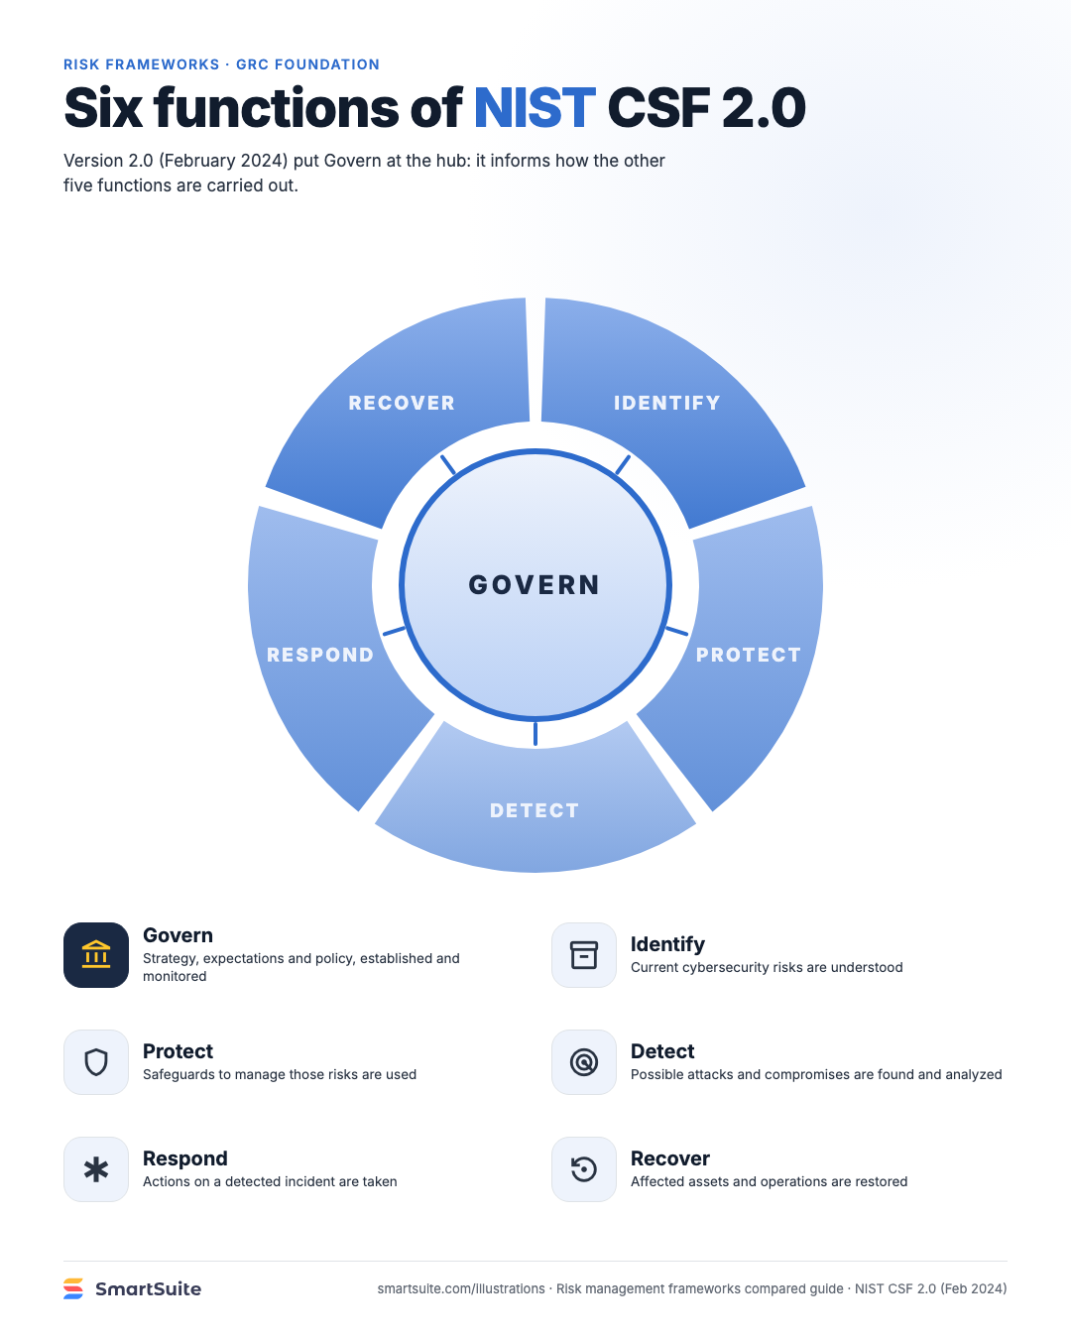
Six functions of NIST CSF 2.0
Govern, identify, protect, detect, respond, recover, and why 2.0 put governance at the center.
Source: NIST CSF 2.0 (Feb 2024)
Notes:
Six functions of NIST CSF 2.0
Govern, identify, protect, detect, respond, recover, and why 2.0 put governance at the center.
Source: NIST CSF 2.0 (Feb 2024) · From: Risk management frameworks compared
Credit: Source: SmartSuite, smartsuite.com/illustrations

