Slide 1
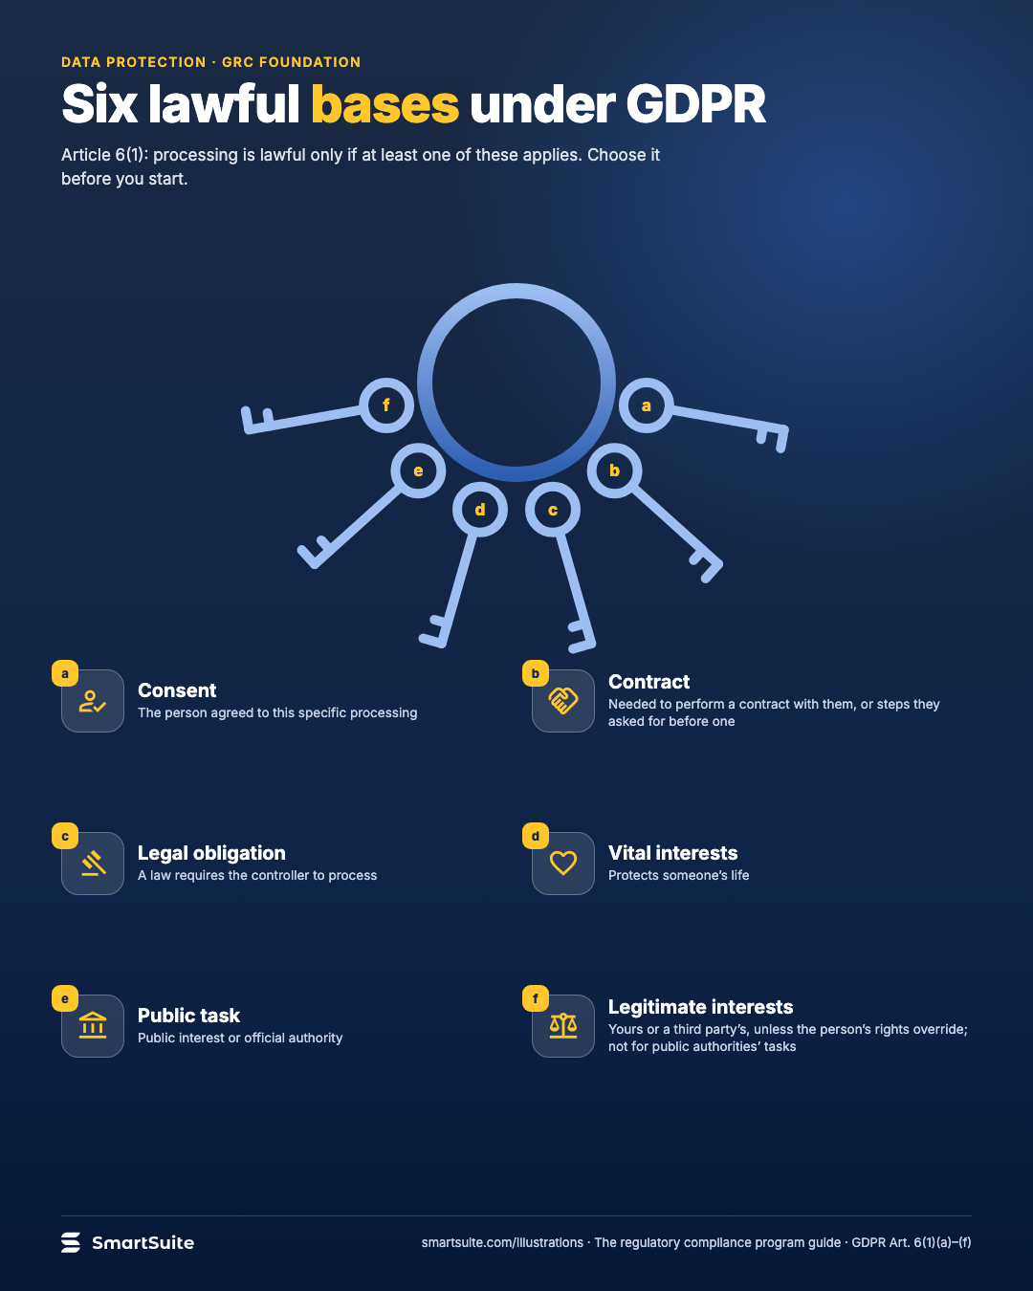
Six lawful bases under GDPR
Consent, contract, legal obligation, vital interests, public task, legitimate interests: one must fit before you process.
Source: GDPR Art. 6(1)(a)–(f)
Notes:
Six lawful bases under GDPR
Consent, contract, legal obligation, vital interests, public task, legitimate interests: one must fit before you process.
Source: GDPR Art. 6(1)(a)–(f) · From: The regulatory compliance program
Credit: Source: SmartSuite, smartsuite.com/illustrations

Slide 2
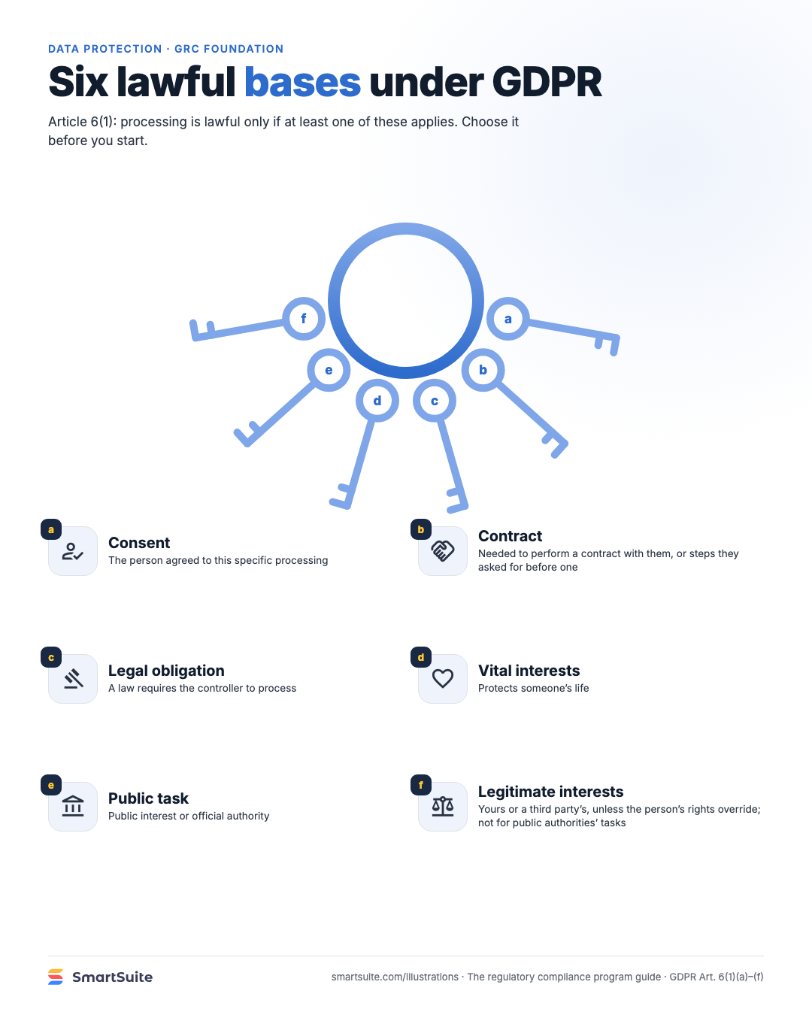
Six lawful bases under GDPR
Consent, contract, legal obligation, vital interests, public task, legitimate interests: one must fit before you process.
Source: GDPR Art. 6(1)(a)–(f)
Notes:
Six lawful bases under GDPR
Consent, contract, legal obligation, vital interests, public task, legitimate interests: one must fit before you process.
Source: GDPR Art. 6(1)(a)–(f) · From: The regulatory compliance program
Credit: Source: SmartSuite, smartsuite.com/illustrations

