Slide 1
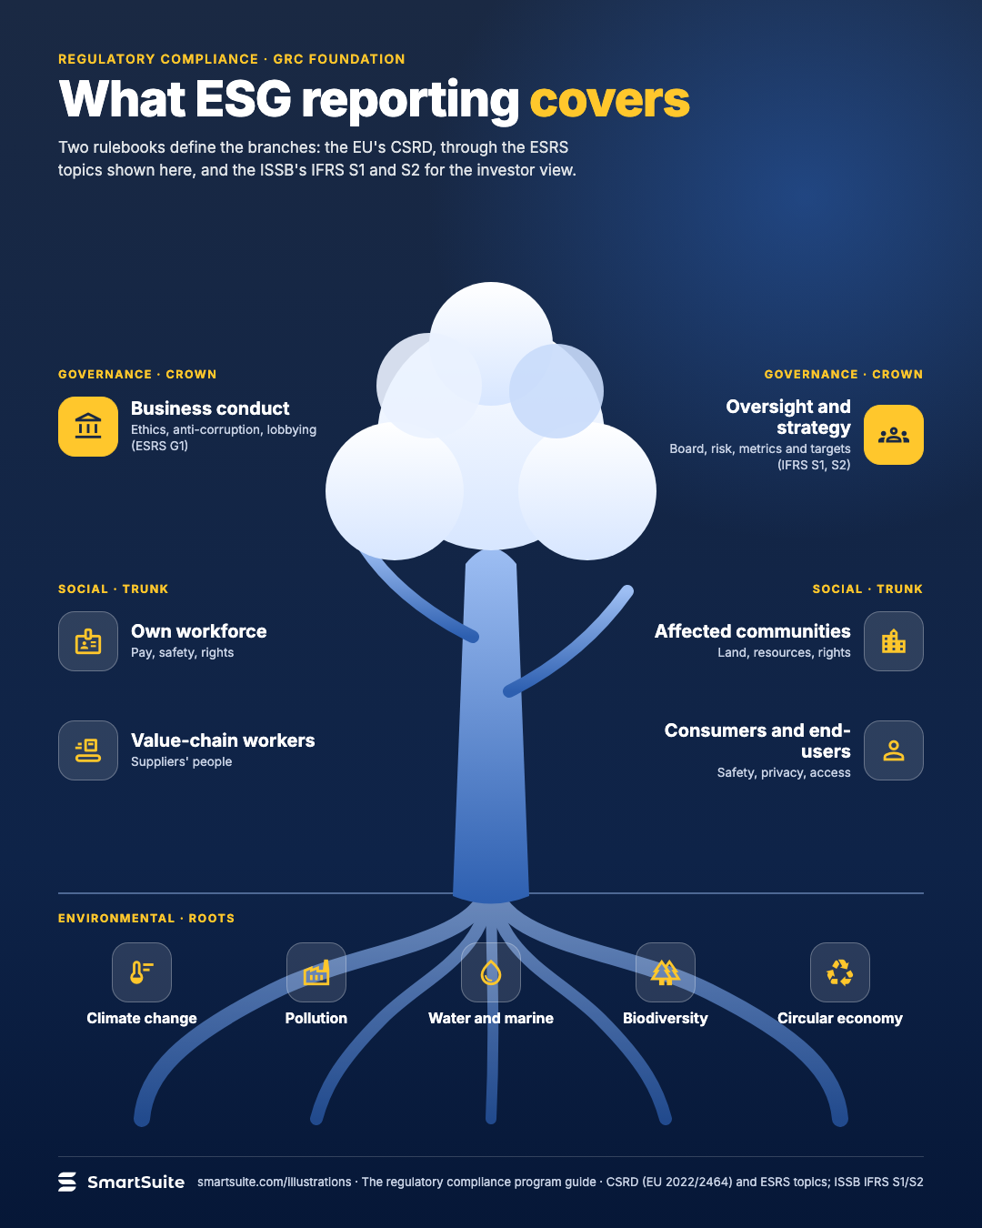
What ESG reporting covers
Environmental, social and governance disclosures, and the frameworks that define each branch.
Source: CSRD (EU 2022/2464); ISSB IFRS S1/S2
Notes:
What ESG reporting covers
Environmental, social and governance disclosures, and the frameworks that define each branch.
Source: CSRD (EU 2022/2464); ISSB IFRS S1/S2 · From: The regulatory compliance program
Credit: Source: SmartSuite, smartsuite.com/illustrations

Slide 2
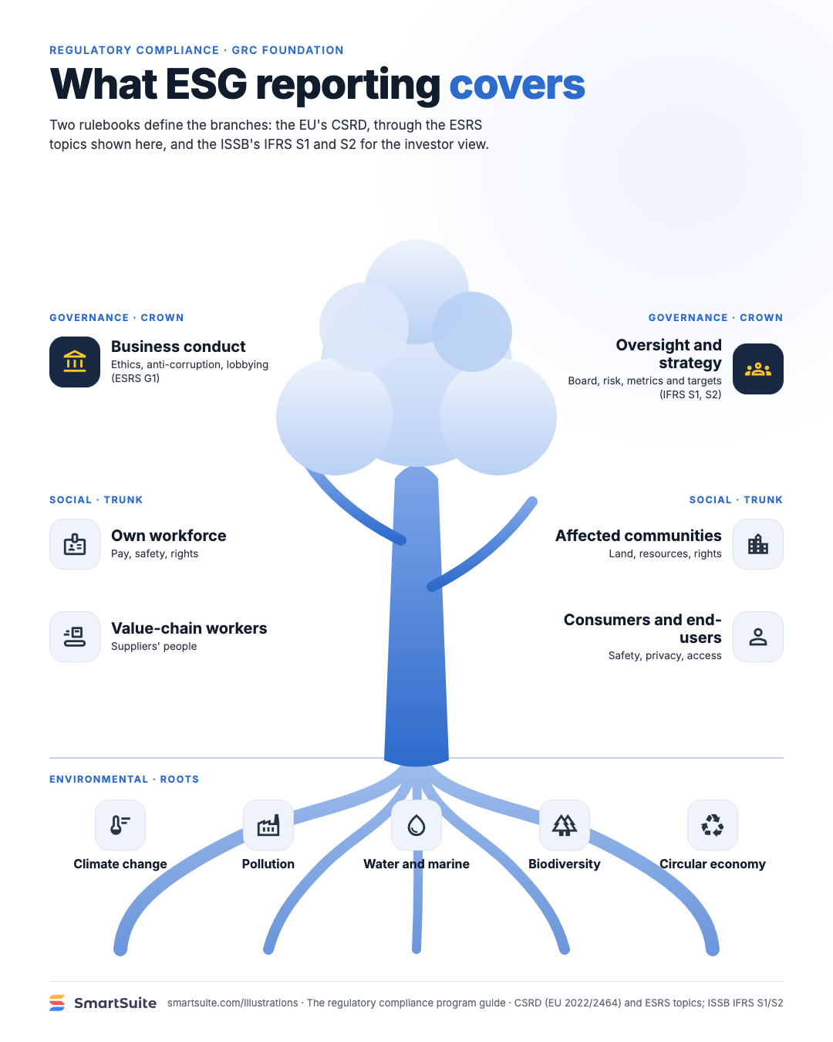
What ESG reporting covers
Environmental, social and governance disclosures, and the frameworks that define each branch.
Source: CSRD (EU 2022/2464); ISSB IFRS S1/S2
Notes:
What ESG reporting covers
Environmental, social and governance disclosures, and the frameworks that define each branch.
Source: CSRD (EU 2022/2464); ISSB IFRS S1/S2 · From: The regulatory compliance program
Credit: Source: SmartSuite, smartsuite.com/illustrations

