Slide 1
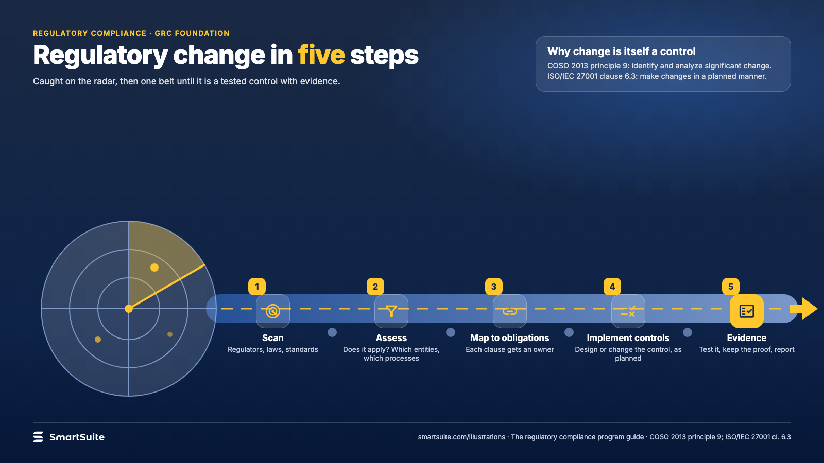
Notes:
Regulatory change in five steps
Scan, assess, map to obligations, implement controls, evidence: how a new rule becomes a tested control.
Source: COSO 2013 principle 9; ISO/IEC 27001 cl. 6.3 · From: The regulatory compliance program
Credit: Source: SmartSuite, smartsuite.com/illustrations

Slide 2
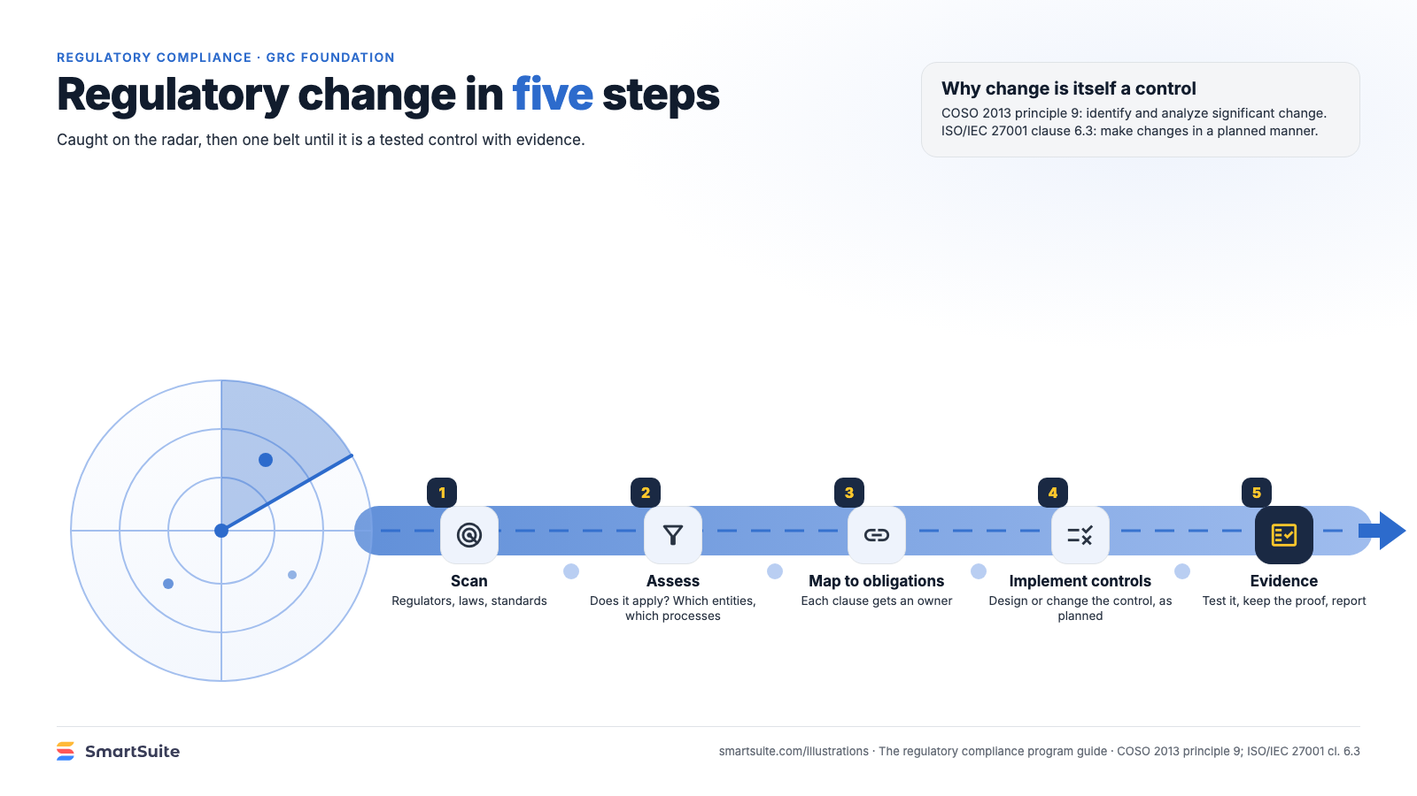
Notes:
Regulatory change in five steps
Scan, assess, map to obligations, implement controls, evidence: how a new rule becomes a tested control.
Source: COSO 2013 principle 9; ISO/IEC 27001 cl. 6.3 · From: The regulatory compliance program
Credit: Source: SmartSuite, smartsuite.com/illustrations

