Slide 1
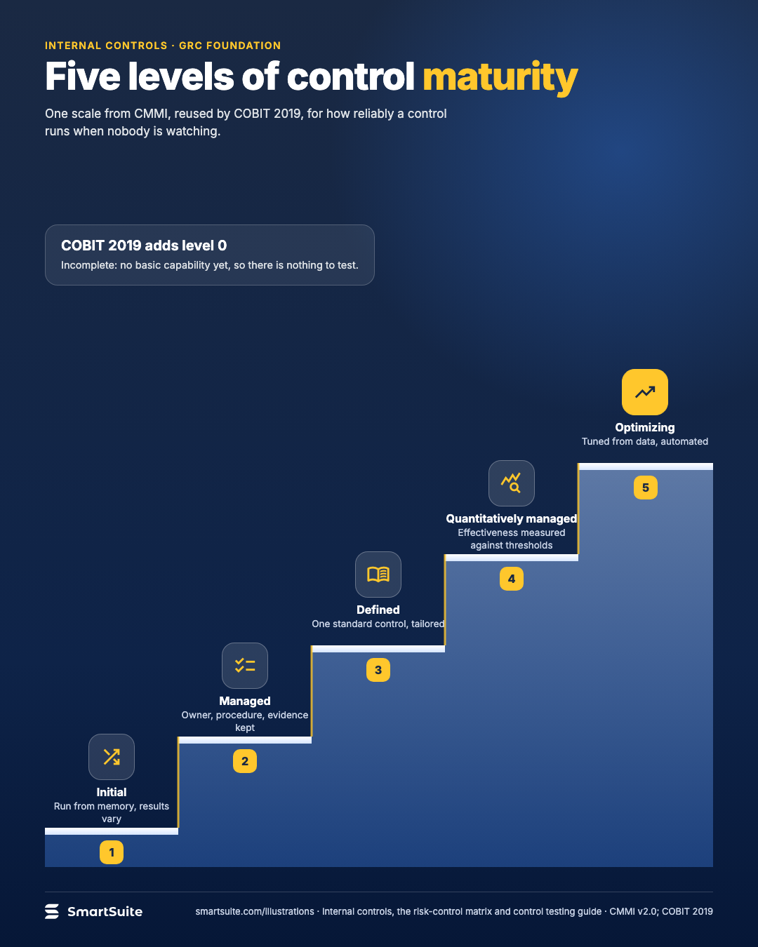
Five levels of control maturity
Initial, managed, defined, quantitatively managed, optimizing, with what a control looks like at each step.
Source: CMMI v2.0 maturity levels; COBIT 2019 CMMI-based scale
Notes:
Five levels of control maturity
Initial, managed, defined, quantitatively managed, optimizing, with what a control looks like at each step.
Source: CMMI v2.0 maturity levels; COBIT 2019 CMMI-based scale · From: Internal controls, the risk-control matrix and control testing
Credit: Source: SmartSuite, smartsuite.com/illustrations

Slide 2
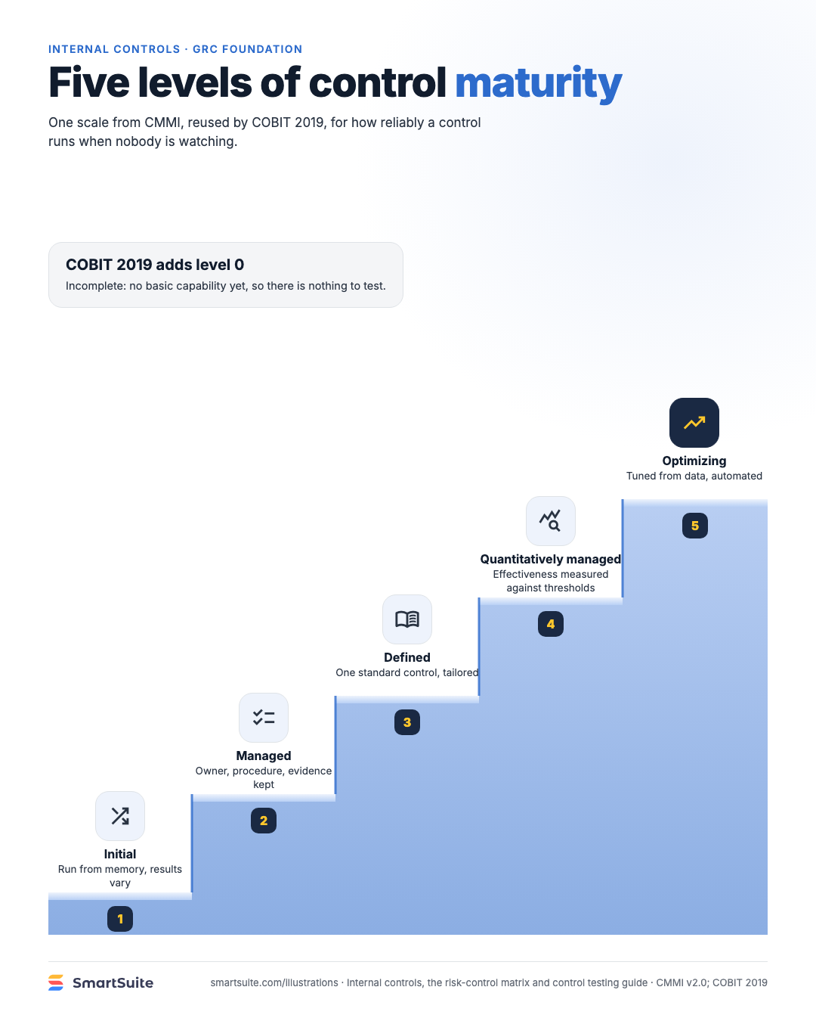
Five levels of control maturity
Initial, managed, defined, quantitatively managed, optimizing, with what a control looks like at each step.
Source: CMMI v2.0 maturity levels; COBIT 2019 CMMI-based scale
Notes:
Five levels of control maturity
Initial, managed, defined, quantitatively managed, optimizing, with what a control looks like at each step.
Source: CMMI v2.0 maturity levels; COBIT 2019 CMMI-based scale · From: Internal controls, the risk-control matrix and control testing
Credit: Source: SmartSuite, smartsuite.com/illustrations

