Slide 1
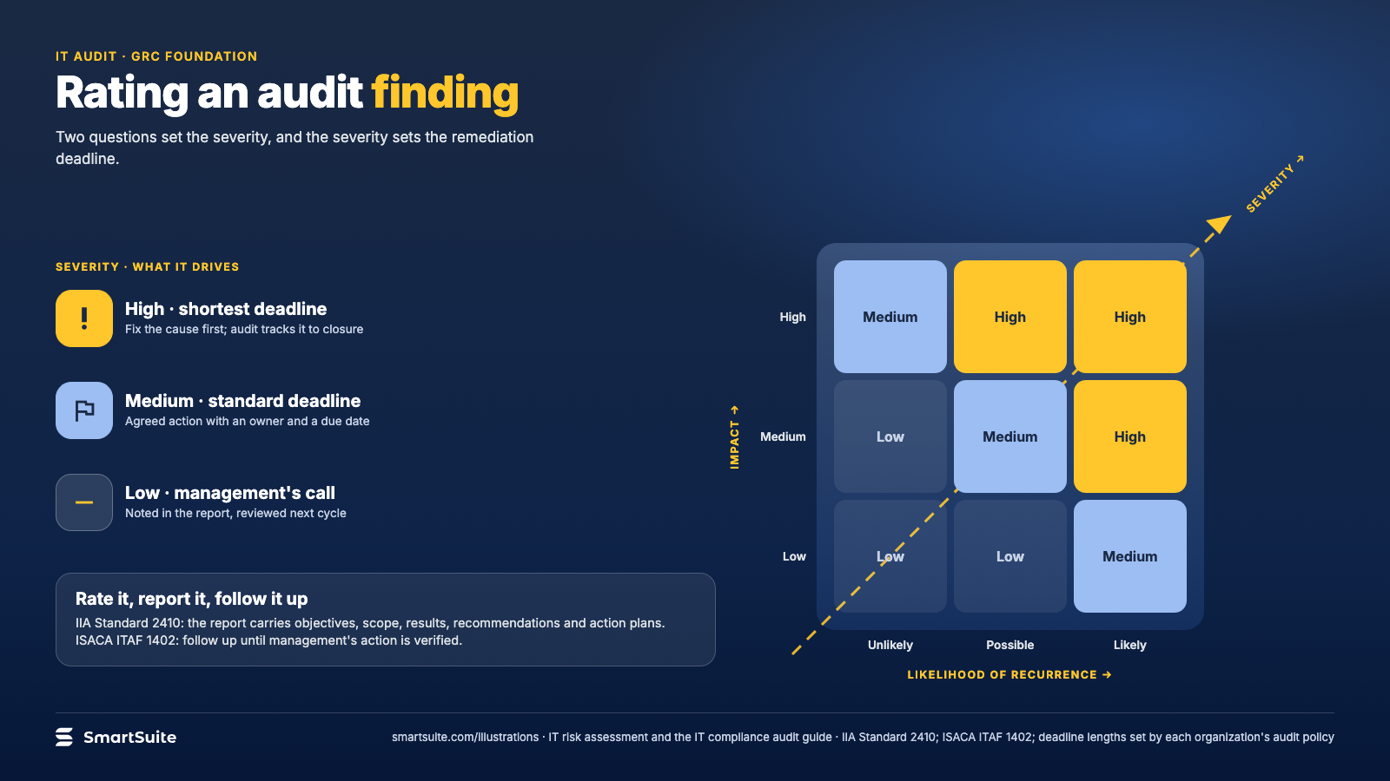
Notes:
Rating an audit finding
Impact against likelihood of recurrence gives the severity that sets the remediation deadline.
Source: IIA Standard 2410; ISACA ITAF 1402 · From: IT risk assessment and the IT compliance audit
Credit: Source: SmartSuite, smartsuite.com/illustrations

Slide 2
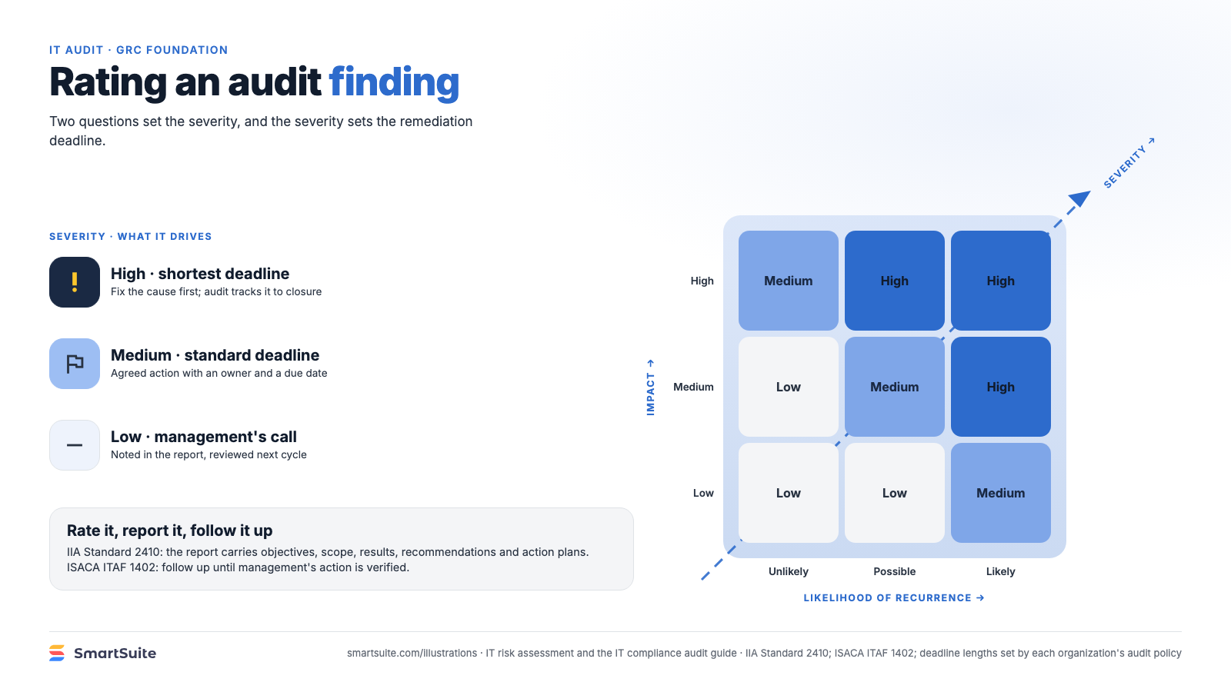
Notes:
Rating an audit finding
Impact against likelihood of recurrence gives the severity that sets the remediation deadline.
Source: IIA Standard 2410; ISACA ITAF 1402 · From: IT risk assessment and the IT compliance audit
Credit: Source: SmartSuite, smartsuite.com/illustrations

