Slide 1
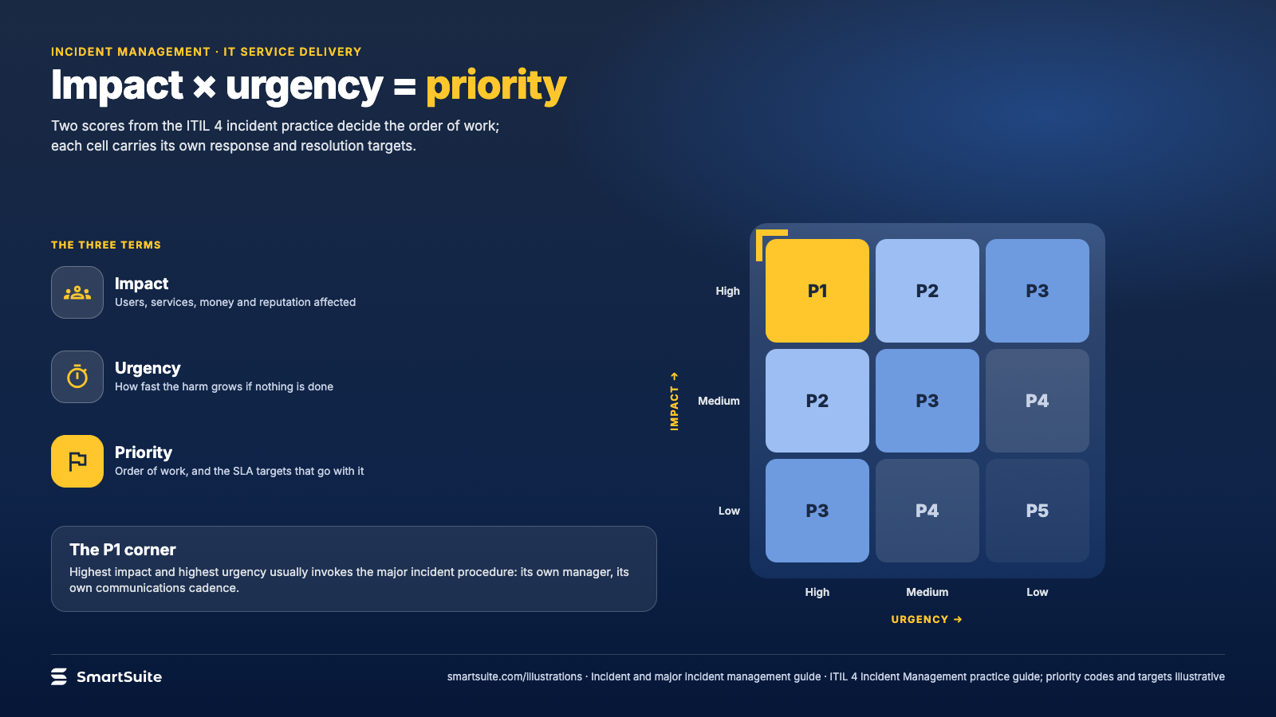
Notes:
Impact × urgency = priority
How impact and urgency combine into a priority, and the response targets that hang off each cell.
Source: ITIL 4 Incident Management practice guide · From: Incident and major incident management
Credit: Source: SmartSuite, smartsuite.com/illustrations

Slide 2
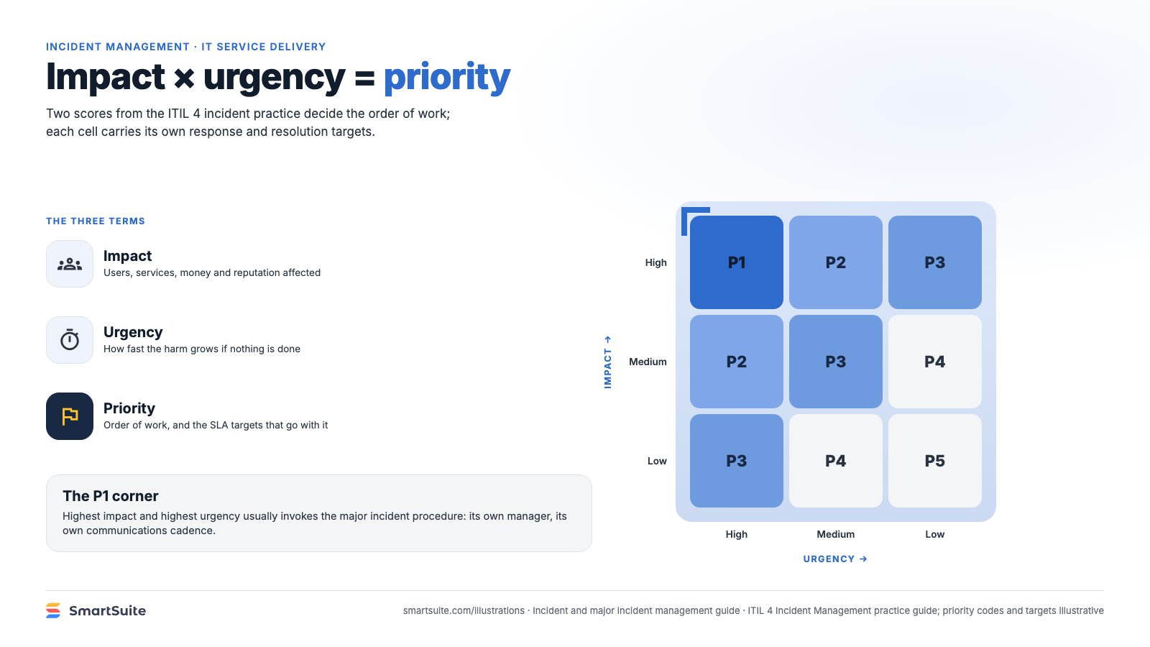
Notes:
Impact × urgency = priority
How impact and urgency combine into a priority, and the response targets that hang off each cell.
Source: ITIL 4 Incident Management practice guide · From: Incident and major incident management
Credit: Source: SmartSuite, smartsuite.com/illustrations

