Slide 1
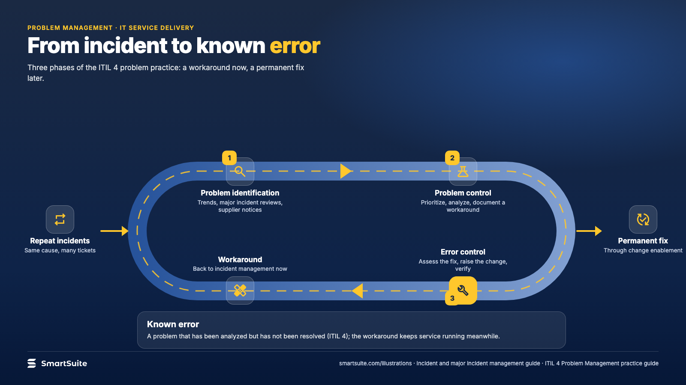
Notes:
From incident to known error
Problem identification, control and error control: the three phases that turn repeat incidents into a permanent fix.
Source: ITIL 4 Problem Management practice guide · From: Incident and major incident management
Credit: Source: SmartSuite, smartsuite.com/illustrations

Slide 2
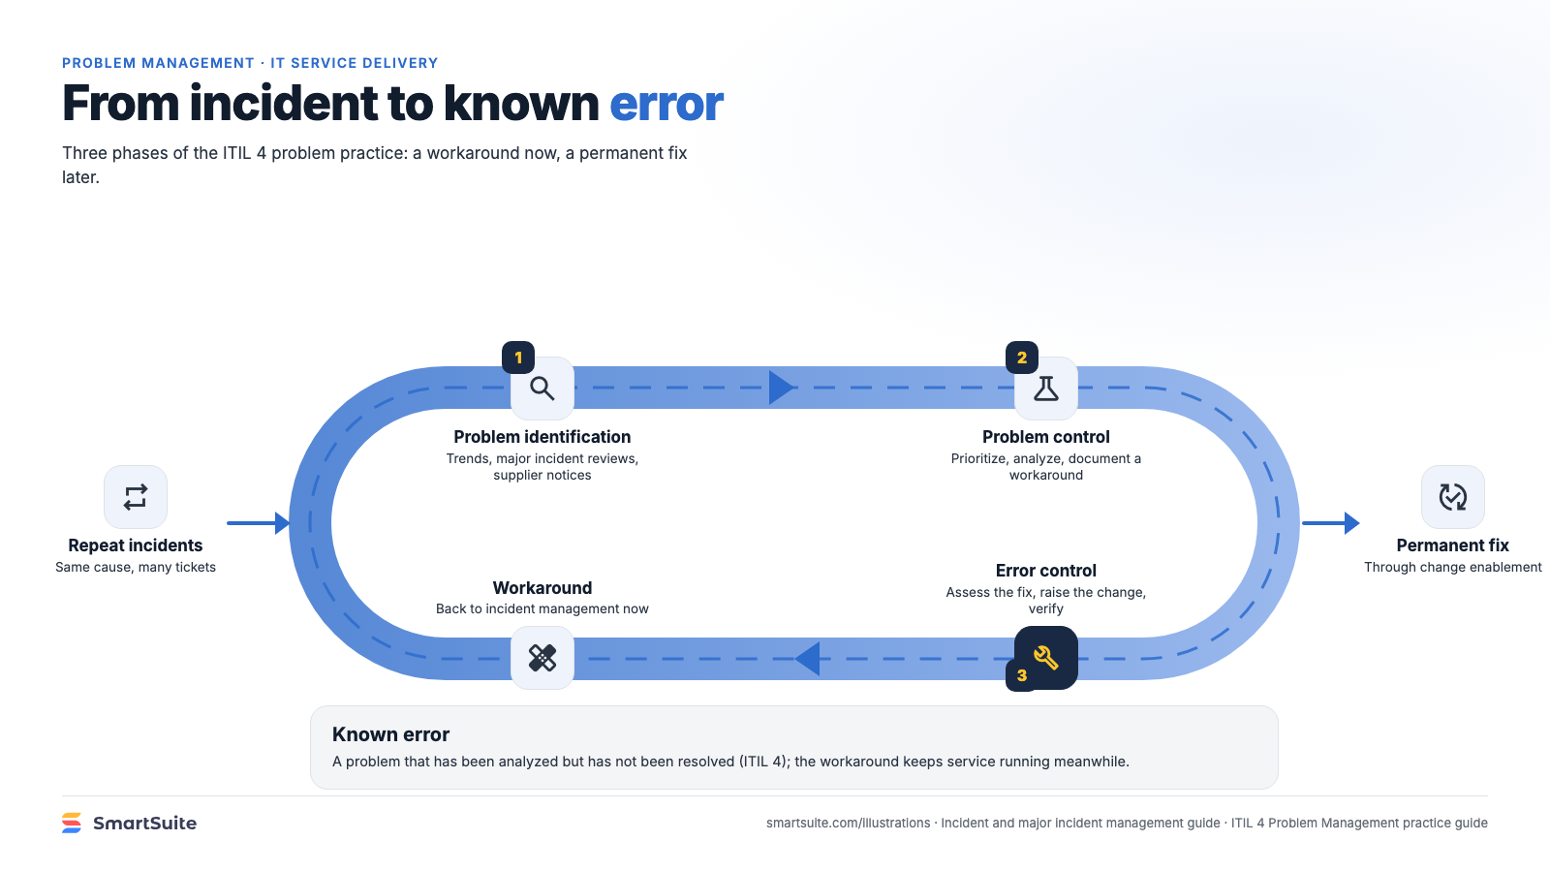
Notes:
From incident to known error
Problem identification, control and error control: the three phases that turn repeat incidents into a permanent fix.
Source: ITIL 4 Problem Management practice guide · From: Incident and major incident management
Credit: Source: SmartSuite, smartsuite.com/illustrations

