Slide 1
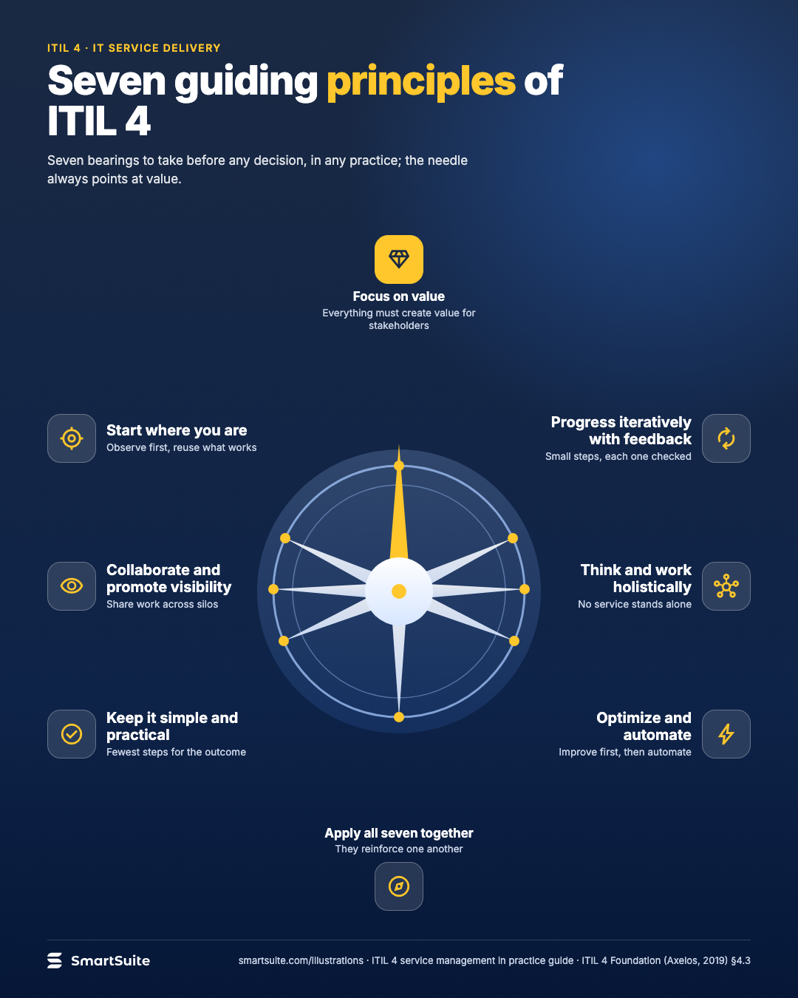
Seven guiding principles of ITIL 4
Focus on value, start where you are, progress iteratively, collaborate, think holistically, keep it simple, optimize and automate.
Source: ITIL 4 Foundation (Axelos, 2019) §4.3
Notes:
Seven guiding principles of ITIL 4
Focus on value, start where you are, progress iteratively, collaborate, think holistically, keep it simple, optimize and automate.
Source: ITIL 4 Foundation (Axelos, 2019) §4.3 · From: ITIL 4 service management in practice
Credit: Source: SmartSuite, smartsuite.com/illustrations

Slide 2
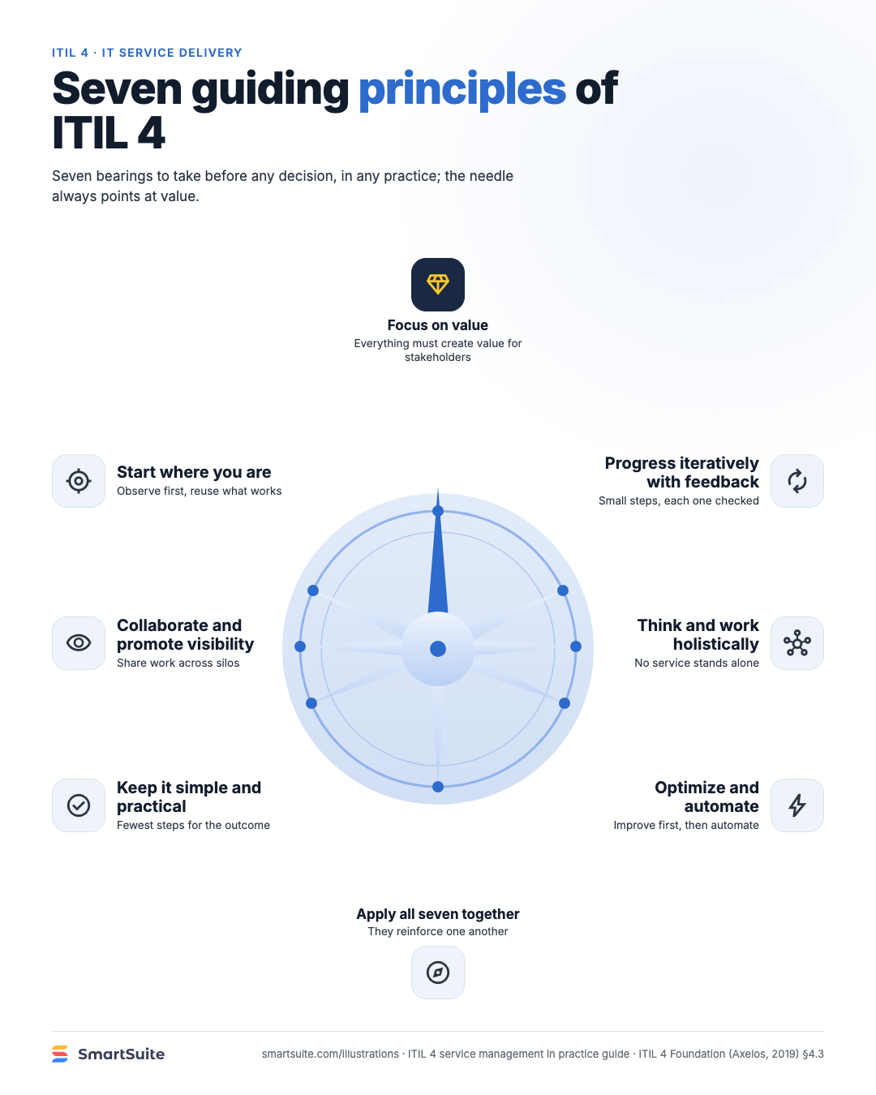
Seven guiding principles of ITIL 4
Focus on value, start where you are, progress iteratively, collaborate, think holistically, keep it simple, optimize and automate.
Source: ITIL 4 Foundation (Axelos, 2019) §4.3
Notes:
Seven guiding principles of ITIL 4
Focus on value, start where you are, progress iteratively, collaborate, think holistically, keep it simple, optimize and automate.
Source: ITIL 4 Foundation (Axelos, 2019) §4.3 · From: ITIL 4 service management in practice
Credit: Source: SmartSuite, smartsuite.com/illustrations

