Slide 1
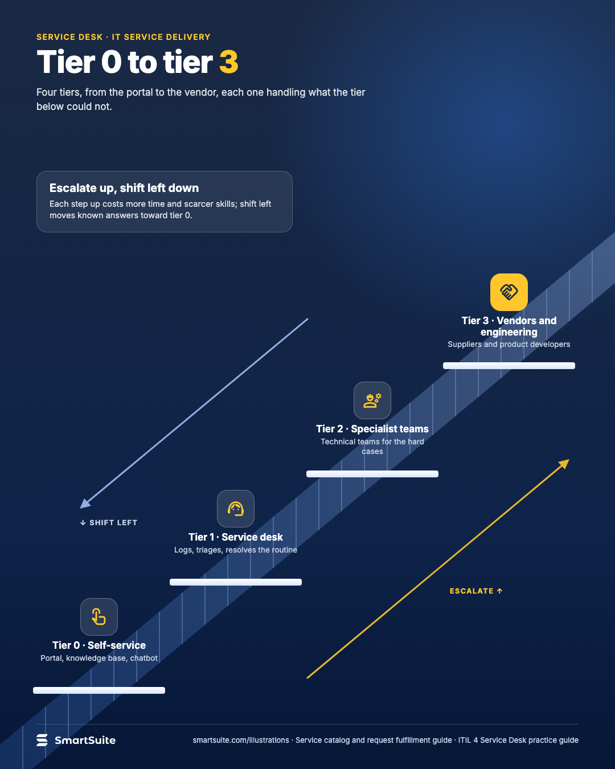
Tier 0 to tier 3
Self-service, service desk, specialist teams and vendors: who handles what, and the cost of each step up.
Source: ITIL 4 Service Desk practice guide
Notes:
Tier 0 to tier 3
Self-service, service desk, specialist teams and vendors: who handles what, and the cost of each step up.
Source: ITIL 4 Service Desk practice guide · From: Service catalog and request fulfillment
Credit: Source: SmartSuite, smartsuite.com/illustrations

Slide 2
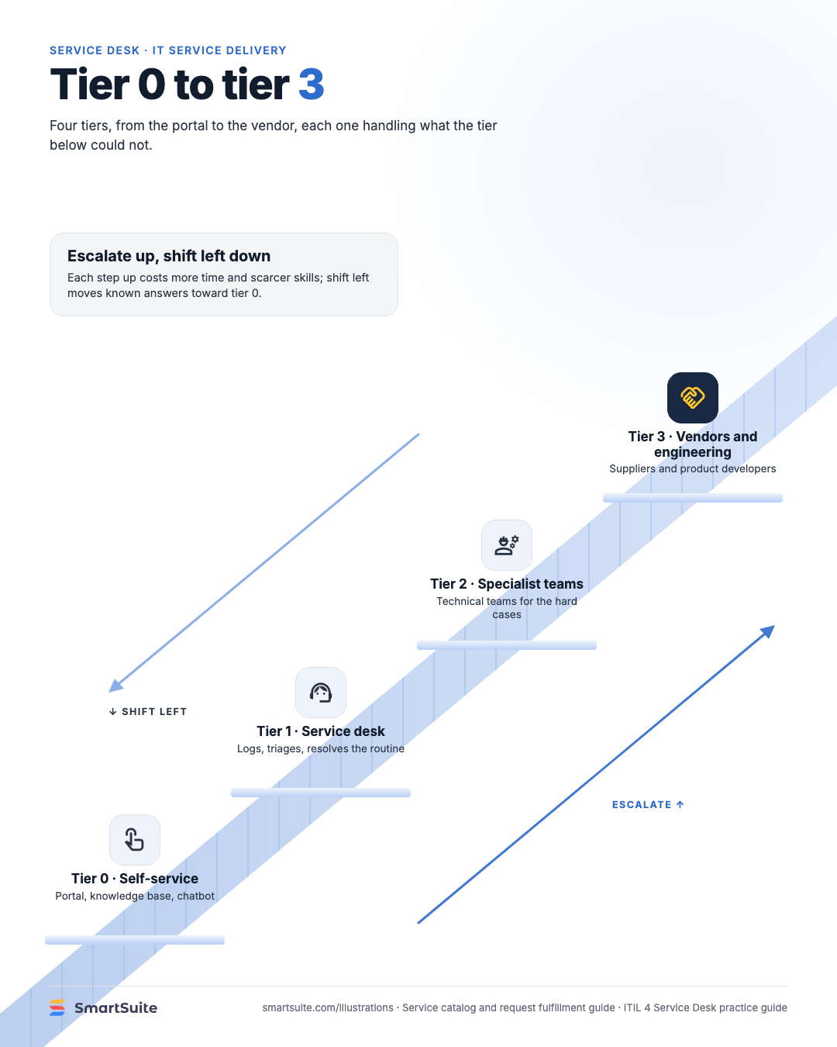
Tier 0 to tier 3
Self-service, service desk, specialist teams and vendors: who handles what, and the cost of each step up.
Source: ITIL 4 Service Desk practice guide
Notes:
Tier 0 to tier 3
Self-service, service desk, specialist teams and vendors: who handles what, and the cost of each step up.
Source: ITIL 4 Service Desk practice guide · From: Service catalog and request fulfillment
Credit: Source: SmartSuite, smartsuite.com/illustrations

