Slide 1
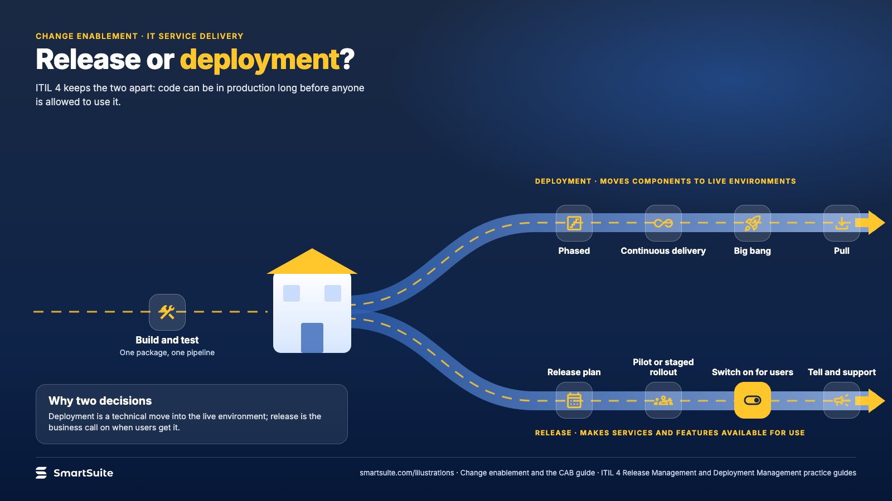
Notes:
Release or deployment?
Deployment moves the code; release makes the feature available. Why the two decisions are separated.
Source: ITIL 4 Release Management and Deployment Management practice guides · From: Change enablement and the CAB
Credit: Source: SmartSuite, smartsuite.com/illustrations

Slide 2
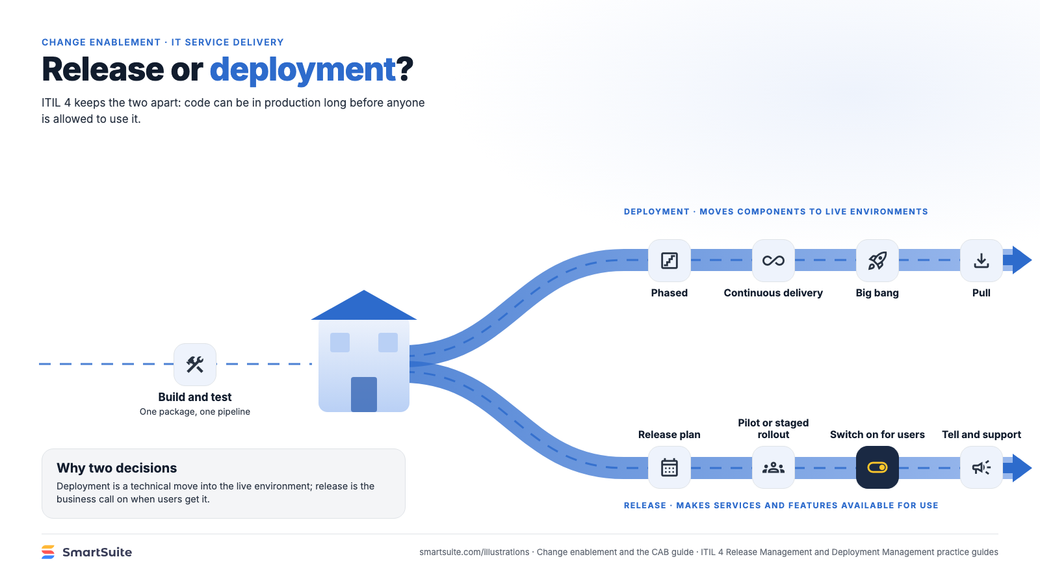
Notes:
Release or deployment?
Deployment moves the code; release makes the feature available. Why the two decisions are separated.
Source: ITIL 4 Release Management and Deployment Management practice guides · From: Change enablement and the CAB
Credit: Source: SmartSuite, smartsuite.com/illustrations

