Slide 1
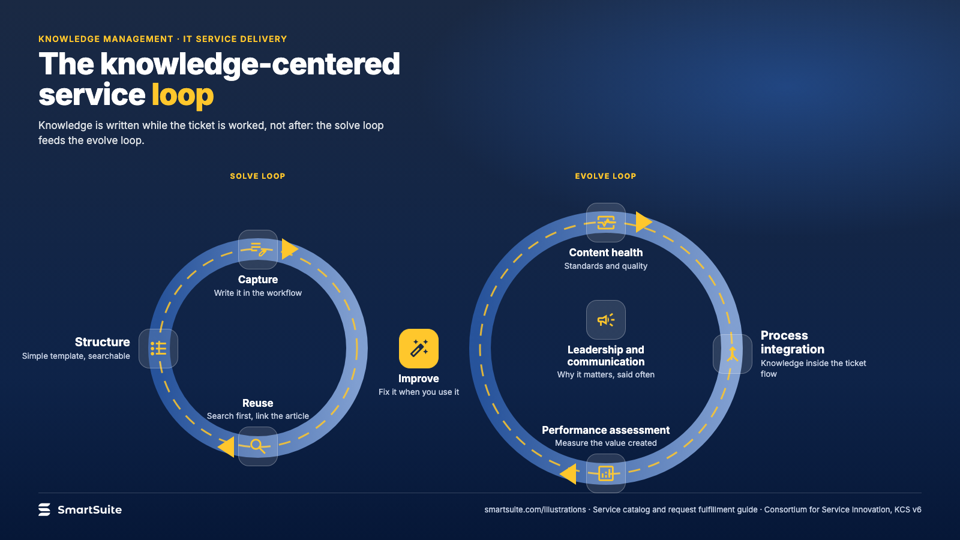
Notes:
The knowledge-centered service loop
Capture, structure, reuse, improve: how knowledge is written while the ticket is being worked, not after.
Source: Consortium for Service Innovation, KCS v6 · From: Service catalog and request fulfillment
Credit: Source: SmartSuite, smartsuite.com/illustrations

Slide 2
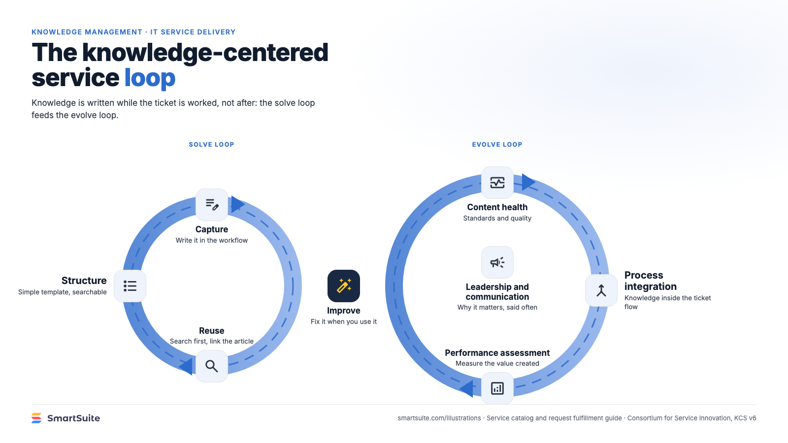
Notes:
The knowledge-centered service loop
Capture, structure, reuse, improve: how knowledge is written while the ticket is being worked, not after.
Source: Consortium for Service Innovation, KCS v6 · From: Service catalog and request fulfillment
Credit: Source: SmartSuite, smartsuite.com/illustrations

