Slide 1
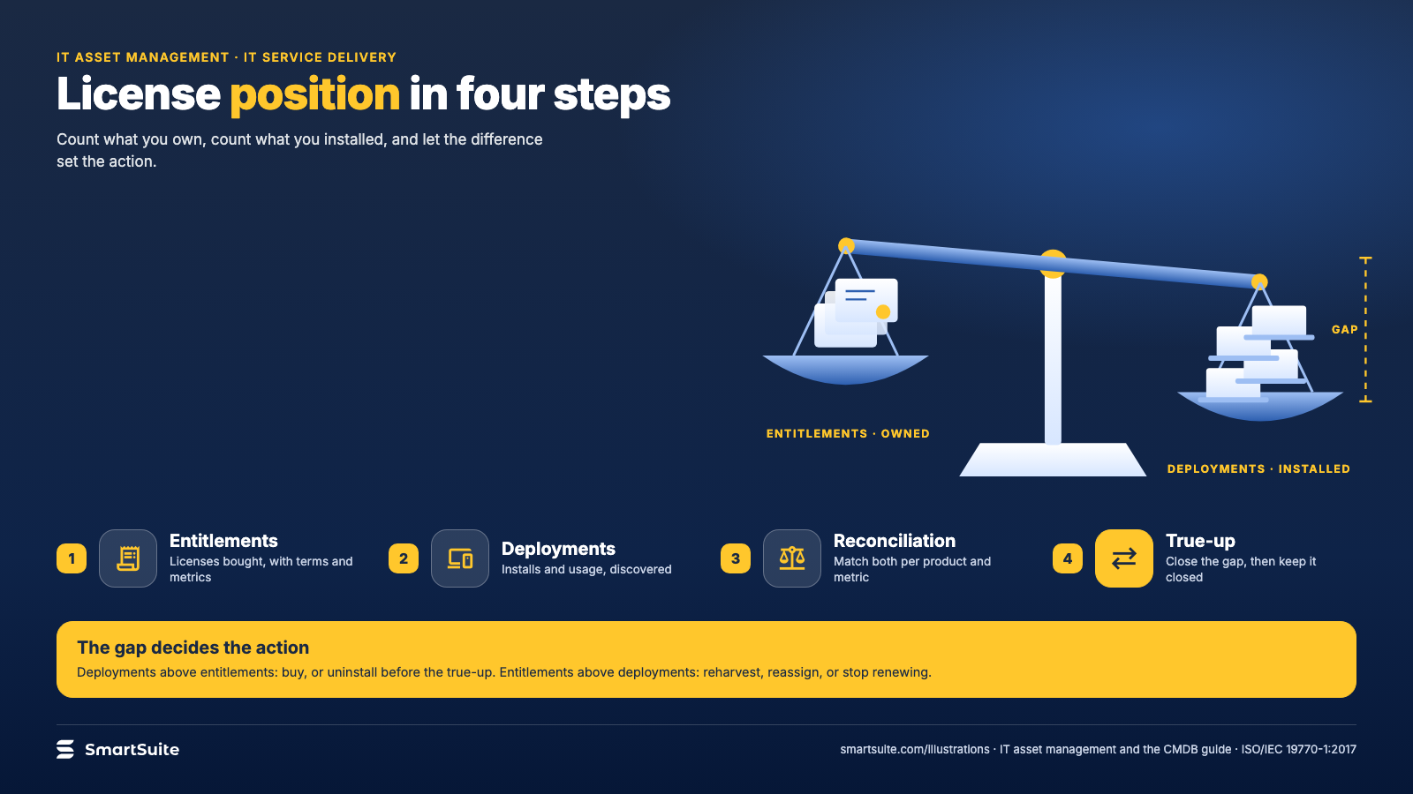
Notes:
License position in four steps
Entitlements, deployments, reconciliation, true-up: the effective license position and what to do with a gap.
Source: ISO/IEC 19770-1:2017 · From: IT asset management and the CMDB
Credit: Source: SmartSuite, smartsuite.com/illustrations

Slide 2
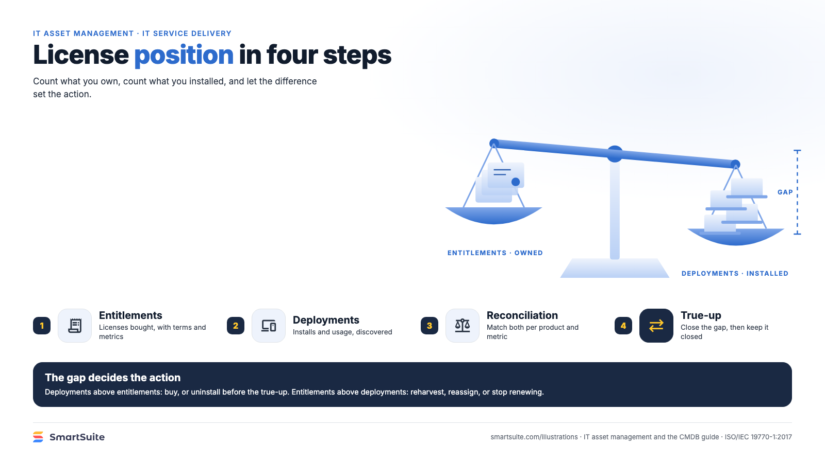
Notes:
License position in four steps
Entitlements, deployments, reconciliation, true-up: the effective license position and what to do with a gap.
Source: ISO/IEC 19770-1:2017 · From: IT asset management and the CMDB
Credit: Source: SmartSuite, smartsuite.com/illustrations

