Slide 1
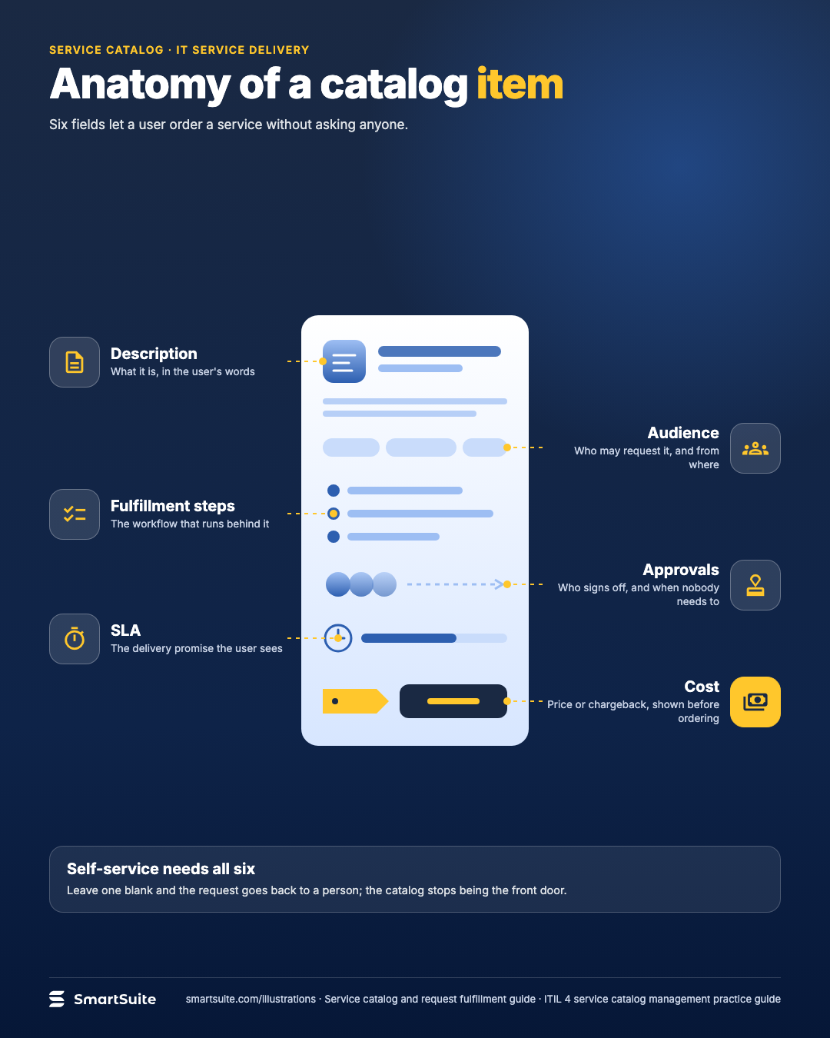
Anatomy of a catalog item
Description, audience, fulfillment steps, approvals, SLA and cost: the fields that make a request self-serviceable.
Source: ITIL 4 Service Catalogue Management practice guide
Notes:
Anatomy of a catalog item
Description, audience, fulfillment steps, approvals, SLA and cost: the fields that make a request self-serviceable.
Source: ITIL 4 Service Catalogue Management practice guide · From: Service catalog and request fulfillment
Credit: Source: SmartSuite, smartsuite.com/illustrations

Slide 2
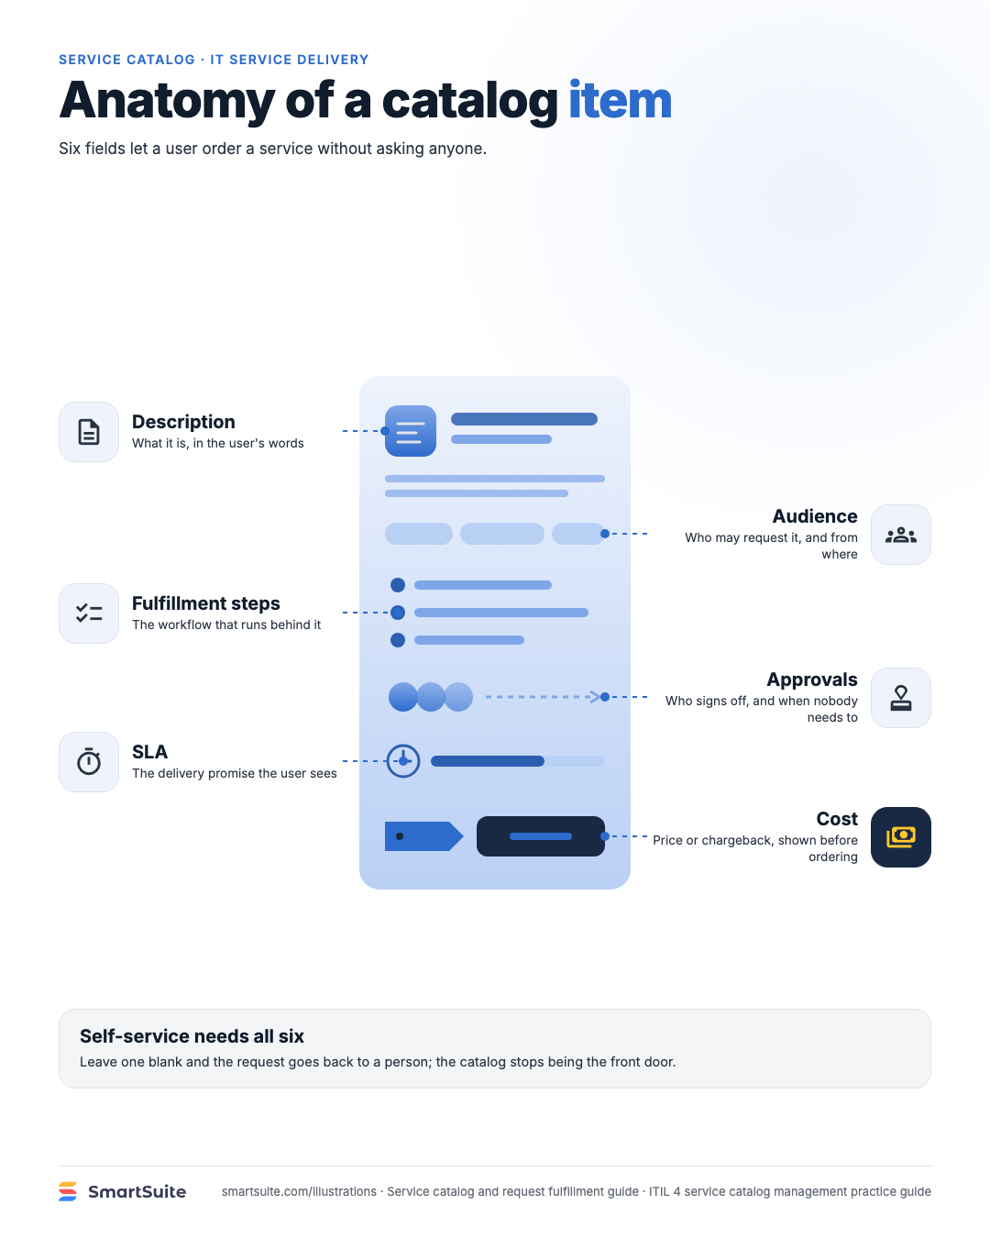
Anatomy of a catalog item
Description, audience, fulfillment steps, approvals, SLA and cost: the fields that make a request self-serviceable.
Source: ITIL 4 Service Catalogue Management practice guide
Notes:
Anatomy of a catalog item
Description, audience, fulfillment steps, approvals, SLA and cost: the fields that make a request self-serviceable.
Source: ITIL 4 Service Catalogue Management practice guide · From: Service catalog and request fulfillment
Credit: Source: SmartSuite, smartsuite.com/illustrations

