Slide 1
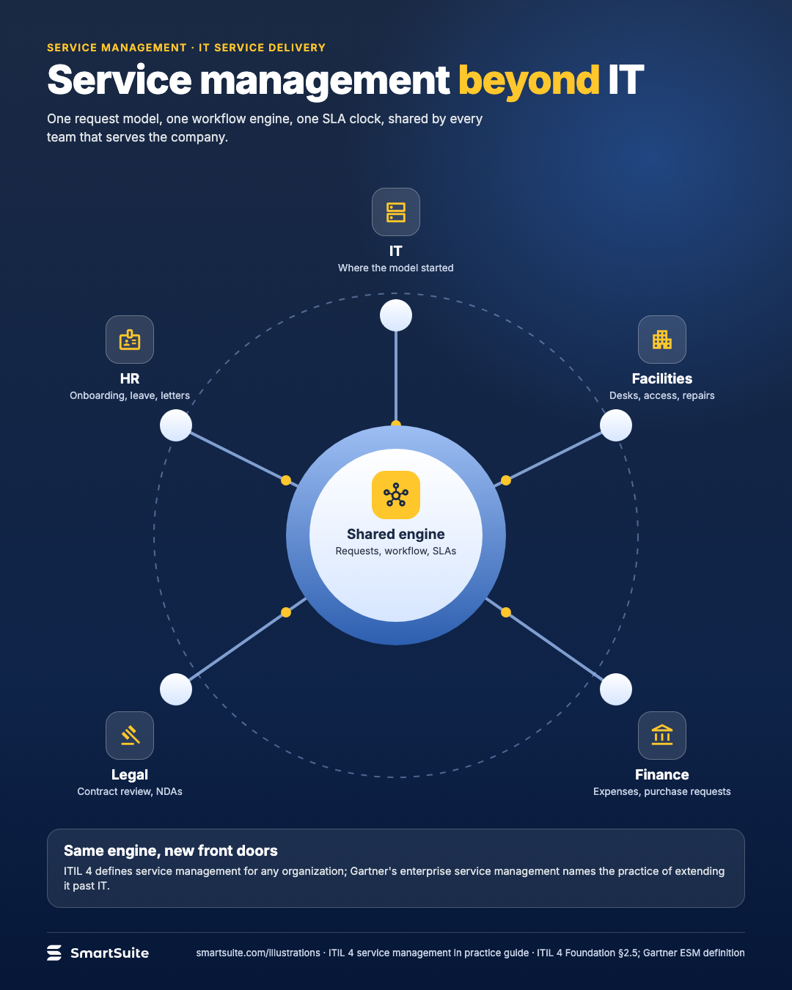
Service management beyond IT
The same request, workflow and SLA model applied to the teams that run the rest of the company.
Source: ITIL 4 Foundation §2.5; Gartner ESM definition
Notes:
Service management beyond IT
The same request, workflow and SLA model applied to the teams that run the rest of the company.
Source: ITIL 4 Foundation §2.5; Gartner ESM definition · From: ITIL 4 service management in practice
Credit: Source: SmartSuite, smartsuite.com/illustrations

Slide 2
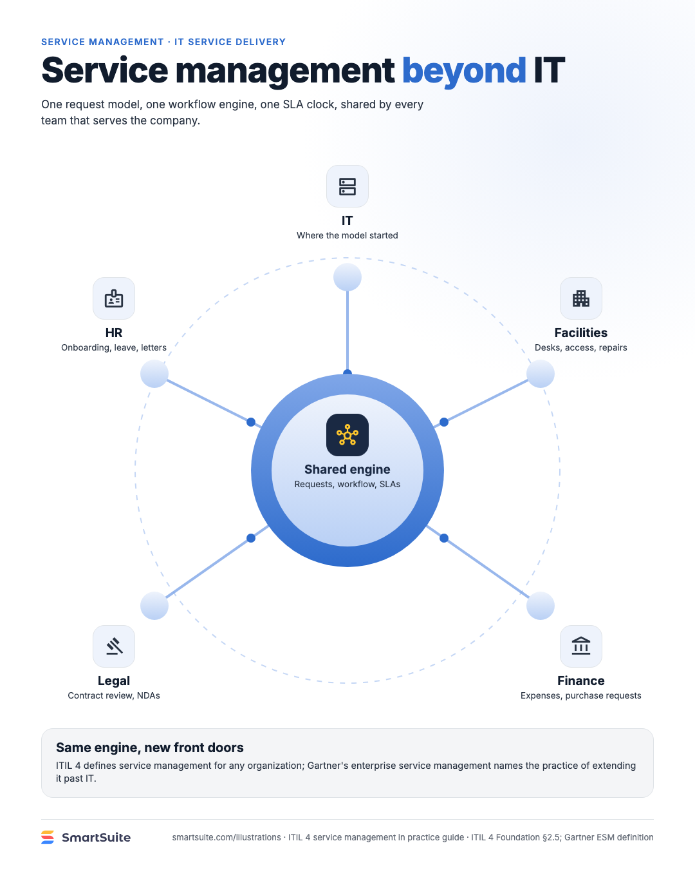
Service management beyond IT
The same request, workflow and SLA model applied to the teams that run the rest of the company.
Source: ITIL 4 Foundation §2.5; Gartner ESM definition
Notes:
Service management beyond IT
The same request, workflow and SLA model applied to the teams that run the rest of the company.
Source: ITIL 4 Foundation §2.5; Gartner ESM definition · From: ITIL 4 service management in practice
Credit: Source: SmartSuite, smartsuite.com/illustrations

